Slide 1
CLIMATE
AFFILIATES
HOPE
What’s Happening to the EPA and What YOU Can Do About It
Climate Hope Affiliates is a joint program of the United Church of Christ and Creation Justice Ministries, an organization with 39 cooperating national faith bodies.
UCC.org/ClimateHope
Notes:
Leave this slide up during any introductions, while people are getting their seats, etc

Slide 2
My Story
[Insert bullet points about your own story of confronting a challenge, making a choice, etc.]
Add a photo of yourself.
  Challenge
  Choice
  Outcome
  Link to now
CLIMATE
AFFILIATES
HOPE
UCC.org/ClimateHope
Notes:
Here is a worksheet to help you develop your own Story of Self:
www.bit.ly/TellYourStoryofSelf
It helps to write it out in bullet points then practice saying it aloud. Time yourself.

Slide 3
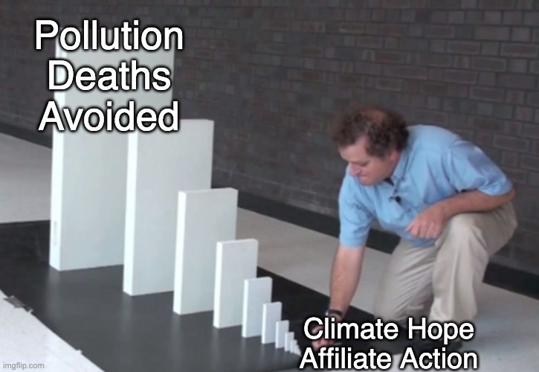
Climate Hope Affiliates
Local affiliates driving nation-wide change.
“Alone, we can do so little; together we can do so much.” –Helen Keller
CLIMATE
AFFILIATES
HOPE
UCC.org/ClimateHope
Notes:
Climate Hope Affiliates have a calling. Our calling is to address the interconnected crises of climate change and societal injustice. We do this by developing powerful relationships of influence with our members of Congress, local media, and the community at large. We have a distinct moral message, and it’s a message that needs to reach the halls of power. Our goals today are to share with you about our current issue, support you in taking action by writing your Congress member, and invite you to join us in making a difference.

Slide 4
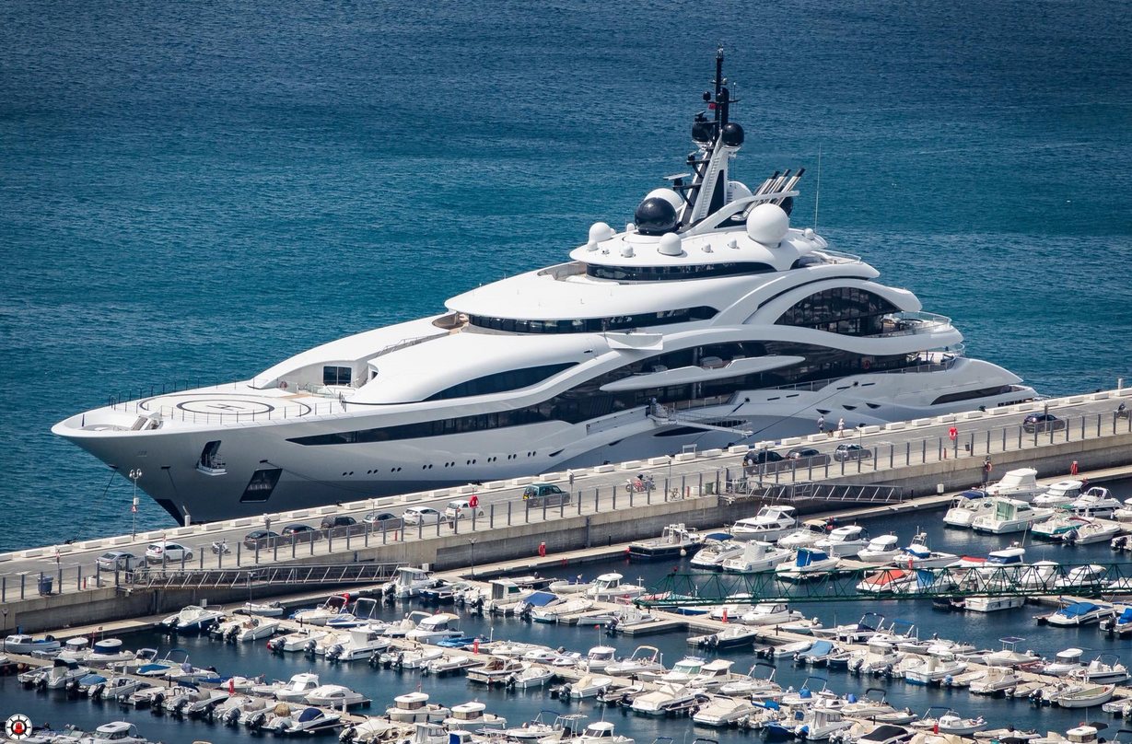
Are we all in the same boat?
Climate-related disasters and fossil fuel pollution do not affect everyone equally.
Race, poverty, and other societal inequities determine the size and condition of your “boat.”
CLIMATE
AFFILIATES
HOPE
UCC.org/ClimateHope
Notes:
As people of faith and conscience, for us climate is about more than numbers. It is a moral issue. When one thinks of the scale of the crisis, we can justifiably call it the moral crisis of our time. It is a moral crisis with real impacts affecting people now, and these impacts do not affect everyone equally. Think of Hurricane Katrina. Think of all the petro-chemical facilities in places like Houston and Louisiana’s cancer alley. Who suffers the most is an issue of racial and economic justice. Maybe we are all in the same boat in terms of climate change affecting all of us, but activist Asah Rehman stated it well in saying, “…we may all be on the Titanic, but it’s the rich, white industrialized countries who are on the top deck, sipping their cocktails, listening to the orchestra and waiting for some technological fix to save them, whilst in the hold of the Titanic are black, brown, indigenous people, poor brown and black people from the Global South, who are already drowning, and when they try and flee, they find that the escape hatch is bolted.”

Slide 5
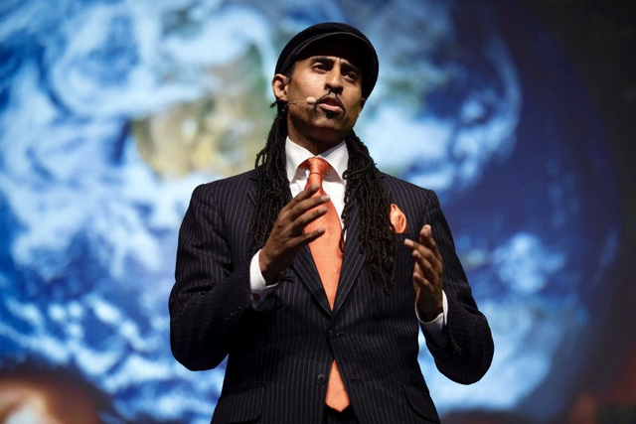
The Stakes
“We've got about 350,000 people who are dying prematurely from the burning of fossil fuels in our country…. That's more people who are dying from air pollution than are dying from gun violence. More people are dying from air pollution than are dying from car crashes. More people are dying from air pollution than are dying from overdoses of drugs.”
Dr. Mustafa Santiago Ali commenting on Harvard University research during a national UCC Climate Hope Affiliates monthly webinar
CLIMATE
AFFILIATES
HOPE
UCC.org/ClimateHope
Notes:
Ask an audience member to read the quote.

Slide 6
EPA Under Attack
1. We’re nearing critical climate deadlines
The next few years are decisive for meeting U.S. climate targets
EPA rules are the *most powerful tools* the government has to cut emissions quickly.
Without strong EPA action now, the country will miss those targets.
CLIMATE
AFFILIATES
HOPE
UCC.org/ClimateHope
Notes:
[Paraphrase and expand upon this slide with your own words as you highlight climate targets like 2030 emissions reductions and EPA rules on power plants, methane, vehicles, and toxic pollution.]

Slide 7
EPA Under Attack
2. Communities, especially communities of color, depend on EPA protections. EPA rules directly impact:
* air quality and asthma rates
* safe drinking water
* exposure to heavy industry and toxic pollution
Rolling back protections puts the highest-burden communities at greater risk.
CLIMATE
AFFILIATES
HOPE
UCC.org/ClimateHope
Notes:
[In your own words summarize this slide]

Slide 8
EPA Under Attack
3. EPA is under coordinated political and legal attack intended to
* weaken EPA rulemaking authority
* delay or overturn climate regulations
* cut EPA funding and staffing
CLIMATE
AFFILIATES
HOPE
UCC.org/ClimateHope
Notes:
The White House, Congress, some states, and industry groups are trying to dismantle the key institutional safeguards that protect us. Don’t get fooled by rhetoric that would have us believe that the EPA is about imposing bureaucratic “rules and regulations” that diminish our freedoms. What we are talking about our the protections that keep us and our environment safe and healthy.

Slide 9
Victories, Setbacks, and the Fight Ahead
Victory: Trump’s Budget Proposal Defeated
Setback: The Endangerment Finding Repealed
What’s Next?: That Depends in Part on You
CLIMATE
AFFILIATES
HOPE
UCC.org/ClimateHope
Notes:
You have probably heard it said that “Congress holds the power of the purse.” In the past year, many of the key battles over the environment have revolved around how federal tax dollars are allocated. Last year, the Trump administration proposed cutting the EPA’s budget by 55%, while the House proposed a 23% cut and the Senate proposed a 5% cut. In February of this year, Trump signed into law an Appropriations package passed by an overwhelming bipartisan majority in Congress. Can any of you guess by what percentage they cut the EPA budget by? In a victory for advocates, the appropriations package cut EPA funding by 3.5% with one analyst stating that it might be even less in practice. One reporter described the bill as “a congressional rebuke” of Trump. With the EPA’s recent repeal of the endangerment finding that previously had established the agency’s mandate to reduce greenhouse gas emissions, the battle over the future of the EPA continues. At the end of my presentation, we are going to do an action, so that you can be an active participant in determining what is going to happen to the EPA.

Slide 10
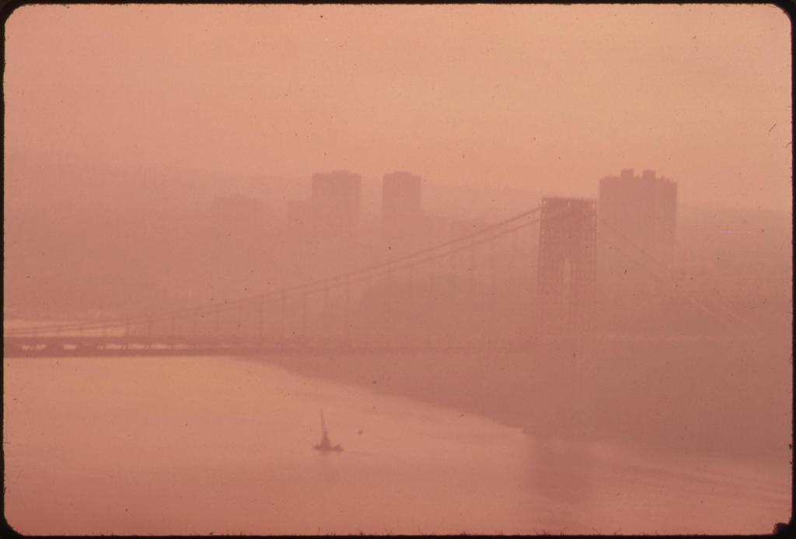
Before the EPA
The George Washington Bridge in Heavy Smog
Notes:
Do we really want to go back to the way things were before the EPA?
Before the EPA started enforcing the clean air act, major cities were regularly blanketed in choking smog.
Here's New York City as seen from NJ.

Slide 11
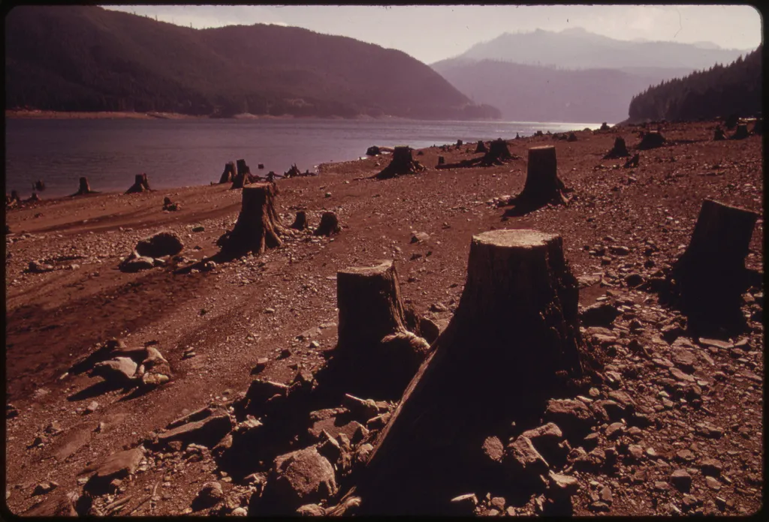
Before the EPA
A clearcut forest beside Detroit Lake in Oregon
Notes:
Do we really want to go back to the way things were before the EPA?
Before the EPA, clearcutting forests was regular practice, even in scenic areas vulnerable to erosion.
09/1973 David Falconer / EPA

Slide 12
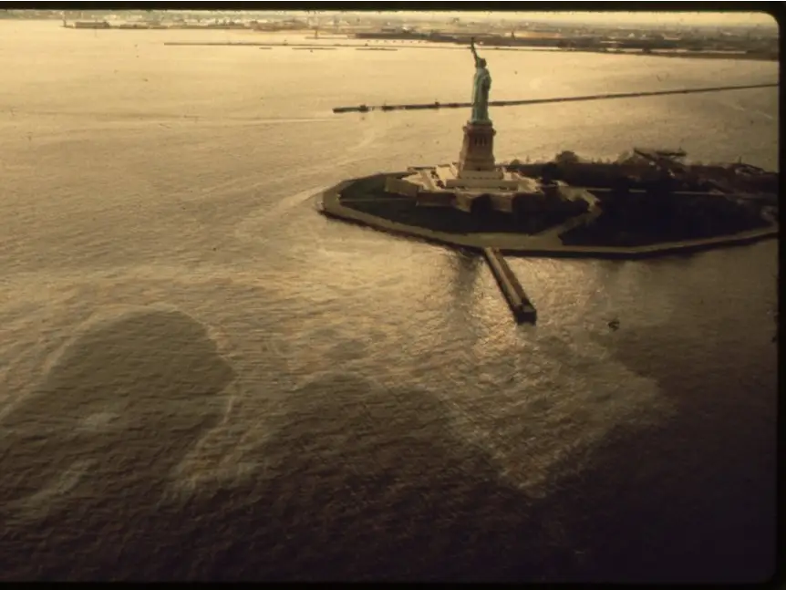
Before the EPA
Statue of Liberty surrounded by oil slick.
Notes:
Before the EPA, oil drilling, use and transport was effectively unregulated.
In just the first six months of 1973, there were over 300 documented oil spills in New York Harbor.

Slide 13
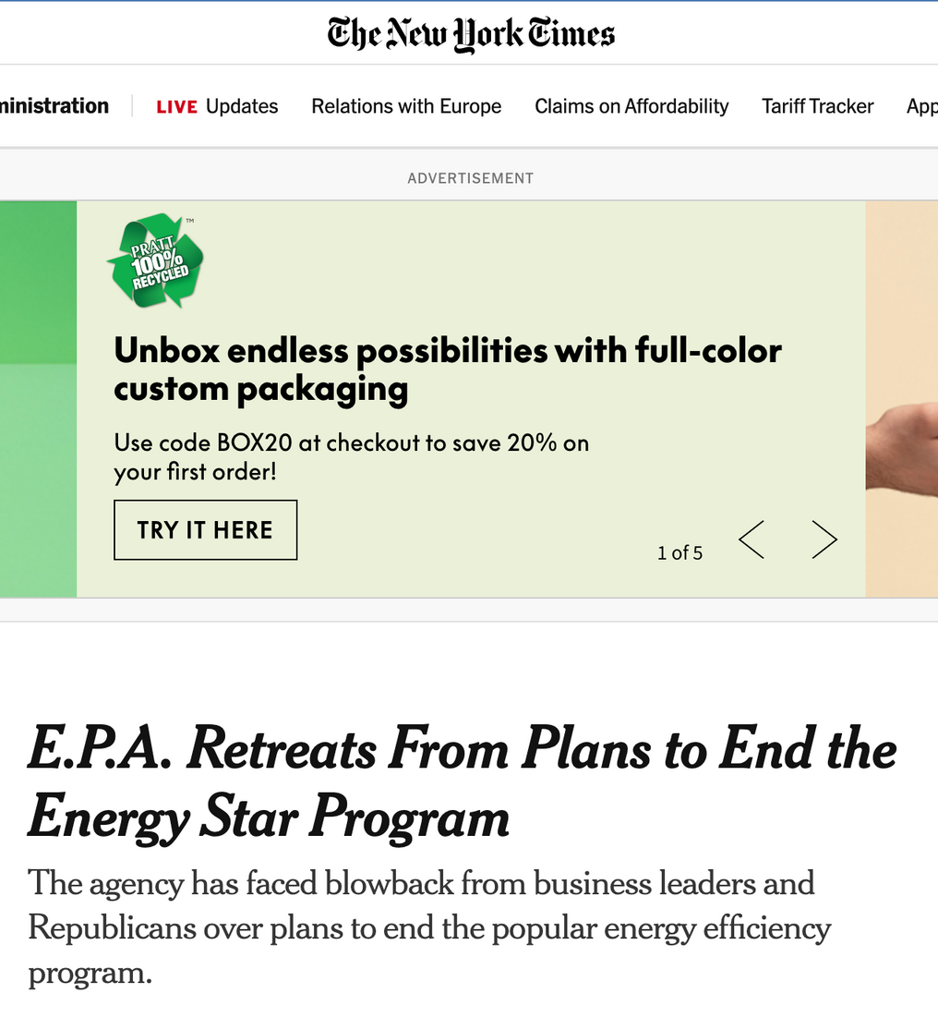
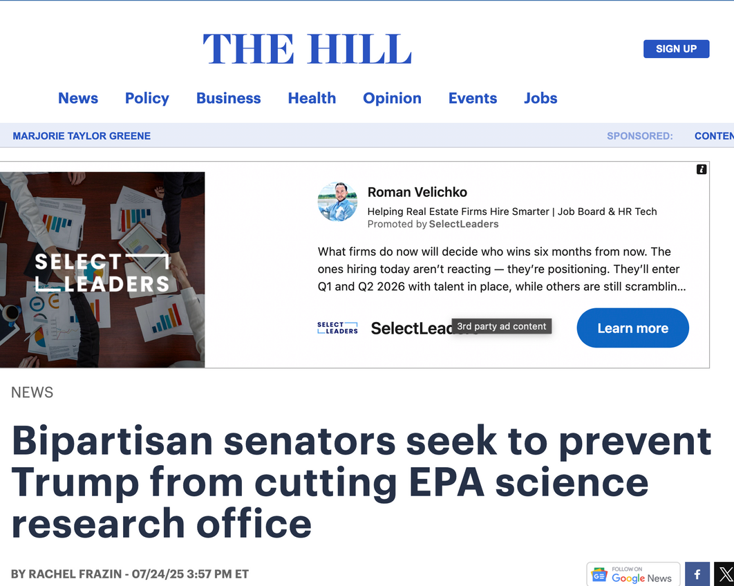
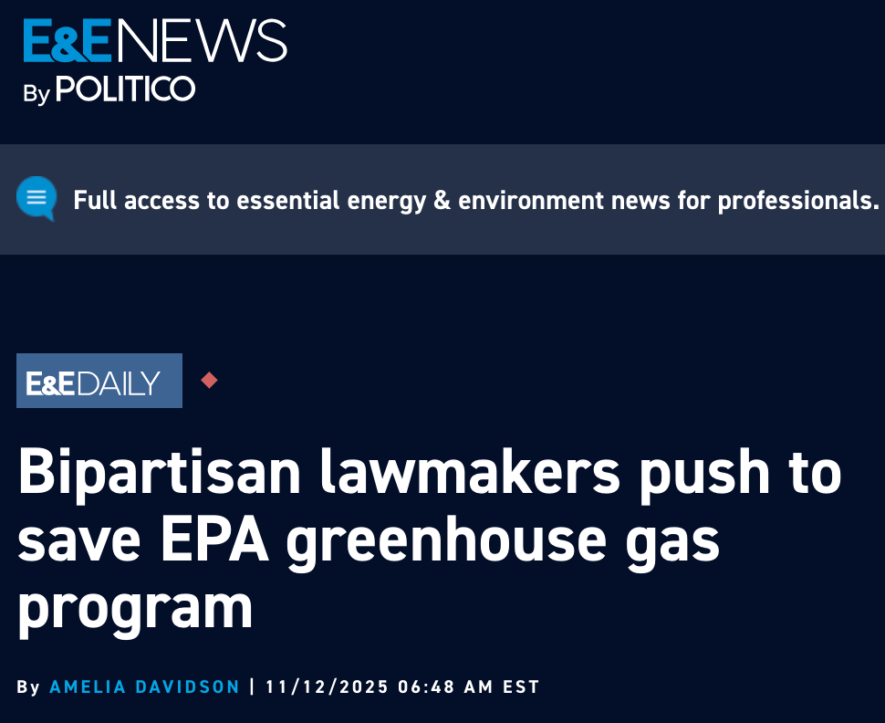
(Some) Bipartisan Resistance
CLIMATE
AFFILIATES
HOPE
UCC.org/ClimateHope
Notes:
Even in our polarized climate, there are glimmers of unity. Some members from both sides of the aisle are taking stands for the environment. This is a crucial, hopeful step.
These efforts might not grab the headlines as often as more divisive issues, but they’re happening. And they’re important.

Slide 14
Our Goals
  Peel off Republican support for Trump’s fossil fuel agenda.
  Encourage both Republicans and Democrats to be active champions for EPA funding and for an EPA fulfills its mission.
CLIMATE
AFFILIATES
HOPE
UCC.org/ClimateHope
Notes:
We have to be strategic in our efforts to support the EPA.
We need to peel off wavering R's and encourage all members of Congress to actively champion EPA funding and to make sure the EPA does what it is supposed to do. The stated mission of the EPA is to protect the environment and public health. The EPA simply cannot fulfill its mission without addressing current and future climate dangers.
Remember things like clean air and clean water are not fully partisan issues. Members of both parties will support it *if they are pushed*

Slide 15
What You Can Do!
(1) Write a postcard or send an email to your Representative.
(2) Join our email list.
(3) Become a chapter member!
CLIMATE
AFFILIATES
HOPE
UCC.org/ClimateHope
Notes:
What can we do, starting right here today?
(You will be asked how many postcards and emails you collect 😊)

Slide 16
Help Us Build and Strengthen Support for the EPA!
Write to ask your Congress members to speak from the floor to lift up how constituents of faith are calling for strong and robust EPA funding to protect public health and all of God’s creation. We need an EPA that is true to its mission and addresses the climate crisis.
CLIMATE
AFFILIATES
HOPE
UCC.org/ClimateHope
Notes:
Every from-the-heart email or letter that your member of Congress is powerful! These messages are even more powerful when they are part of a collective, ongoing effort. For Climate Hope Affiliates, these messages are part of our developing and strengthening ongoing relationships with our members of Congress. We are demonstrating that people in our community care about these issues and will continue to care about these issues. As people of faith and conscience, we care about these issues when we vote, and we care about these issues between elections. Our moral commitments are an occasional or passing gesture. Our convictions run deep, and we are passionate about caring about our “common home” as Pope Francis called it.

