Slide 3
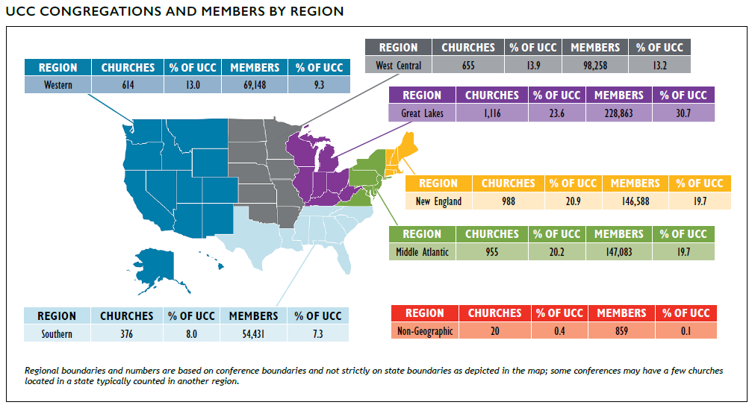
Congregations and Members
Notes:
At the end of 2021, there were 4,724 congregations in the United Church of Christ with a total of 745,230 members. The UCC’s congregations represent about 1.4% of total U.S. congregations* while the membership of the UCC represents about half of one percent (0.49%) of total U.S. religious adherents* and about 0.22% of the U.S. population.** UCC membership is concentrated in the Great Lakes, Middle Atlantic, and New England regions of the country.
*2010 U.S. Religion Census http://www.usreligioncensus.org/
**U.S. Census https://www.census.gov

Slide 4
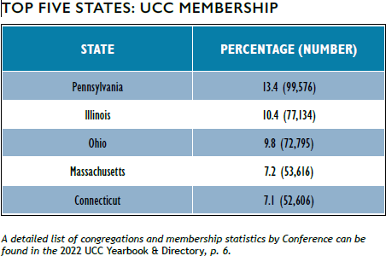
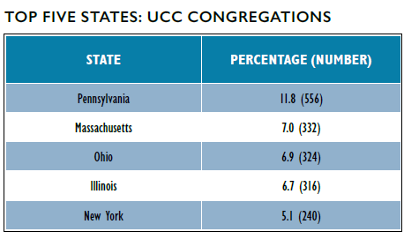
Congregations and Members
Notes:
In examining the distribution of congregations by state, 11.8% of all UCC congregations were located in Pennsylvania, which reported the greatest number of congregations. In total, the top five states with the most congregations contained over one-third (37.5%) of all UCC congregations.
Membership, as with congregations, was concentrated largely in the Middle Atlantic, Great Lakes, and New England states. Nearly half of UCC members (47.9%) reside in the top five states by membership. Membership has become slightly more concentrated in these top five states over the past two years, with 47.1% of membership residing in these states in 2019. Notably, the churches in the states with the highest number of churches do not necessarily have the highest number of members. For example, Connecticut only has 4.8% of UCC churches, but has 7.1% of UCC members, while New York has 5.1% of UCC churches but only 3.8% of UCC members. This indicates that churches in Connecticut, on average, have a larger membership than churches in New York.

Slide 5
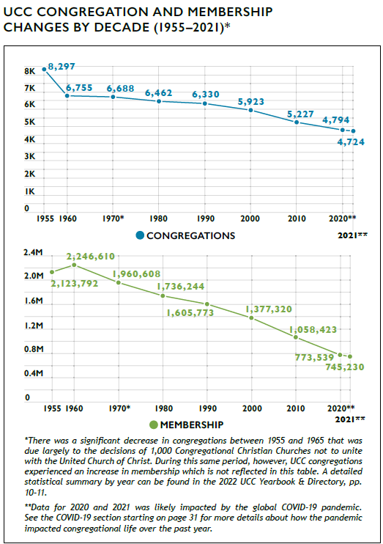
Growth and Decline
Notes:
Similar to other Protestant denominations, the UCC has experienced a decline in the numbers of congregations and members in recent decades. From 2011 to 2021 alone, the UCC encountered a net loss of 470 congregations and 254,785 members. Some of this decline, however, began prior to the formation of the denomination in 1957 as the number of congregations steadily decreased despite membership increases in the UCC’s early years.
In 2021, 85 congregations were removed from denominational records. This was an 18.1% increase from 2020, when 72 churches were removed from denominational records. These numbers are similar to the number of removals in previous years; while 2019 had an unusually low number of churches removed (43), 85 churches were removed in 2018 and 74 in 2017. From 2005 through 2007, the UCC experienced a loss of nearly three congregations per week on average (mostly as a result of General Synod’s resolution regarding same-sex marriage). In the past year, however, the loss rate has been about one and two thirds (1.63) congregations removed from denominational records per week on average; this is slightly higher than the rate for 2020 (1.38 congregations per week).
Over the past year, 15 congregations have been added to denominational records (this includes churches that received
standing, affiliated, or merged with another congregation), which is an increase over the prior year (12 congregations added). In total, 77 congregations received standing and were added to the UCC over the last five years, which is equivalent to a new congregation being added about every three weeks or slightly more than one and a quarter congregations being
added every month.

Slide 6
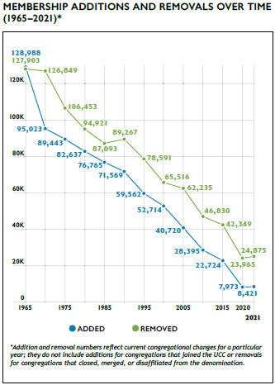
Membership Growth and Decline
Notes:
In general, the number of members removed each year exceeds the number of members added for that same time period. Members are removed from congregational records for several reasons including death, transfer of membership to another denomination, or updating of local church membership records.
The net difference between UCC members added and removed from congregational membership rolls has continued to decline as total membership has decreased. In 2021, there was a net removal of 16,454 members, which was somewhat higher than the past two years (15,992 in 2020 and 12,341 in 2019) but consistent with other recent previous years (16,302 in 2018 and 16,600 in 2017) and less than earlier points in the 2010s (19,625 in 2015 and 18,435 in 2010). (Note that net loss figures represented here are different than the net change figure represented in the UCC Yearbook & Directory, which is based on total membership.) Over time, the number of members added and removed have both declined although the net loss contributing to this decline has generally become smaller. The particularly small number of members added in 2020 compared to other years is likely an effect of COVID-19; this number rose slightly in 2021 and future years of data will demonstrate whether this is part of a long-term trend.

Slide 7
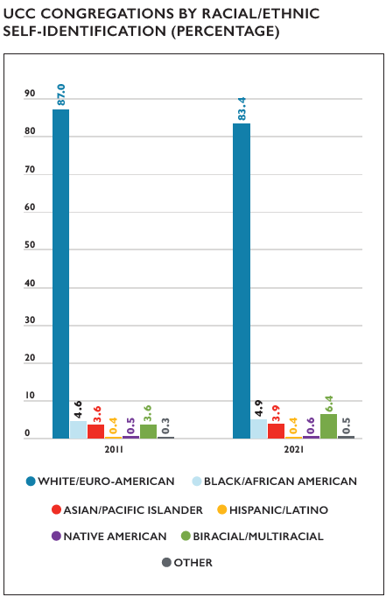
Congregations by Race/Ethnicity
Notes:
A substantial majority of congregations in the UCC self-identify as White/Euro-American (meaning that most members of a congregation belong to that particular racial/ethnic group). Over time,
however, the UCC as a whole is becoming more racially/ethnically diverse. Over the last decade, the percentage of self-reported primarily White/Euro-American congregations decreased from
87.0% in 2011 to 83.4% in 2021. During this same time frame, the percentage of Biracial/Multiracial congregations increased from 3.6% in 2011 to 6.4% in 2021 and Other congregations increased
from 0.3% to 0.5%. In addition, the percentage of Black/ African American and Asian/Pacific Islander congregations each increased by 0.3% during this time period, from 4.6 to 4.9% and
3.6 to 3.9% respectively. The proportion of Native American congregations also increased slightly, from 0.5% to 0.6%. One cause of these shifts over time may be due to the fact that the majority
of congregations that close, merge, or disaffiliate with the denomination are primarily White/Euro-American congregations, thus decreasing the overall proportion of these congregations,
while newer UCC congregations tend to be more racially/ethnically diverse.

Slide 8
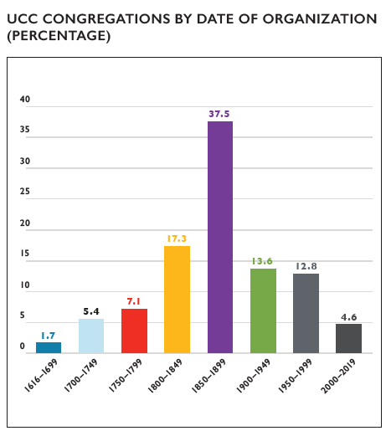
Congregations by Date of Organization
Notes:
While the UCC has only been in existence since 1957, many of its congregations were founded by predecessor denominations. The vast majority of churches (84.9%) were organized before the UCC’s founding year. The latter nineteenth century (1850-1899) was the most common founding era for UCC churches while just under 1 in 20 UCC churches (4.6%) has been founded in 2000 or later, a percentage that has been increasing steadily. The average founding date of congregations is 1873 while the median founding date is 1875.

Slide 9
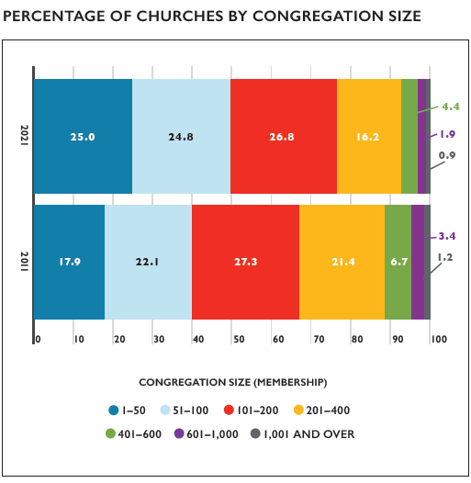
Congregation Size by Membership
Notes:
The vast majority (92.8%) of UCC members belong to congregations with 400 or fewer members with half (49.8%) attending congregations with 100 or fewer members. This reflects an overall trend within the UCC of membership being increasingly concentrated in smaller churches; in 2011, 88.7% of UCC members belonged to churches with 400 members or fewer and 40.0% belonged to churches with 100 members or fewer. The biggest changes in the past 10 years have been in churches with less than 50 members, which have increased from 17.9% to 25.0% of members since
2011, and churches with 201–400 members, which have decreased from 21.4% to 16.2% of members since 2011.

Slide 10
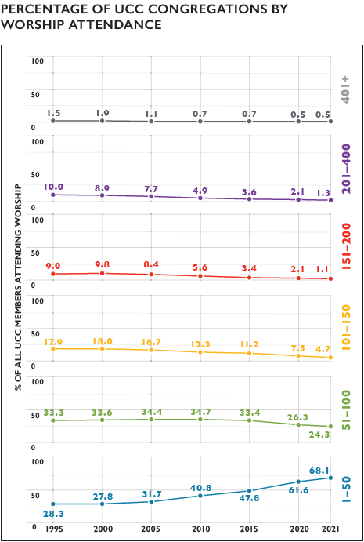
In-Person Worship Attendance
Notes:
When considering worship attendance figures rather than membership size, even more congregations are categorized as smaller churches. In 2021, over 90% of churches in the UCC (92.4%) had a
weekly worship attendance of 100 or fewer, which is 16.9% higher than in 2010 and 31.0% higher than in 2000. Over time, the percentage of congregations in the highest worship attendance categories has decreased steadily, with the most dramatic decreases occurring in the three categories spanning congregations from 101 to 400 worship attenders since 1995—from 36.9% of congregations with worship attendance in this range in 1995 to 7.1% of congregations in 2021. As a result, over two thirds (68.1%) of all UCC congregations now have a weekly worship attendance of 1-50 individuals.
While these shifts toward smaller worship attendance have been present for decades in the UCC, the restrictions on gathering size many churches faced for in-person worship during the COVID-19
pandemic may be partly responsible for the increases in the 1-50 category in 2020 and 2021. Also, the widespread practice of virtual worship during the pandemic may have also impacted in-person worship attendance patterns. For information on virtual worship attendance in 2021, please see page 31.

Slide 11
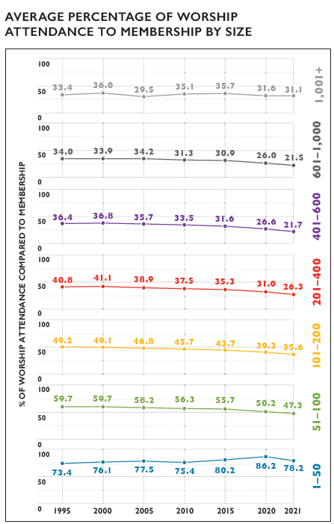
In-Person Worship Attendance and Membership
Notes:
The relationship between in-person worship attendance and membership continues to shift incrementally over time. From 1995 to 2021, the proportion of people attending in-person worship services compared to membership declined, with two exceptions—the largest churches, which have effectively remained stable, and the smallest churches, which have overall seen an increase. In 1995, churches with 1,001+ members reported on average that 33.4% of the number of people attended in-person worship compared to the total membership; while this figure has risen and fallen in the subsequent decades, the current figure is 31.1%. On average, in 1995 there were 73.4% of people attending in-person worship compared to the overall membership of a 1–50 member congregation; this percentage has also vacillated over time but had currently risen to 78.2% in 2021. The overall patterns suggest that a greater share of members may attend in-person worship in smaller congregations than larger congregations, though this cannot be known for certain, as those who attend in-person worship may not all be members. In addition, given the restrictions many churches faced for in-person worship during the COVID-19 pandemic, the attendance for in-person worship in 2020 and 2021 may have been limited for health and safety reasons.

Slide 12
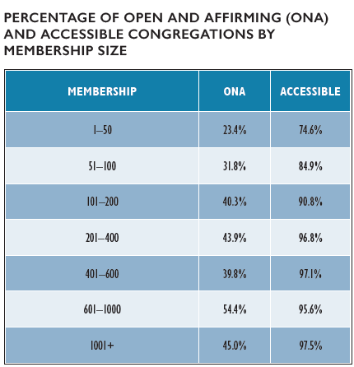
Congregational Designations
Notes:
Since 2005, there has been an 171.0% increase in the number of Open and Affirming (ONA) congregations in the United Church of Christ, from 600 churches in 2005 (10.9% of all UCC churches at
that time) to 1,626 churches (34.6% of all UCC congregations in 2021) being ONA. The proportion of ONA churches with 100 or fewer members, however, continues to grow each year.
Self-reported accessibility also tended to increase with church size. While the specific types and degrees of accessibility among these congregations are unknown, it is possible that these figures
partly reflect the resources churches have available to address the accessibility of their space.

Slide 13
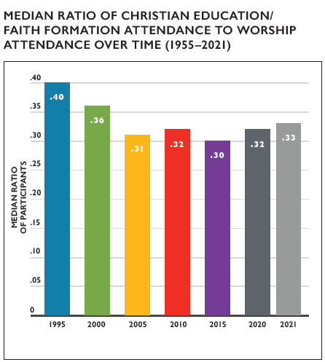
Christian Education/Faith Formation
Notes:
Since the 1950s, enrollment and attendance numbers for Christian Education/Faith Formation programming (also known as Church School or Sunday School enrollment in previous years) has been declining along with membership numbers. When thinking about Christian Education/Faith Formation attendance in terms of all the people who may be present on a Sunday morning (i.e. in comparison to worship attendance), the median percentage of Christian Education/Faith Formation attendance compared to worship attendance has been quite stable since 2005, hovering between 30–32% when comparing 5-year increments (2021 actually shows a slight increase in the ratio to 0.33). This suggests that just under one third of people who attend worship services also
attend Christian Education/Faith Formation programming, though these categories may not perfectly overlap in practice. While there have been unusually large decreases in Christian Education/ Faith Formation enrollment in 2020 and 2021 (a net change of 19,903 in 2020 and 15,668 in 2021 people compared to 7,164 in 2019)—most likely a result of the pandemic—the median percentage of attendance remained similar to previous years.
In comparing Christian Education/Faith Formation attendance to worship attendance by church size, the smallest and the largest churches tend to have the highest ratios of Christian Education/ Faith Formation attendance to worship attendance. This may be due to different factors: smaller churches might have higher ratios due to the close connections among congregations that are common in these congregations, while larger churches may have higher ratios due to capacity for organized programming.

Slide 14
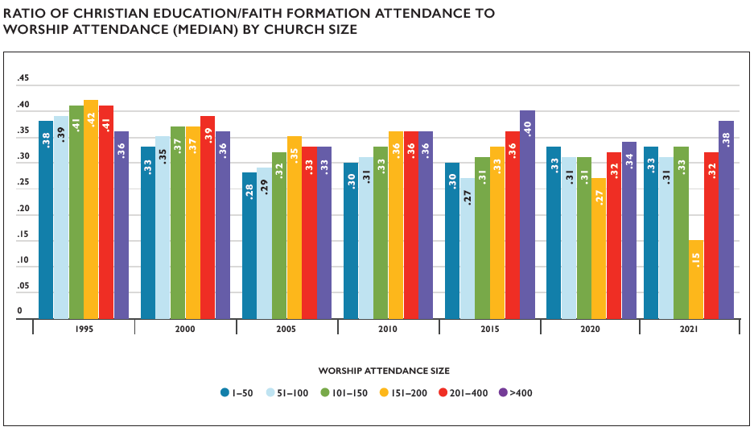
Christian Education/Faith Formation

Slide 15
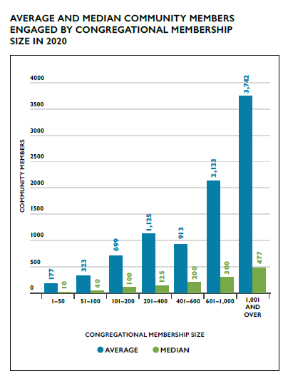
Congregational Outreach
Notes:
Congregational reports indicated that an average of 671 community members and a median of 70 community members were impacted by each local church’s outreach activities and initiatives in 2021. The total number of community members engaged in 2021 was 1,221,322 with 38.5% of congregations reporting. This continues to be lower than the 47.2% of congregations who reported engaging 2,055,868 in 2019 (38.8% of congregations reported engaging 1,211,038 in 2020), which likely reflects the continued impact of the COVID-19 pandemic on congregations’ opportunities to engage with their communities. The average number of community members is notably much higher than the median, which suggests that some churches may have a particular focus on community outreach or may engage in types of outreach that tend to engage more people than other types of outreach.

Slide 16
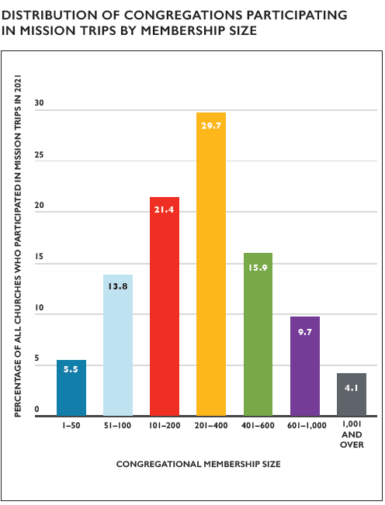
Mission/ Immersion/ Service Trips
Notes:
Since 2014, congregations have been asked to report whether members participated in a U.S. or international mission/immersion/service trip. In 2021, 145 (3.1%) congregations reported that members had participated in these types of trips. Given the widespread travel restrictions due to COVID-19 in 2021 and limited opportunities for virtual mission/immersion/service trips, this low rate compared to 2019, when 574 congregations participated in mission/immersion/service trips, is not unexpected. While still much lower than the 2019 figures, the 2021 figures are slightly higher than those for 2020, when 116 congregations (2.4%) reported participating in these trips. Among churches that did report participating in mission/immersion/service trips in 2021, midsized churches most frequently engaged in this type of activity, with churches of 101–400 members conducting half of all these trips.

Slide 17
Local Church Financial Trends
Notes:
Average operating expenses for local UCC congregations in 2021 was $176,720, a $3,786 (2.2%) average increase from 2020. Average total income for a local church in 2021 was $236,700—a $16,195 (-7.3%) average decrease from 2020. Both the average operating expenses and income for local congregations increased from average amounts reported over the past decade—from $161,943 in expenses (a 9.1% increase) and $212,399 in income (a 11.4% increase) in 2011.
In 2011, Our Church’s Wider Mission (OCWM) giving represented 4.3% of total local church expenditures. This percentage decreased to 3.2% of total local church expenditures in 2021.

Slide 18
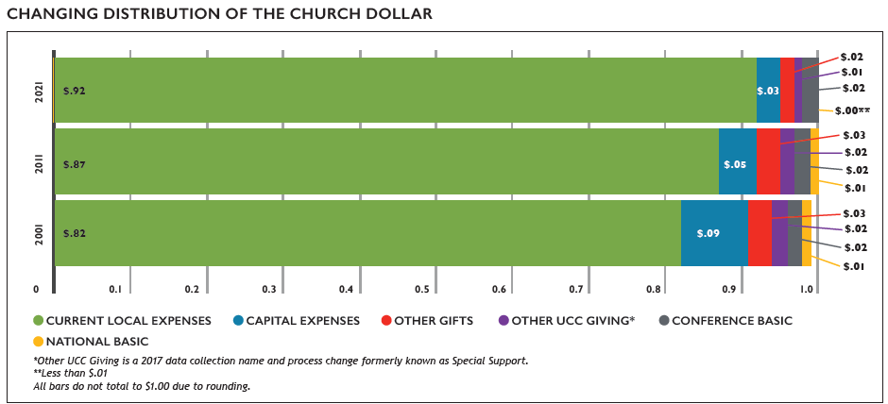
The Church Dollar
Notes:
In the last two decades, the distribution of the church dollar has experienced some noticeable shifts. Current local expenses have increased by $.10 while all others have decreased or remained steady. All types of UCC Giving (Conference Basic, National Basic and Other UCC Giving) have decreased or remain unchanged in the past 20 years.

Slide 19
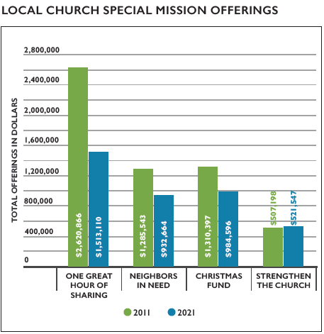
Stewardship and Mission Support
Notes:
Totals for mission support and giving by local congregations of the United Church of Christ decreased over the past several years. Over the past decade, the number of churches that have not given to any Special Mission Offering has increased. In terms of dollars given, all the Special Mission Offerings have seen a decrease this year compared to 2011, except Strengthen the Church which has seen an increase of 2.8%. The total giving to all Special Mission Offerings in 2021 decreased by 31.0% when compared to 2011. While this is not as large of a 10-year decrease as seen from 2010-2020 (48.4%), it is still quite larger than seen from 2009-2019 (11.7%). The ongoing COVID-19 pandemic may be continuing to contribute to this decline.
Total mission support for 2020 decreased from the previous year by $1,463,977 (-3.2%) and has decreased 23.3% since 2017. The data reported in the 2021 edition of the Statistical Profile indicated larger than usual changes in giving over the previous year. For example, there was a 10.6% decrease in Total Mission Support from 2019 to 2020 while the yearly changes observed in 2018 and 2019 were 5.6% and 6.1%, respectively. This year the giving changes appear to be returning to levels seen prior to 2020. Other UCC Giving increased 1.7% in 2021 compared to 2020.

Slide 20
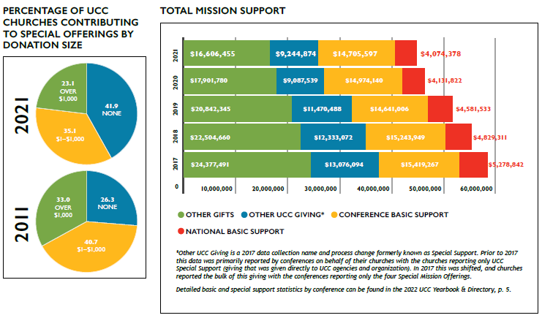
Stewardship and Mission Support

Slide 21
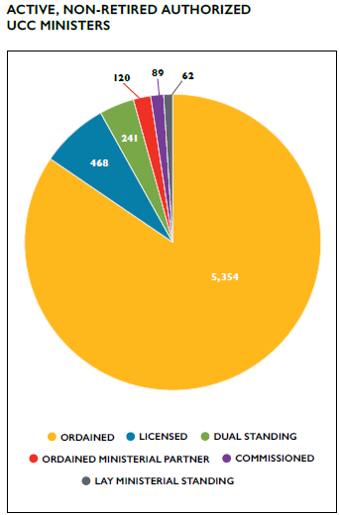
Summary of UCC Ordained Ministers
Notes:
As reported for 2021, there were a total of 6,334 active (non-retired) Authorized Ministers in the United Church of Christ (Ordained, Licensed, Lay Ministerial Standing, Dual Standing, and Ordained Ministerial Partner). Ordained Ministers were the largest percentage of active ministers reported (84.5%); and Licensed Ministers comprised the second largest group of Authorized Ministers (7.4%). In addition, one active (non-retired) minister holds standing in the Congregational Christian Church.

Slide 22
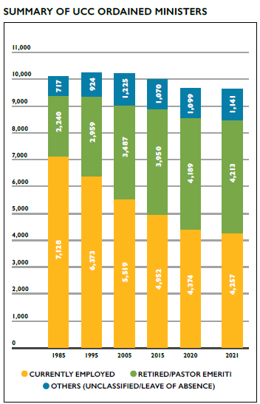
Summary of UCC Ordained Ministers
Notes:
At the end of 2021, there were 9,611 reported Ordained Ministers in Full Standing, including Retired Ministers and Pastor Emeriti. Of those 9,611 Ordained Ministers, nearly one-half (44.3% or 4,257) were employed, with 69.0% (2,939) of those employed actively serving in a local church (either a UCC church or non-UCC church). Four out of ten (43.8% or 4,213) were Retired Ministers or Pastor Emeriti, and 11.9% (1,141) were unclassified (ministers without a reported specialty at the time of Yearbook production) or were on a leave of absence.
Over the last 36 years (1985 to 2021), Ordained Ministers only had a numerical net decrease of 474 (4.7%). However, the number of employed Ordained Ministers decreased by over one third (-40.3%), while Retired Ministers and Pastor Emeriti saw an increase of 88.1% over this same 36-year period.

Slide 23
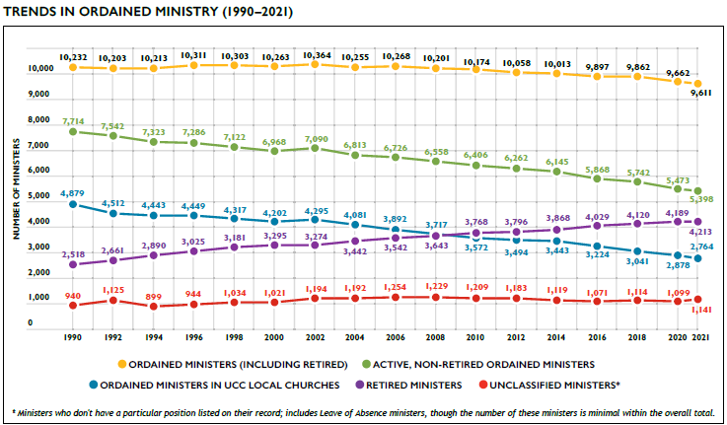
Trends in Ordained Ministry
Notes:
Since 1990, the number of Ordained Ministers has remained relatively stable, though there are slight incremental decreases in more recent years. At the same time, the number of Retired Ministers and Pastor Emeriti has increased steadily. Notably, since 1990 the decline in ordained ministers (-6.1%) has been much smaller than the declines in congregations (-25.4%) or membership (-53.6%) during the same time frame.

Slide 24
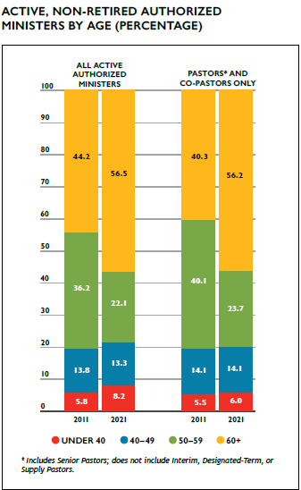
Authorized Ministers by Age
Notes:
Data regarding Authorized Ministers in the denomination reflects a population of predominantly older clergy. Over one half of all active (non-retired) Authorized Ministers were age 60 and above (56.5%) and over three-quarters (78.6%) were 50 and older. Local church pastors and co-pastors are increasingly comprised of the oldest clergy in the UCC, with over half (56.2%) of all congregations in 2021 being served by authorized ministers aged 60 and above while only 40.3% were served by this group in 2011. The number of congregations being served by clergy under 50 has remained relatively stable, although notably the proportion of congregations served by clergy under 40 has actually increased in the past 10 years, from 5.8 to 8.2% of congregations.

Slide 25
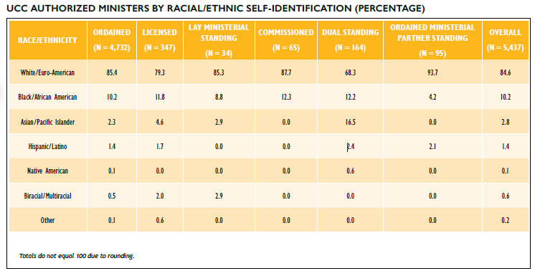
Authorized Ministers by Race/Ethnicity
Notes:
The majority (84.6%) of all active, non-retired UCC Authorized Ministers identified as White/Euro-American, with 15.4% identifying as nonwhite. Among the various types of authorization, Ministers with Dual Standing continue to be the most racially/ethnically diverse group with three in ten (31.7%) ministers identifying as non-white. Commissioned Ministers and ministers with Ordained Ministerial Partner Standing were the least racially/ethnically diverse authorization groups, both in terms of having the highest rates of clergy identifying as White/Euro-American and reflecting the fewest racial/ethnic categories.

Slide 26
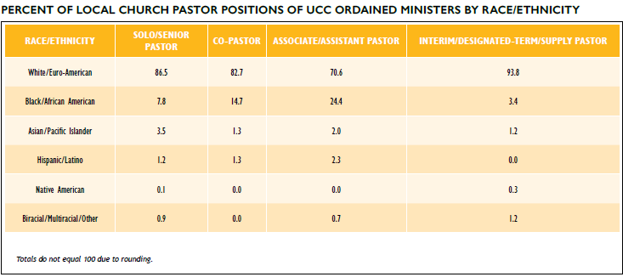
Ordained Ministers in Local Churches by Race/Ethnicity
Notes:
Regarding racial/ethnic representation in local church pastor positions, different patterns emerge based on position. Among senior/solo pastors, clergy who identify as Black/African American were proportionally under-represented (7.8% compared to 10.2% of all clergy) while clergy who identify as White/Euro-American were represented at a slightly higher rate among senior/solo clergy (86.5%) compared to clergy overall (84.6%). Associate/Assistant Pastors were notably more racially/ethnically diverse compared to clergy overall, with 29.4% of clergy self-identifying as non-white compared to 15.4% of all active, non-retired Authorized Ministers.

Slide 27
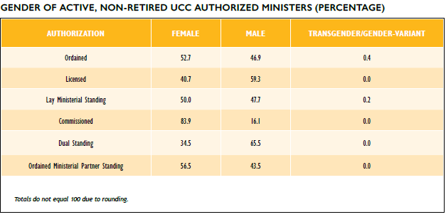
Authorized Ministers by Gender
Notes:
In total, 52.7% of active, non-retired ordained ministers in the United Church of Christ identified as female, 46.9% identified as male, and 0.4% identified as transgender/gender-variant. This is a notable shift from the early 2000s, when according to the 2003 UCC Statistical Handbook only 27% of all Ordained Ministers identified as female. Among other categories of Authorized Ministers, Licensed, and Dual Standing ministers proportionately identified more often as male, while more than 4 out of every 5 Commissioned Ministers identified as
female.

Slide 28
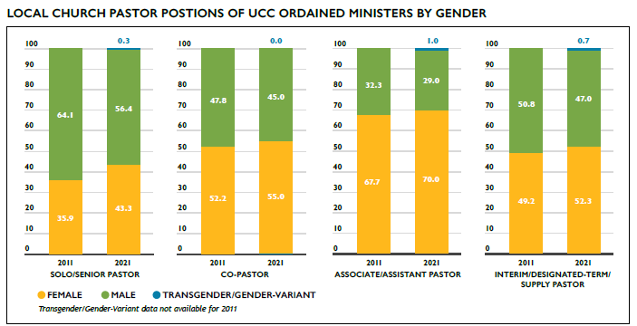
Ordained Ministers in Local Churches by Gender
Notes:
The percentage of active, non-retired female Ordained Ministers serving in local UCC church pastoral positions has continued to increase, from 28.7% in 2004 to 47.6% in 2021. Slightly more than four in ten (43.3%) senior/solo pastors identified as female in 2021, compared with 28.7% in 2004 and 35.9% in 2011. Over half (55.0%) of co-pastors and interim/designated-term/supply pastors (52.3%) and over two-thirds (70.0%) of associate/assistant pastors identified as female.

Slide 29
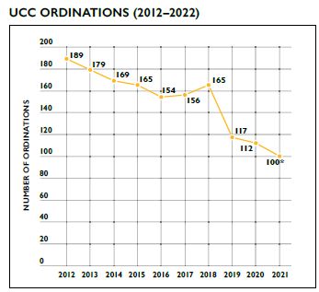
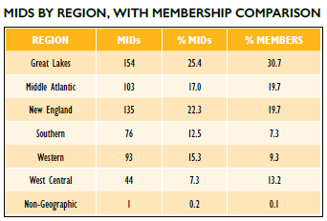
Ordinations and Members in Discernment
Notes:
The number of ordinations per year decreased over the past decade from 189 in 2012 to 100 in 2021.* Overall, the number of ordinations has been in decline except for 2018 when there was a notable increase in ordinations over the previous year. When reviewing trends over the past several decades, however, ordination numbers fluctuated in similar ways; there is a distinctive downward trend; however, there are years when numbers increased more than 5% and began the downward trend again.
As of May 2022, there were 606 active Members in Discernment (MIDS) on record within the denominational database. Some regions— New England, Southern, and Western—had proportionally more MIDs compared to their overall membership proportion in the UCC.
Among MIDs who report their gender identity, females comprised 60.6% of all MIDs, a greater percentage than that of current female Authorized Ministers, which currently comprise 52.7% of all Authorized, non-retired clergy. It is important to note that nearly one-third (31.4%) of all MIDs do not have a gender recorded. Members in Discernment were also more racially/ethnically diverse than current Authorized Ministers with 27.2% identifying as non-white (compared with 15.4% of all Authorized Ministers identifying as non-white).
*Number of ordinations for 2021 and recent previous years is expected to increase in 2022 as additional records are updated by Conferences.

Slide 30
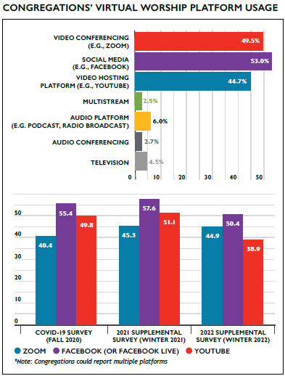
The COVID-19 Pandemic and the Church
Notes:
VIRTUAL WORSHIP PREVALENCE
The COVID-19 pandemic has continued to disrupt and reshape congregational life in the UCC. One of the most notable changes to congregational life was the expansion and ongoing offering of virtual worship at a level never before seen. In the UCC’s first COVID-19 survey, conducted in the fall of 2020, 9% of congregations reported offering virtual worship prior to the pandemic; by the winter of 2021, 91.3% of congregations reported offering virtual worship at some point during the pandemic. Recognizing that virtual worship has quickly become a regular feature of church life, this question was rephrased in the 2022 supplemental survey to ask congregations if they held virtual worship at any time in 2021, to which 88.7% of congregations responded “yes.” Among congregations who reported holding virtual worship opportunities, nearly 9 out of 10 (89.1%) reported offering these opportunities every week, with an additional 5.8% reporting such opportunities were offered more than once per week.
These virtual worship opportunities may be live (76.4% of congregations), pre-recorded (26.5%), or recorded at a live worship event (in-person or virtual and available later for replay) (52.8%) (note: congregations could report all options that applied). 69.1% of congregations holding virtual worship reported streaming their in-person worship service. Note that the reporting of platforms was updated for 2022 to capture platform by broad category (such as video conference or social media), given that attendance tends to be counted similarly within categories but not necessarily between categories and also so that the data will continue to be meaningful in the future even if and when individual platforms change. Zoom, Facebook/Facebook Live, and YouTube were the most

Slide 31
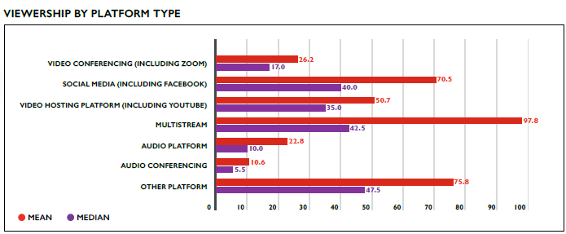
The COVID-19 Pandemic and the Church
Notes:
commonly used individual platforms reported in 2021, though small numbers of churches used a wide variety of platforms to share their worship services.
Congregations most commonly used Zoom, Facebook/Facebook Live, and YouTube as platforms for sharing their virtual worship services, with congregations increasingly using multiple platforms for their services over time. Even as some congregations have been able to resume in-person worship, virtual worship is likely to remain a common offering alongside in-person worship, as over 8 in 10 (83.6%) of congregations that held virtual worship in 2021 reported that they are planning to continue to offer virtual worship beyond the pandemic.
VIRTUAL WORSHIP ATTENDANCE
Virtual worship attendance is measured separately from in-person worship attendance because these numbers essentially measure different things. While in-person worship attendance figures represent the number of people present, online worship attendance generally represents the number of devices that have connected, as multiple people may be viewing worship on a single device, or a single device may connect multiple times. In addition, different platforms have different ways of measuring viewership, which is why attendance is measured separately for different platforms.
Given that virtual worship will continue to be a part of church life for the majority of UCC congregations, CARDD will continue to collect this data going forward. While currently the Data Hub is not equipped to collect this data, once CARDD has determined the most reliable

Slide 32
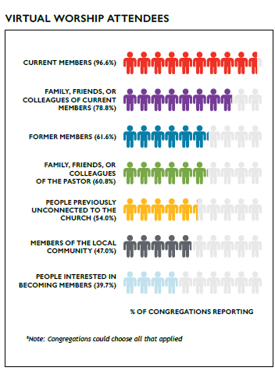
The COVID-19 Pandemic and the Church
Notes:
way to capture virtual worship attendance for the future, this data will be directly reportable into the Data Hub along with the rest of a church’s annual data. In the meantime, this data is being recorded in the annual Supplemental Survey, where it is attached to church ID so it can be part of a church’s long-term records.
VIRTUAL WORSHIP PARTICIPANTS
Virtual worship has enabled congregations to welcome new people to their church as well as reconnect with people whom they haven’t seen in a while. Among churches holding virtual worship, nearly all congregations (96.6%) reported that current members attended their services. In addition, family, friends, and colleagues of current members (78.8%) as well as family, friends, and colleagues of the pastor (60.8%) also commonly attended congregations’ online worship services. Over half of congregations (54.0%) reported that people previously unconnected to their church were attending their online worship services and 39.7% of congregations reported that people interested in becoming members were attending online worship services, suggesting that virtual worship may be a way many congregations can and are engaging in outreach.

Slide 33
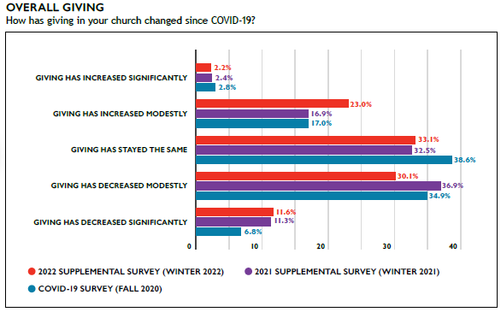
The COVID-19 Pandemic and the Church
Notes:
THE PANDEMIC IMPACT ON CONGREGATIONAL FINANCES
The pandemic has had a variety of financial implications for congregations and these implications have continued to shift over time. Relative to the 2021 supplemental survey, the proportion of congregations that have reported their giving has decreased significantly was slightly higher (increasing from 11.3% to 11.6%); however, the proportion of congregations reporting their giving decreased modestly was lower (decreasing from 36.9% to 30.1%). As a result, the proportion of congregations reporting that their giving has decreased since the pandemic began is now closer to 4 in 10 (41.7%) rather than nearly half (48.2%) that reported this in 2021. The proportion of congregations reporting that giving has stayed the same increased very slightly (33.1% in 2022 from 32.5%), while nearly a quarter (25.2%) of congregations reported in 2022 that their giving has actually increased modestly or significantly during the pandemic (up from 19.3% in 2021). These trends have changed directions between the first COVID-19 survey in 2020 and the 2021 supplemental survey, suggesting the impact of the pandemic on congregations’ finances is dynamic and experiences have varied widely between churches.

Slide 34
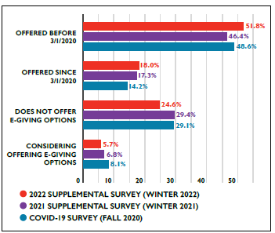
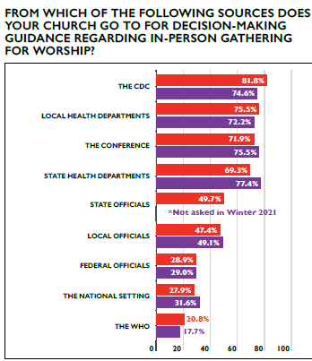
The COVID-19 Pandemic and the Church
Electronic Giving
In-Person Worship Practices
Notes:
ELECTRONIC GIVING
Electronic giving has been a way for people to contribute financially to congregations without being physically present and amidst health and safety concerns. Over half of congregations (51.8%) reported offering electronic giving options before the pandemic, and now about seven out of ten congregations (69.8%) offer electronic giving. This proportion has not changed much since the initial COVID-19 survey but has slightly increased over time, suggesting that churches that adopted online giving as a result of the pandemic did so early on. Churches most frequently reported using Vanco/Realm, PayPal, and the church website for electronic giving; other options reported being used include Tithe.ly, Venmo, Breeze, or payments directed by givers from individual banks.
IN-PERSON WORSHIP PRACTICES
For the 97.7% of UCC churches that reported holding in-person worship services during 2021, a wide variety of decisions had to be made about practices amid an ongoing pandemic. Congregations most frequently sought guidance from the CDC, local health departments, their conference, and state health departments. Notably, over seven in 10 (71.9%) congregations mentioned seeking guidance from their conference offices, underscoring the particularly important role Conference offices have served for congre-

Slide 35
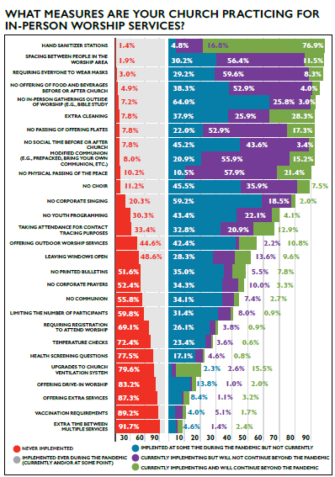
The COVID-19 Pandemic and the Church
Notes:
gations during the pandemic. Congregations also reported seeking information from a state level council of churches, congregants/friends/etc. who have training in public health, experts in academic settings outside the congregation, a non-expert congregational team or leader(s), other state level officials, and other experts and institutions.
Throughout the pandemic, congregations have not only faced decisions about whether and when to hold in-person worship, but also under what conditions. Congregations have reported implementing a variety of practices to curb the spread of COVID-19 during the pandemic, most frequently reporting having hand sanitizer stations, spacing people in the worship area, requiring everyone to wear masks, and not offering food or beverages before or after church. Given the ongoing complexity of pandemic decision-making, this year congregations were asked whether a particular practice was never implemented, implemented at some time during the pandemic but not currently, is currently implementing but will not continue beyond the pandemic, or is currently
implementing and will continue beyond the pandemic.

Slide 36
Special Reports Section: Pandemic Reflections

Slide 38
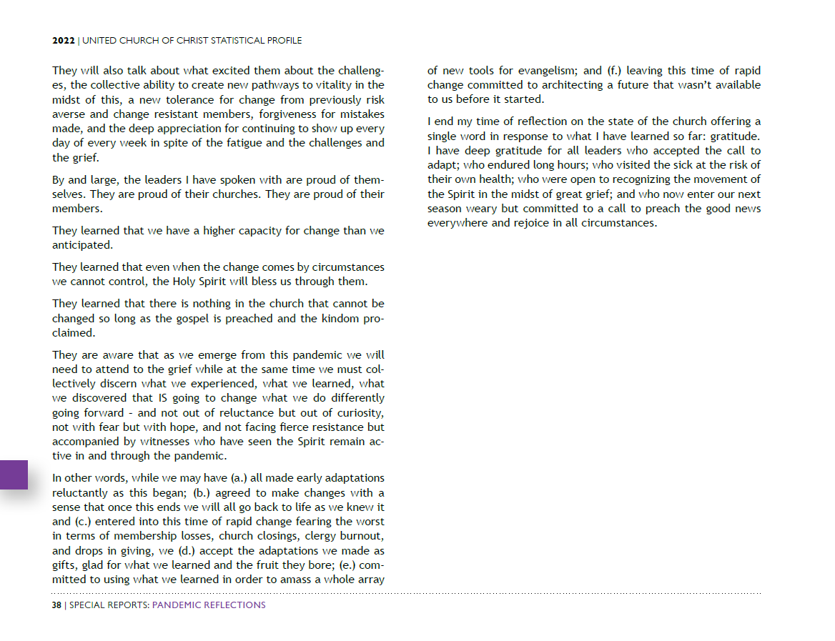

Slide 39
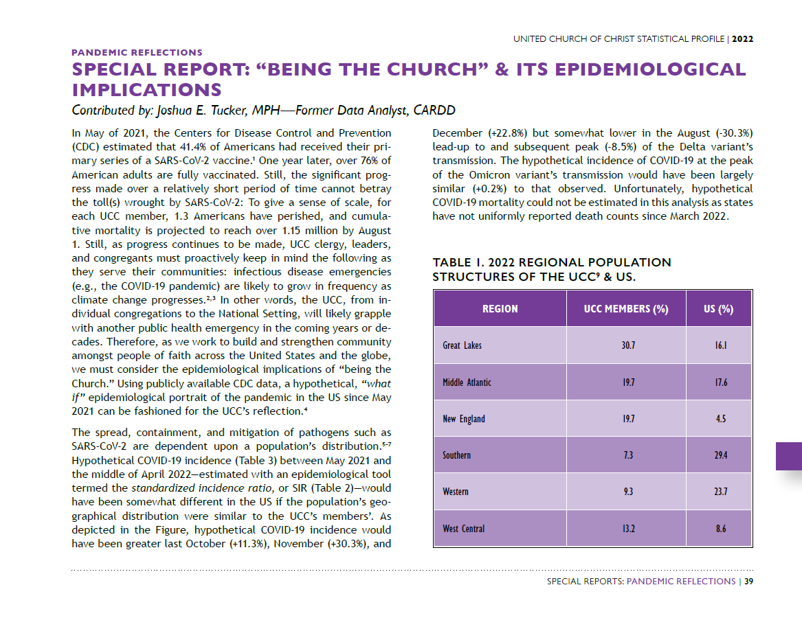

Slide 40
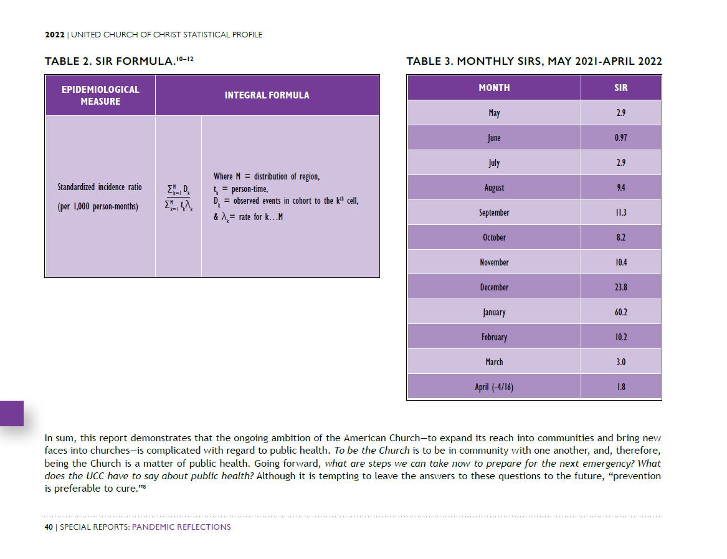

Slide 42
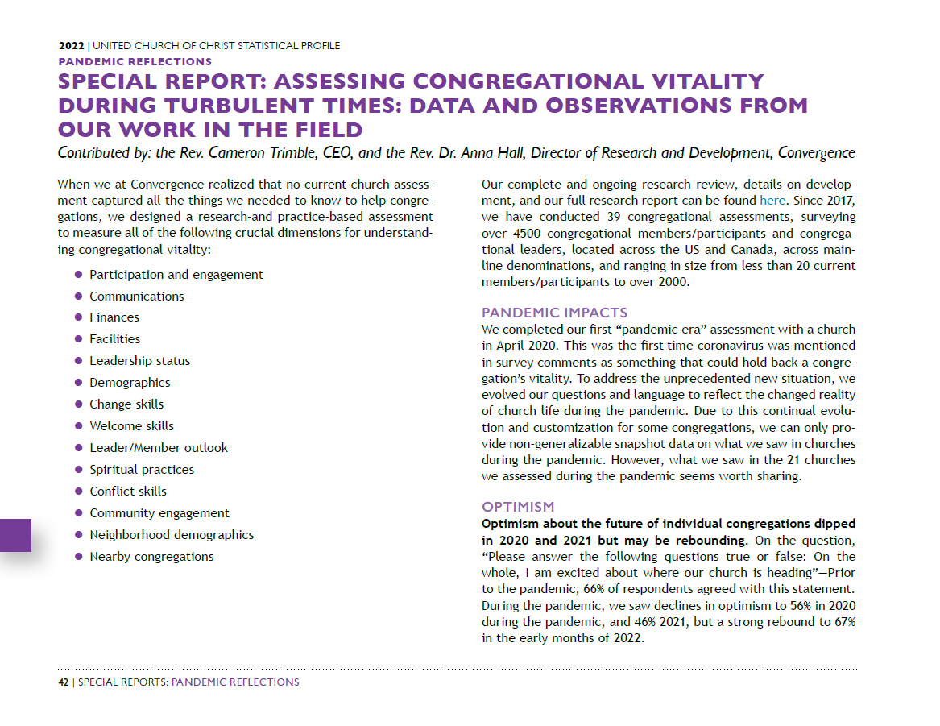

Slide 43
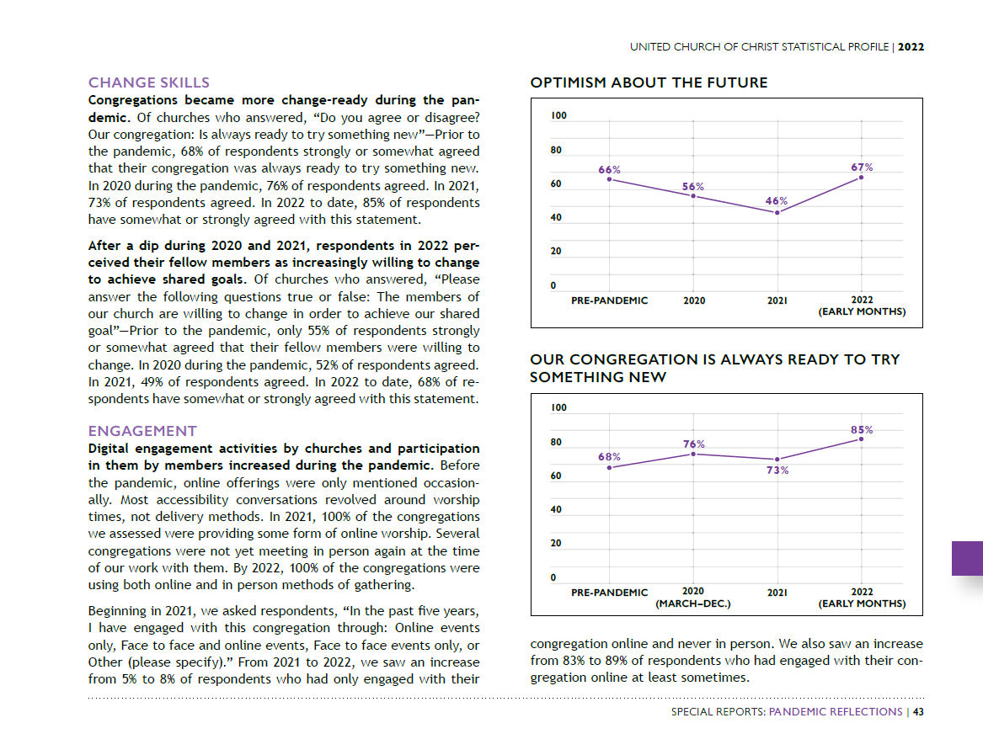

Slide 44
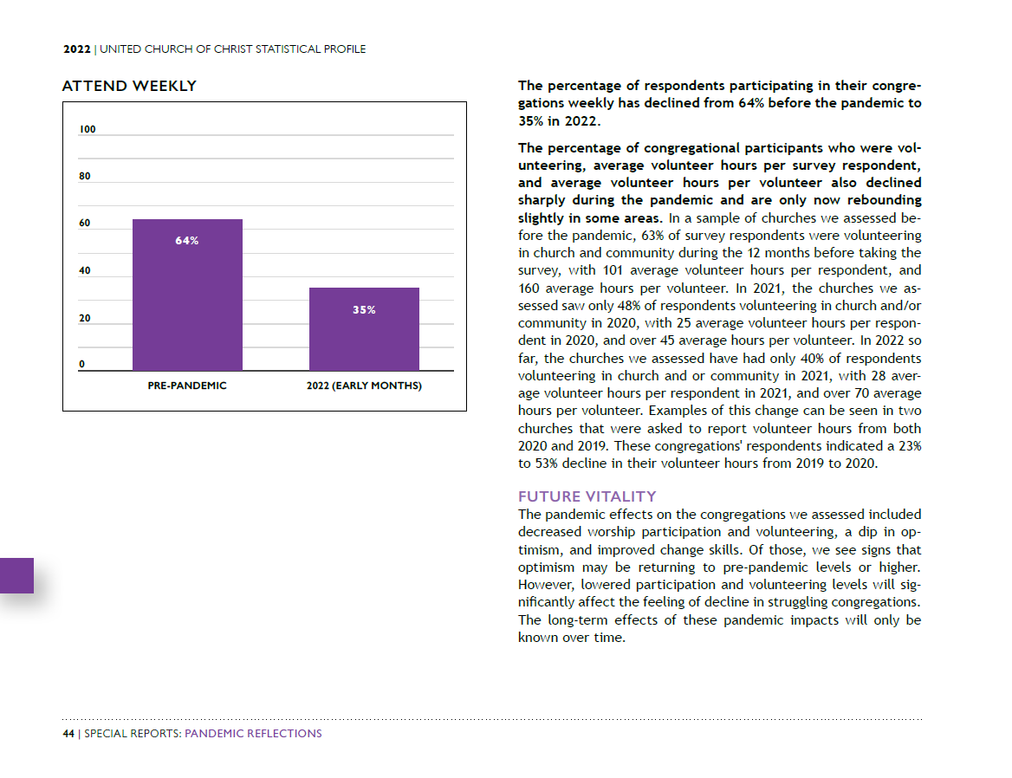

Slide 45
Special Reports Section: Denominational Trends, Members, Clergy, and Congregations

Slide 46
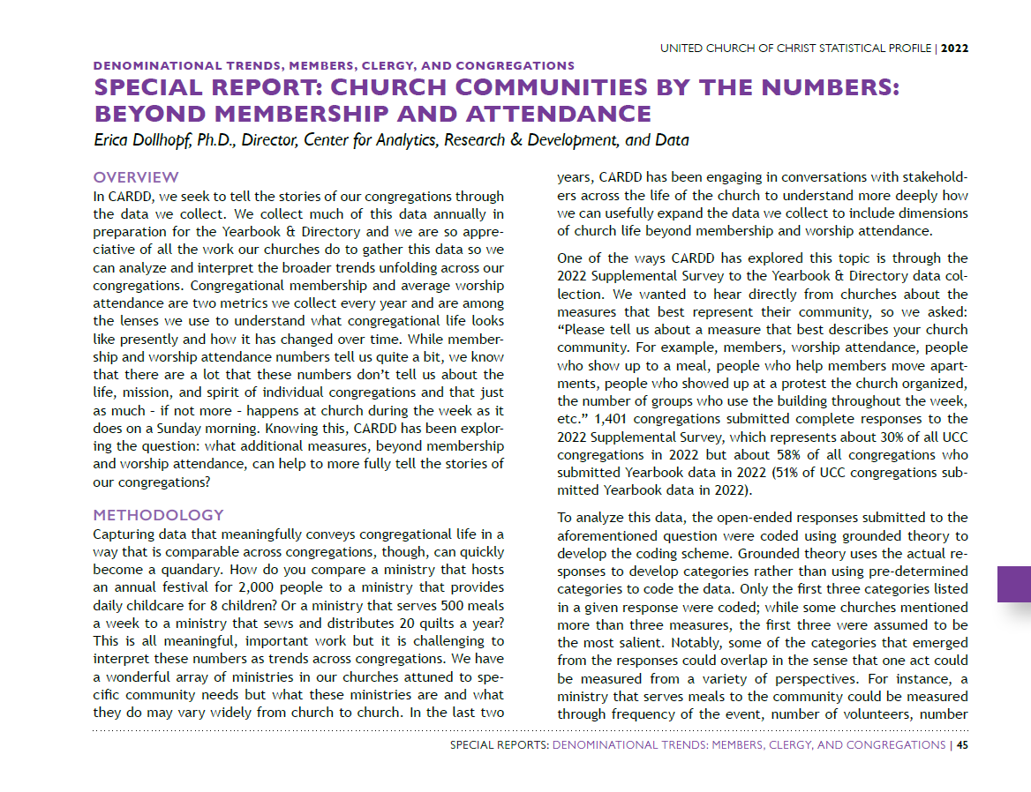

Slide 47
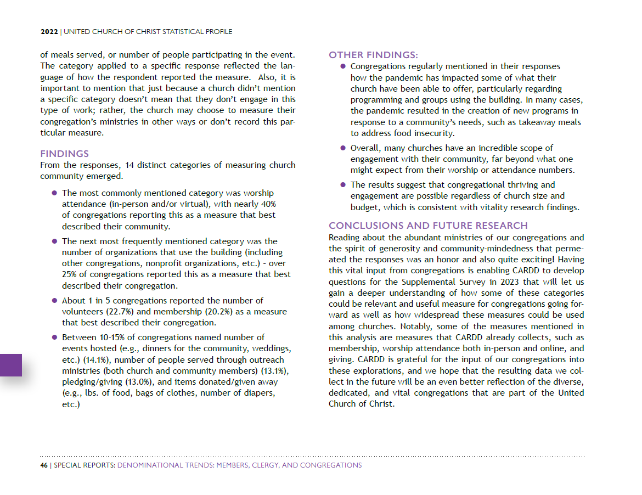

Slide 53
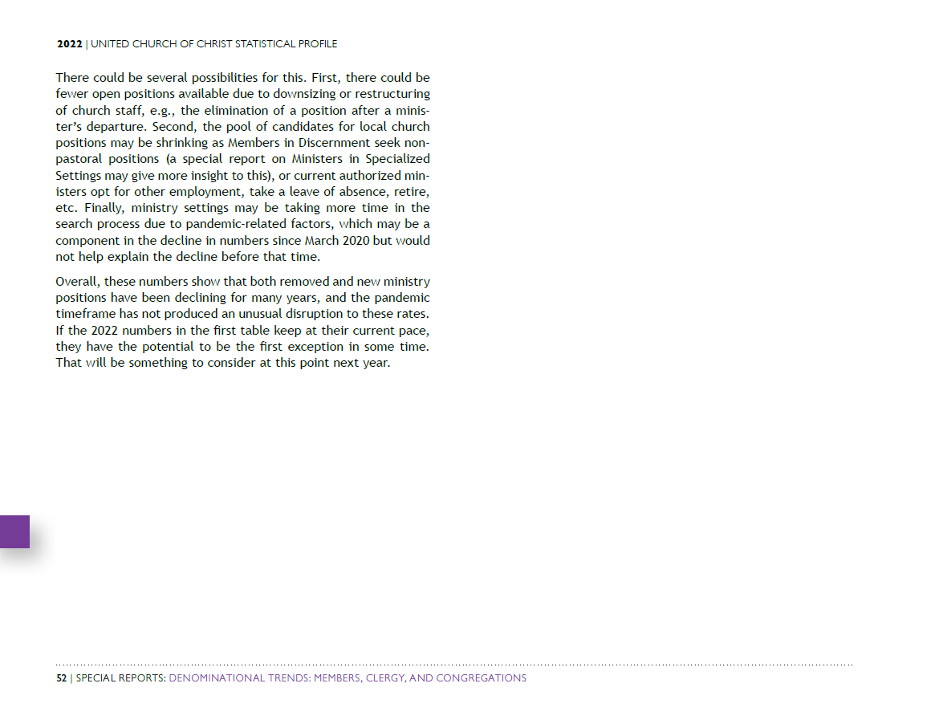

Slide 54
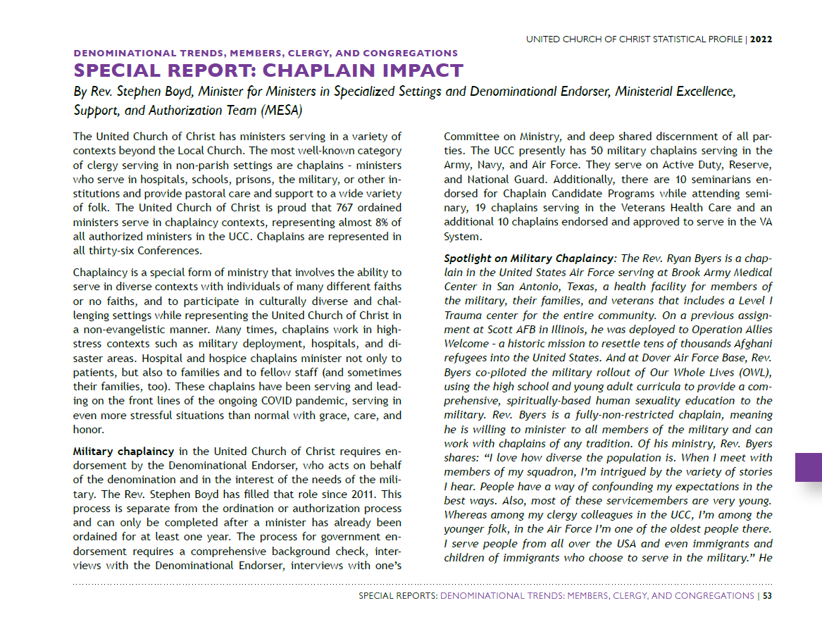

Slide 55
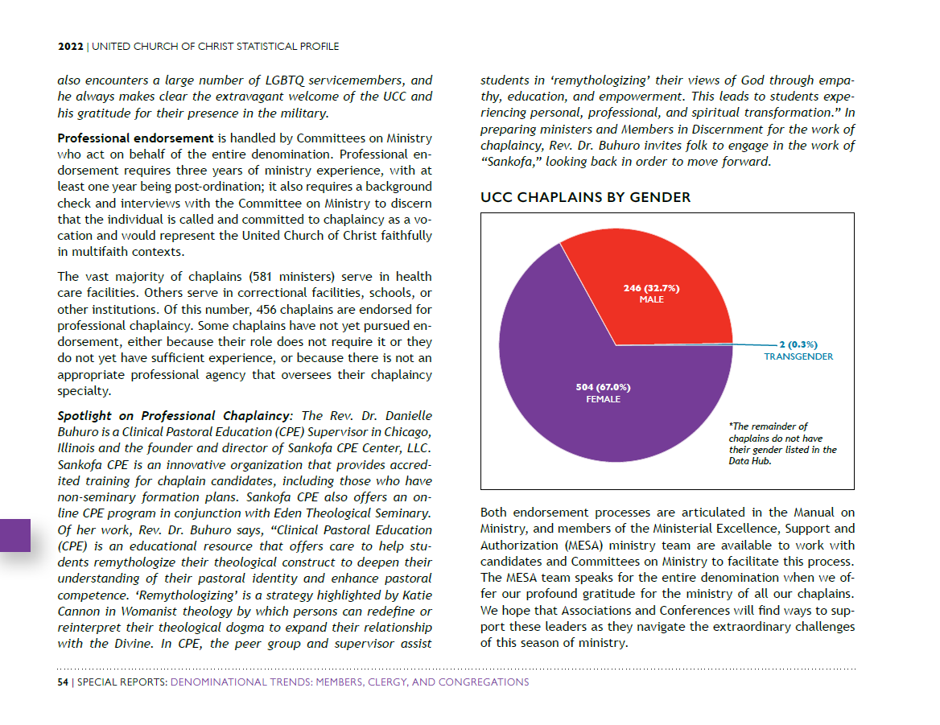

Slide 59
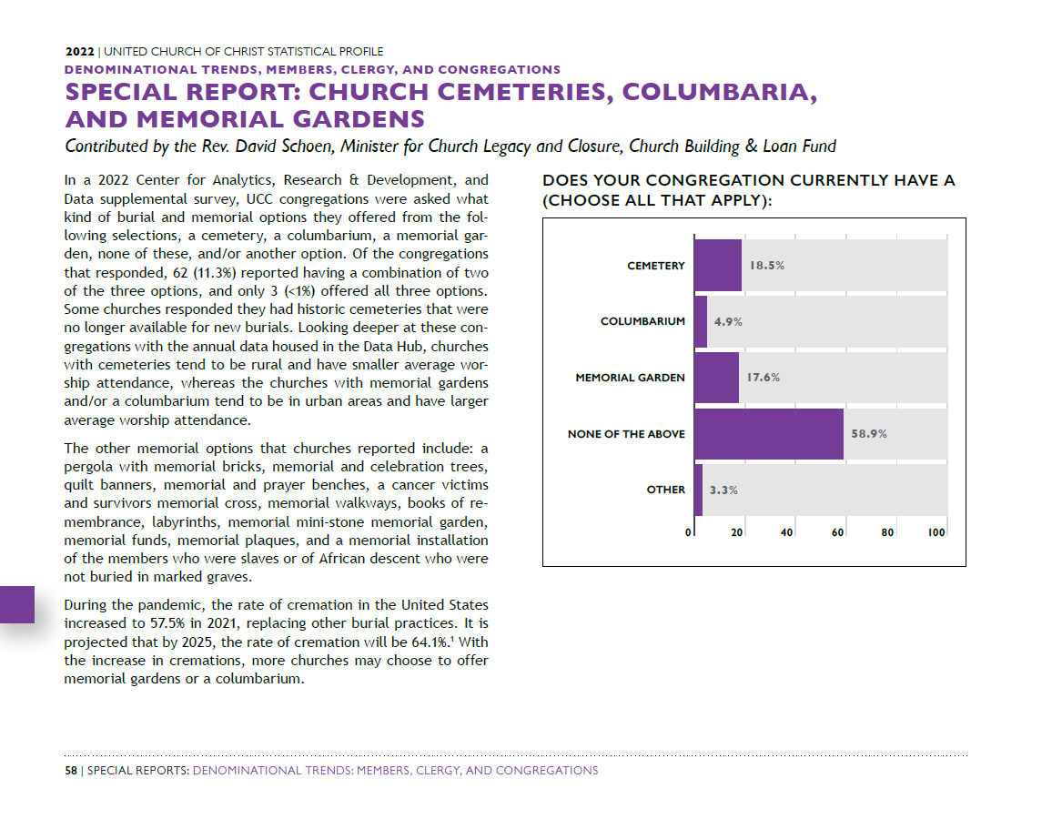

Slide 61
Special Reports Section: UCC Programmatic Work

Slide 63
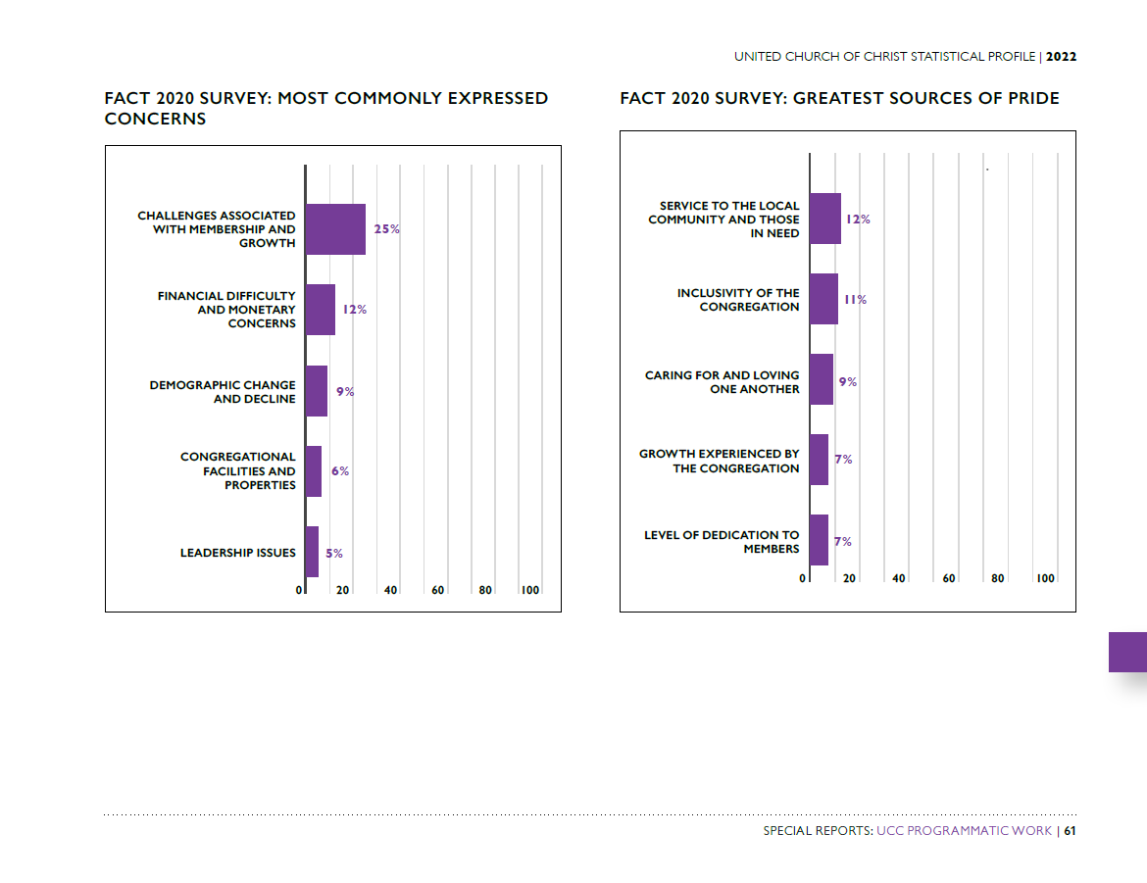

Slide 66
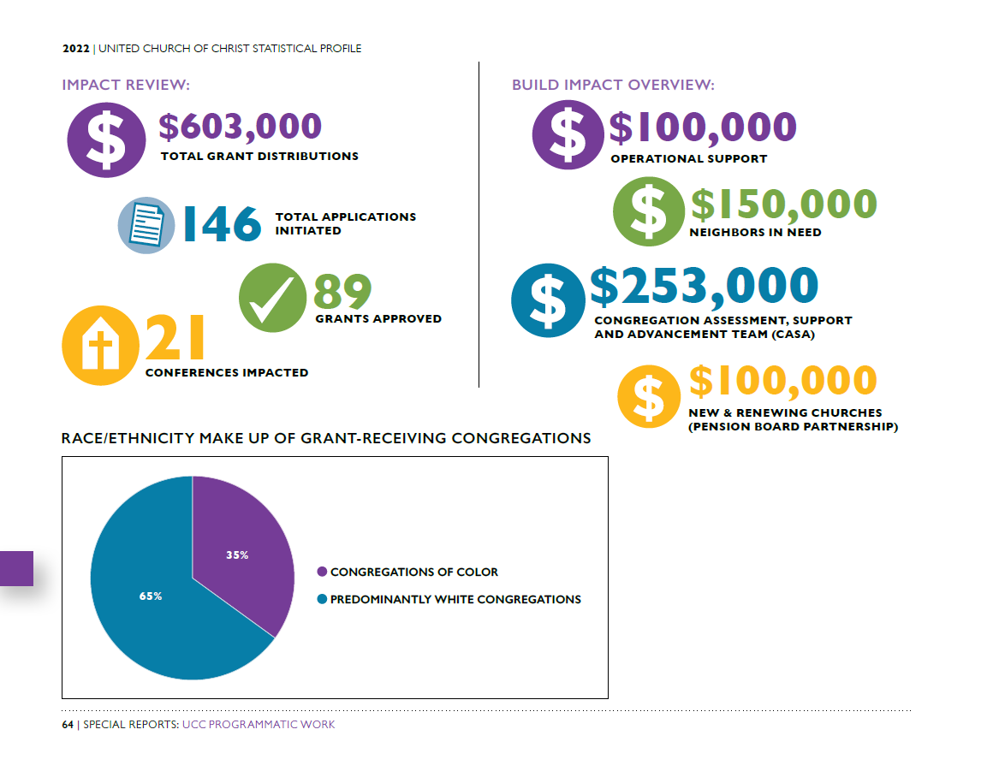

Slide 68
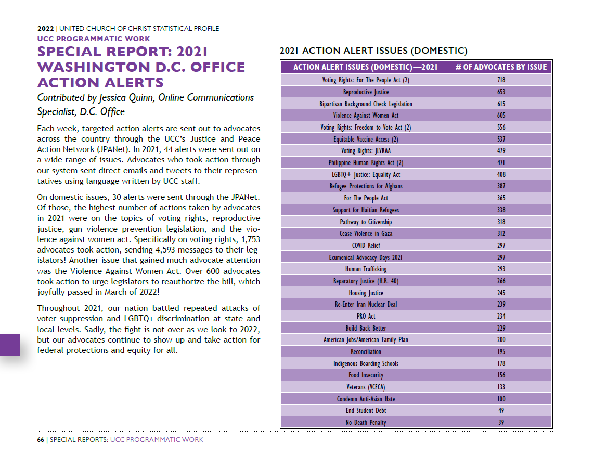

Slide 83
Special Reports Section: Reports from Affiliated Ministries

