Slide 3
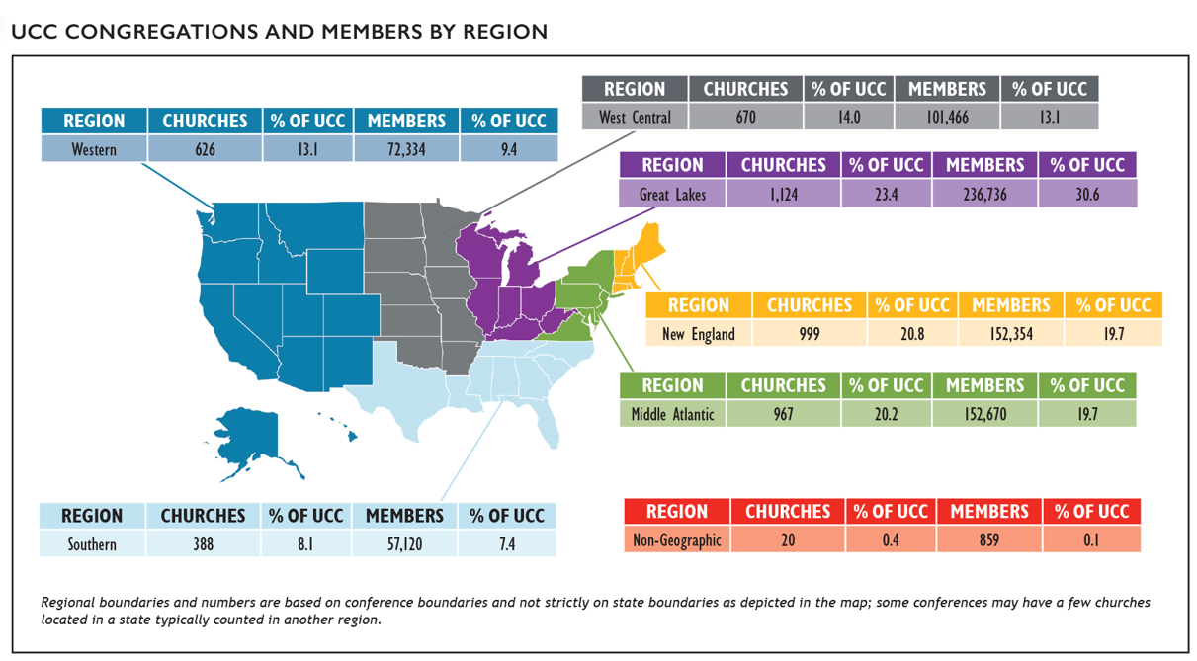
Congregations and Members
Notes:
At the end of 2020, there were 4,794 congregations in the United Church of Christ with a total of 773,539 members. The UCC’s congregations
represent about 1.4% of total U.S. congregations* while the membership of the UCC represents about half of one percent (0.51%) of total
U.S. religious adherents* and about 0.23% of the U.S. population.** UCC membership is concentrated in the Great Lakes, Middle Atlantic,
and New England regions of the country.
*2010 U.S. Religion Census http://www.usreligioncensus.org/
**U.S. Census https://www.census.gov

Slide 4
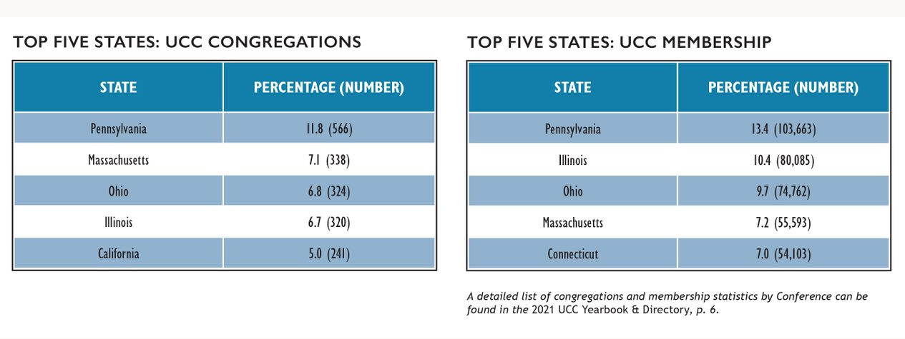
Congregations and Members
Notes:
In examining the distribution of congregations by state, 11.8% of all UCC congregations were located in Pennsylvania, which reported the greatest number of congregations. In total, the top five states with the most congregations contained over one-third (37.4%) of all UCC congregations.
Membership, as with congregations, was concentrated largely in the Middle Atlantic, Great Lakes, and New England states. Nearly half of UCC members (47.7%) reside in the top five states by membership. Interestingly, membership became slightly more concentrated in these top five states over the past year, with 47.1% of membership residing in these states in 2019. Notably, the states with the highest number of churches are not necessarily the states with the highest number of members. For example, Connecticut only has 4.8% of UCC churches, but has 7.0% of UCC members, while California has 5.0% of UCC churches but only 3.6% of UCC members. This indicates that churches in Connecticut, on average, have a larger membership than churches in California.

Slide 5
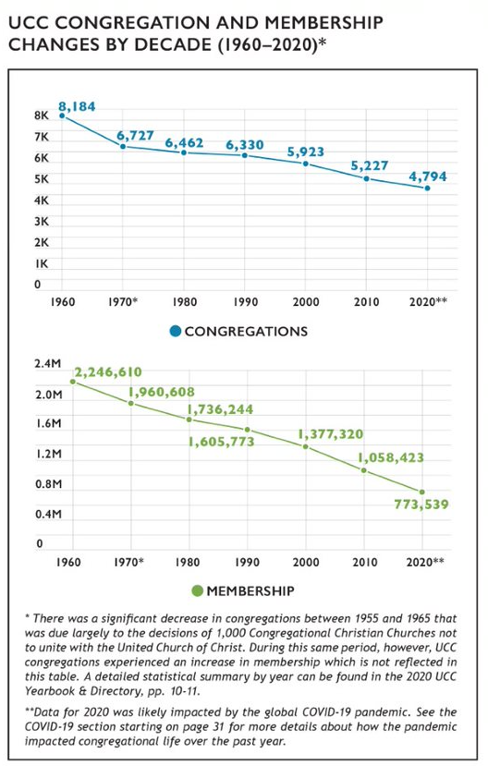
Growth and Decline
Notes:
Similar to other Protestant denominations, the UCC has experienced a decline in the numbers of congregations and members in recent decades. From 2010 to 2020 alone, the UCC encountered a net loss of 433 congregations and 284,884 members. Some of this decline, however, began prior to the formation of the denomination in 1957 as the number of congregations steadily decreased despite membership increases in the UCC’s early years.
In 2020, 72 congregations were removed from denominational records. This was a 67.4% increase from 2019, when only 43 churches were removed from denominational records. Notably, 2019 had an unusually low number of churches removed compared to previous years (85 in 2018 and 74 in 2017); this increase for 2020 may be partially the result of a lag in church closure reporting due to the pandemic. From 2005 through 2007, the UCC experienced a loss of nearly three congregations per week on average (mostly as a result of General Synod’s resolution regarding same-sex marriage). In the past year, however, the loss rate has been about one (1.39) congregation removed from denominational records per week on average; this is slightly higher than the rate for 2019 (0.83 congregations per week).
Over the past year, 12 congregations have been added to denominational records (this includes churches that received standing, affiliated, or merged with another congregation). In total, 74 congregations received standing and were added to the UCC over the last five years, which is equivalent to a new congregation being added about every three and a half weeks or slightly more than one congregation being added every month.

Slide 6
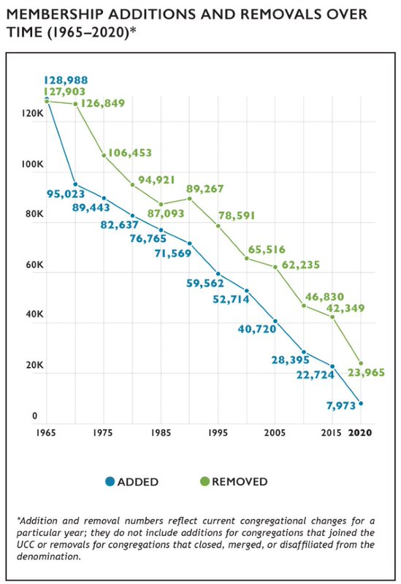
Membership Growth and Decline
Notes:
In general, the number of members removed each year exceeds the number of members added for that same time period. Members are removed from congregational records for several reasons including death, transfer of membership to another denomination, or updating of local church membership records.
The net difference between UCC members added and removed from congregational membership rolls has continued to decline as total membership has decreased. In 2020, there was a net removal of 15,992 members, a number that was higher than 2019, which had a net removal of 12,341 members, but overall still less than any other recent year: 2018 had a net removal of 16,302 members and in 2017, 16,600. Looking further back, in 2015, there was a net loss of 19,625 members and in 2010, 18,435 members. (Note that net loss figures represented here are different than the net change figure represented in the UCC Yearbook & Directory, which is based on total membership.) Over time, the number of members added and removed have both declined although the net loss contributing to this decline has generally become smaller. The particularly small number of members added in 2020 compared to other years is likely an effect of COVID-19; future years of data will demonstrate whether this is part of a long-term trend.

Slide 7
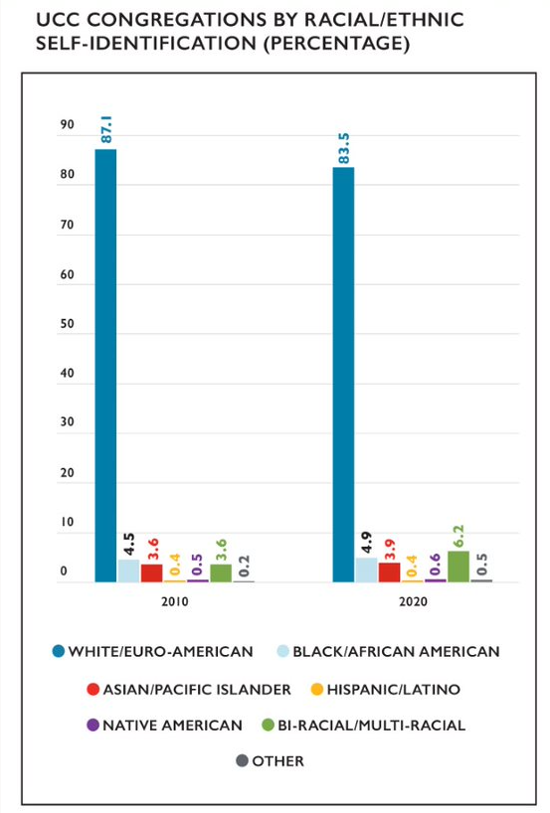
Congregations by Race/Ethnicity
Notes:
A substantial majority of congregations in the UCC self-identify as White/Euro-American (meaning that most members of a congregation belong to that particular racial/ethnic group). Over time, however, the UCC as a whole is becoming more racially/ethnically diverse. Over the last decade, the percentage of self-reported primarily White/Euro-American congregations decreased from 87.1% in 2010 to 83.5% in 2020. During this same time frame, the percentage of Bi-Racial/Multi-Racial congregations increased from 3.6% in 2010 to 6.2% in 2020 and Other congregations increased from 0.2% to 0.5%. In addition, the percentage of Black/African American congregations increased by 0.4% and Asian/Pacific Islander congregations increased by 0.3% during this time period, from 4.5 to 4.9% and 3.6 to 3.9% respectively. The proportion of Native American congregations also increased slightly, from 0.5% to 0.6%. One cause of these shifts over time may be due to the fact that the majority of congregations that close, merge, or disaffiliate with the denomination are primarily White/Euro- American congregations, thus decreasing the overall proportion of these congregations, while newer UCC congregations tend to be more racially/ethnically diverse.

Slide 8
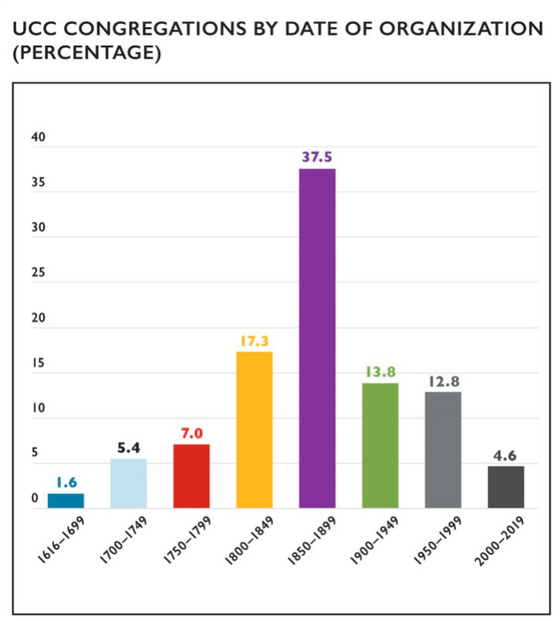
Congregations by Date of Organization
Notes:
While the UCC has only been in existence since 1957, many of its congregations were founded by predecessor denominations. The vast majority of churches (84.9%) were organized before the UCC’s founding year. The latter nineteenth century (1850–1899) was the most common founding era for UCC churches while just under 1 in 20 UCC churches (4.6%) has been founded in 2000 or later, a percentage that has been increasing steadily. The average founding date of congregations is 1873 while the median founding date is 1875.

Slide 9
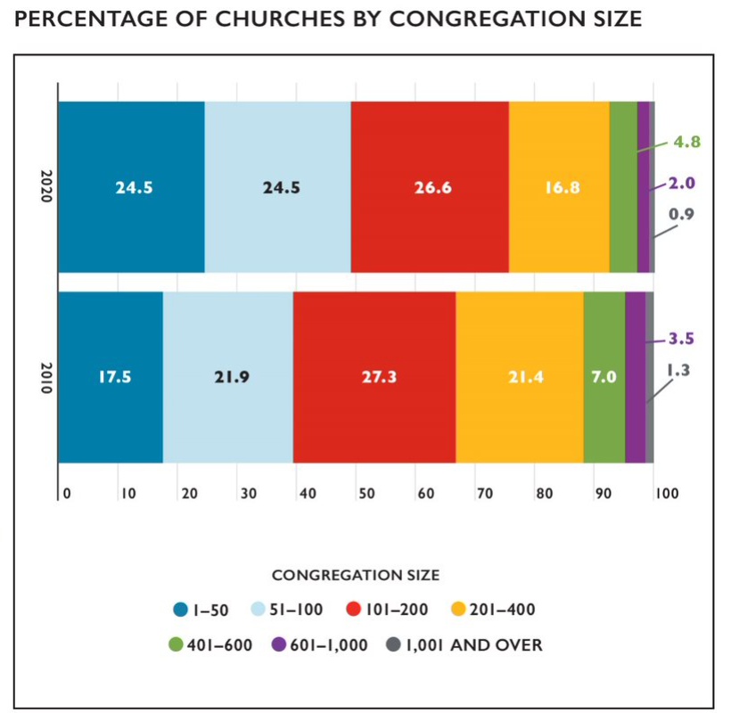
Congregation Size by Membership
Notes:
The majority (92.4%) of UCC congregations have fewer than 400 members; almost half of congregations (49.0%) have 100 members or fewer. This reflects an overall trend within the UCC of the denomination increasingly being a denomination of small churches. In 2010, 88.1% of UCC churches had 400 members or fewer and 39.4% of churches had 100 members or fewer. The biggest changes in the past 10 years have been in churches with fewer than 50 members, which have increased from 17.5% to 24.5% of churches since 2010, and churches with 201-400 members, which have decreased from 21.4% to 16.8% of churches since 2010.

Slide 10
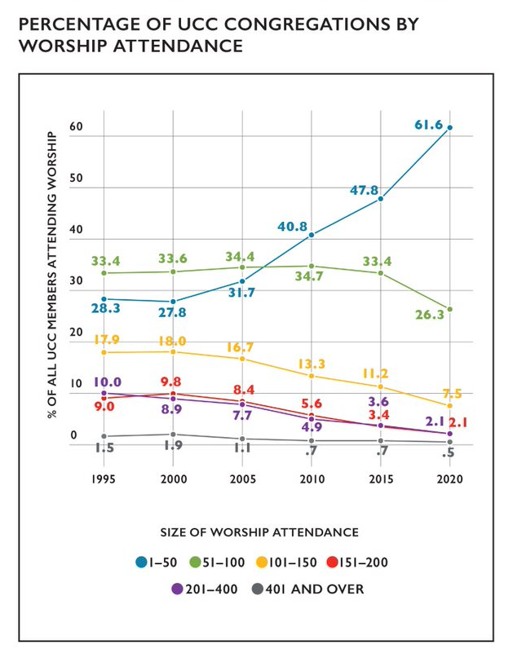
In-Person Worship Attendance
Notes:
When considering worship attendance figures rather than membership size, even more congregations are categorized as smaller churches. In 2020, nearly 90% of churches in the UCC (87.9%) had a weekly worship attendance of fewer than 100, which is 12.4% higher than in 2010 and 26.5% higher than in 2000. Over time, the percentage of congregations with greater worship attendance numbers has decreased steadily, with the most dramatic decreases occurring in congregations of 101-400 worship attenders since 1995. As a result, over three out of every five (61.6%) UCC congregations now have a weekly worship attendance of 1–50 individuals.
While these shifts toward smaller worship attendance have been present for decades in the UCC, the restrictions on gathering sizes many churches faced for in-person worship during the COVID-19 pandemic may be partly responsible for the increases in the 1-50 category in 2020. Also, the widespread practice of virtual worship during the pandemic may have also impacted in-person worship attendance patterns. For information on virtual worship attendance in 2020, please see page 32.

Slide 11
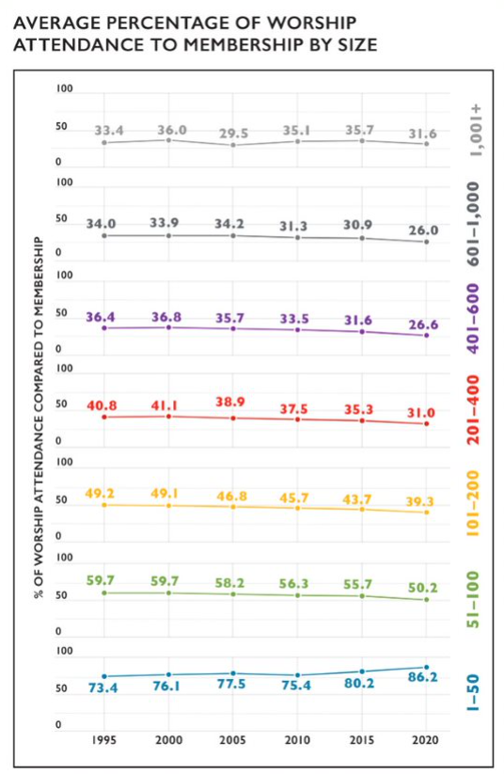
In-Person Worship Attendance and Membership
Notes:
The relationship between in-person worship attendance and membership continues to shift incrementally over time. From 1995 to 2020, fewer people generally attended in-person worship as an overall proportion of the number of church members, with two exceptions—the largest churches, which have effectively remained stable, and the smallest churches, which have seen an increase. In 1995, churches with 1,001+ members reported on average that 33.4% of the number of people attended in-person worship compared to the total membership; while this figure has risen and fallen in the subsequent decades, the current figure is 31.6%. On average, in 1995 there were 73.4% of people attending in-person worship compared to the overall membership of a 1–50 member congregation; this percentage has risen to 86.2% in 2020. The overall patterns suggest that a greater share of members may attend in-person worship in smaller congregations than larger congregations, though this cannot be known for certain, as those who attend in-person worship may not all be members. In addition, given the restrictions many churches faced for in-person worship during the COVID-19 pandemic, the attendance for in-person worship in 2020 may have been limited for health and safety reasons.

Slide 12
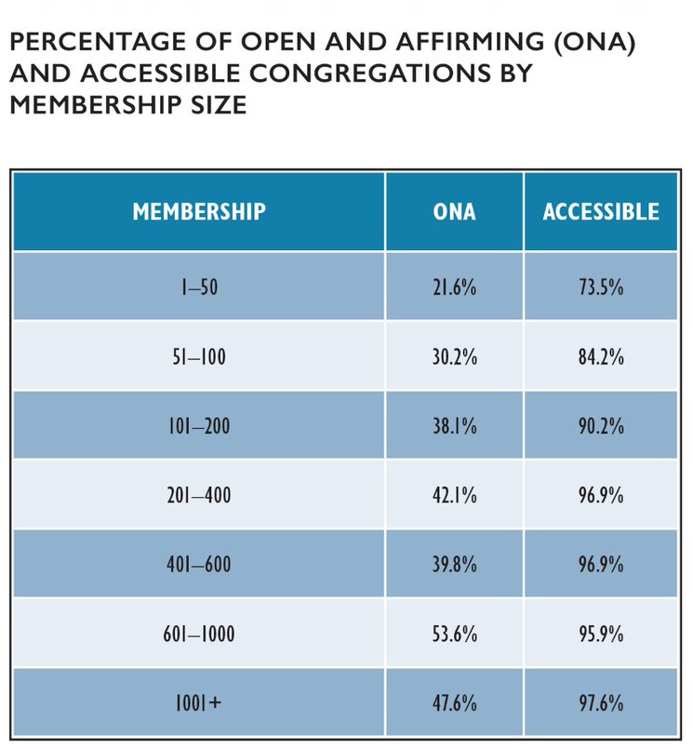
Congregational Designations
Notes:
In the past fifteen years, there was an 165.3% increase in the number of Open and Affirming (ONA) congregations in the United Church of Christ, from 600 churches in 2005 (10.9% of all UCC churches at that time) to 1,592 churches (33.2% of all UCC congregations in 2020). ONA designations tend to be more common as church size increases, with half or nearly half of the largest churches in the UCC (with 600–1000 and 1001+ members) being an ONA congregation.
Self-reported accessibility also tended to increase with church size. While the specific types and degrees of accessibility among these congregations are unknown, it is possible that these figures partly reflect the resources churches have available to address the accessibility of their space.

Slide 13
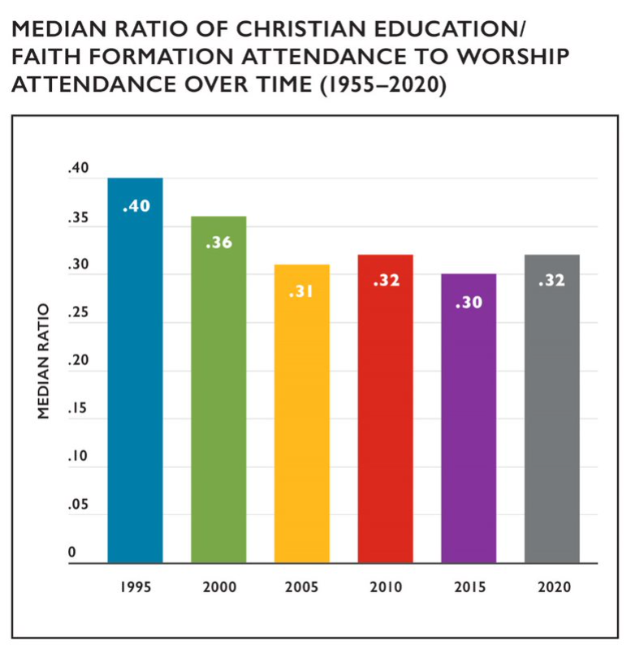
Christian Education/Faith Formation
Notes:
Since the 1950s, enrollment and attendance numbers for Christian Education/Faith Formation programming (also known as Church School or Sunday School enrollment in previous years) has been declining along with membership numbers. When thinking about Christian Education/Faith Formation attendance in terms of all the people who may be present on a Sunday morning (i.e. in comparison to worship attendance), the median percentage of Christian Education/Faith Formation attendance compared to worship attendance has been quite stable since 2005, hovering between 0.30 and 0.32 percent when comparing 5 year increments. This suggests that just under one third of people who attend worship services also attend Christian Education/Faith Formation programming, though these categories may not perfectly overlap in practice. While there has been an unusually large decrease in Christian Education/Faith Formation enrollment in 2020 (a net change of 19,903 people compared to 7,164 in 2019)—most likely a result of the pandemic—the median percentage of attendance remained similar to previous years.

Slide 14
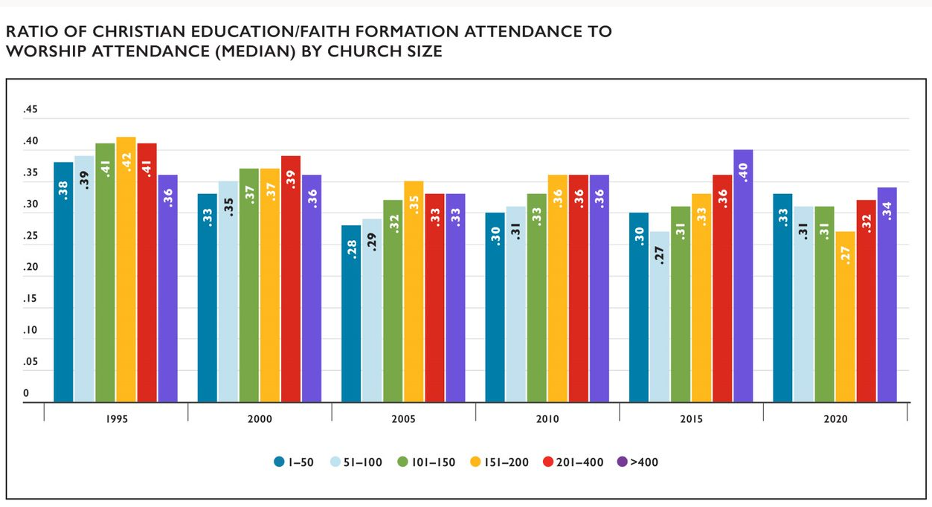
Christian Education/Faith Formation
Notes:
In comparing Christian Education/Faith Formation attendance to worship attendance by church size, the smallest and the largest churches tend to have the highest ratios of Christian Education/ Faith Formation attendance to worship attendance. This may be due to different factors: smaller churches might have higher ratios due to the close connections among congregations that are common in these congregations, while larger churches may have higher ratios due to capacity for organized programming.

Slide 15
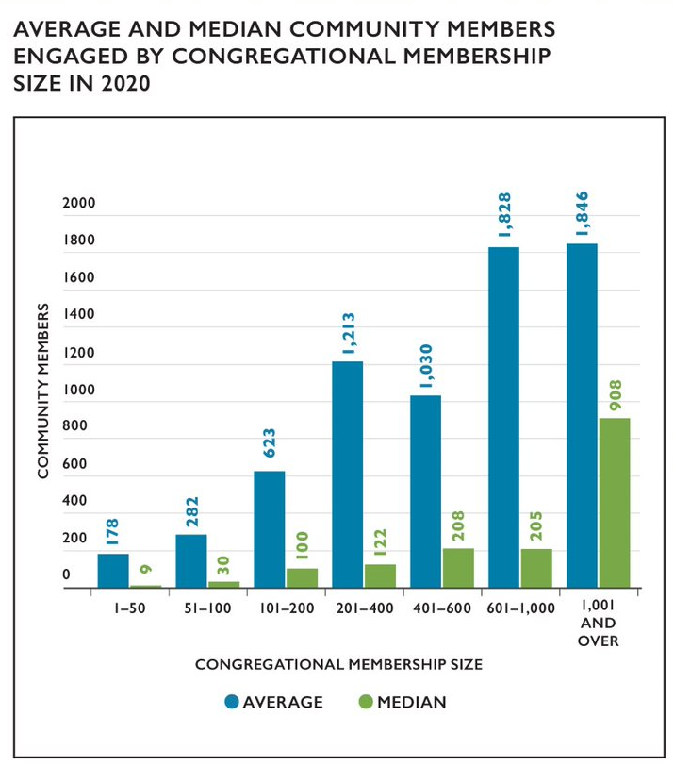
Congregational Outreach
Notes:
Congregational reports indicated that an average of 651 community members and a median of 65 community members were impacted by each local church’s outreach activities and initiatives in 2020. The total number of community members engaged in 2020 was 1,211,038 with 38.8% of congregations reporting. This is lower than the 47.2% of congregations who reported engaging 2,055,868 in 2019, which likely reflects the impact of the COVID-19 pandemic on congregations’ opportunities to engage with their communities. The average number of community members is notably much higher than the median, which suggests that some churches may have a particular focus on community outreach or may engage in types of outreach that tend to engage more people than other types of outreach.

Slide 16
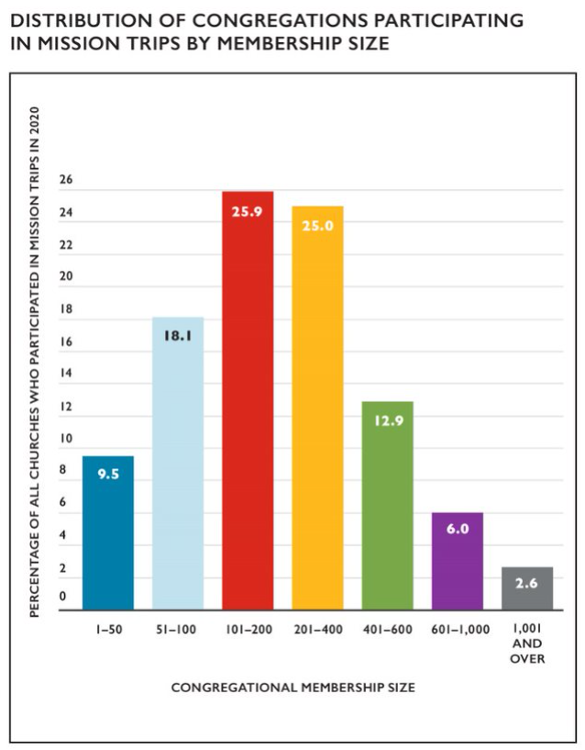
Mission/Immersion/Service Trips
Notes:
Since 2014, congregations have been asked to report whether members participated in a U.S. or international mission/immersion/service trip. In 2020, 116 (2.4%) congregations reported that members had participated in these types of trips. Given the widespread travel restrictions due to COVID-19 in 2020 and limited opportunities for virtual mission/immersion/service trips, this low rate compared to 2019, when 574 congregations participated in mission/immersion/service trips, is not unexpected. Among churches that did report participating in mission/immersion/service trips in 2020, mid-sized churches most frequently engaged in this type of activity, with churches with 101–400 members conducting half of all these trips.

Slide 17
Local Church Financial Trends
Notes:
Operating expenses for an average local congregation in 2020 was $172,934—a $10,918 (-5.9%) average decrease from 2019. Average total income for a local church in 2020 was $220,505—a $14,740 (-6.3%) average decrease from 2019. Both the average operating expenses and income for local congregations increased from average amounts reported over the past decade—from $161,759 in expenses (a 6.9% increase) and $206,743 in income (a 6.7% increase) in 2010. This is a considerably smaller increase than in previous years (15.0% and 16.3% increase in 2019, respectively).
In 2020, Our Church’s Wider Mission (OCWM) giving represented 4.6% of total local church expenditures. This percentage decreased to 3.2% of total local church expenditures in 2020.

Slide 18
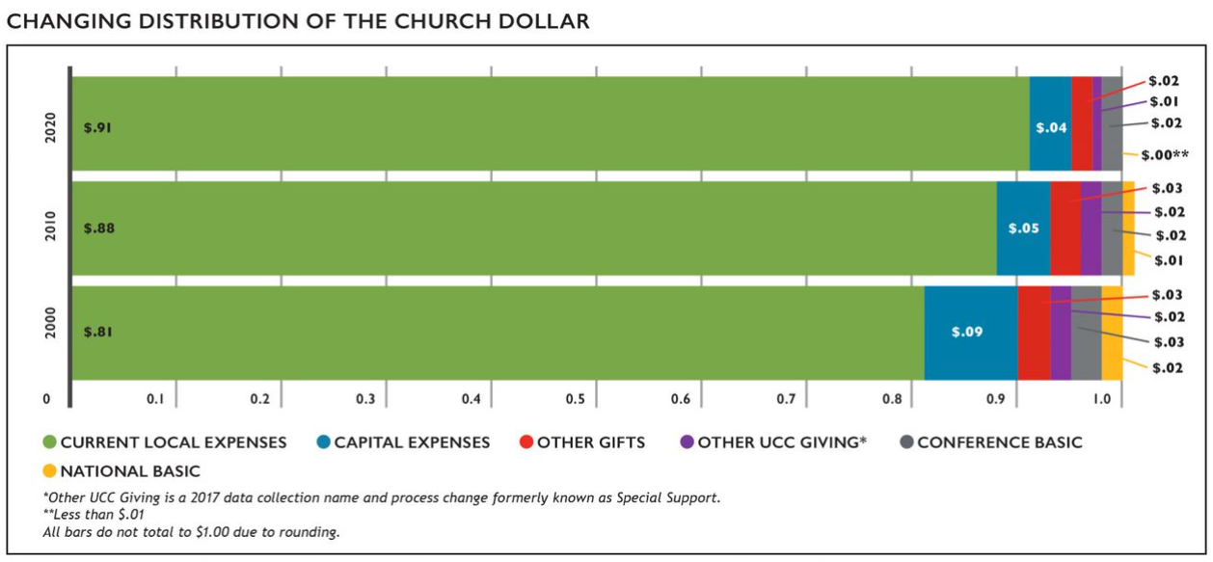
The Church Dollar
Notes:
In the last two decades, the distribution of the church dollar has experienced some noticeable shifts. Current local expenses have increased by $.10 while all others have decreased or remained steady. All types of UCC Giving (Conference Basic, National Basic, and Other UCC Giving) have decreased in the past 20 years.

Slide 19
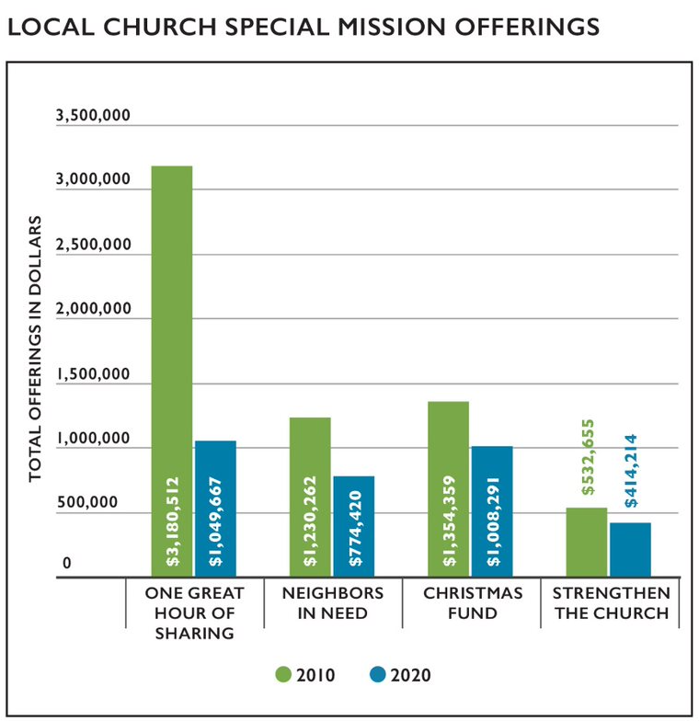
Stewardship and Mission Support
Notes:
Totals for mission support and giving by local congregations of the United Church of Christ decreased over the past several years. Over the past decade, the number of churches that have not given to any Special Mission Offering has increased. In terms of dollars given, all the Special Mission Offerings have seen a decrease this year compared to 2010. In previous editions of this publication some offerings have experienced decreases in giving as others have experienced increases. In looking at 10 year trends, the total giving to the Special Mission Offerings in 2020 decreased by 48.4% when compared to 2010, which is in stark contrast to the decrease of 11.7% in 2019 compared to 2009. The widespread financial impact of the COVID-19 pandemic on congregations in 2020 may have contributed to the sharp decline.

Slide 20
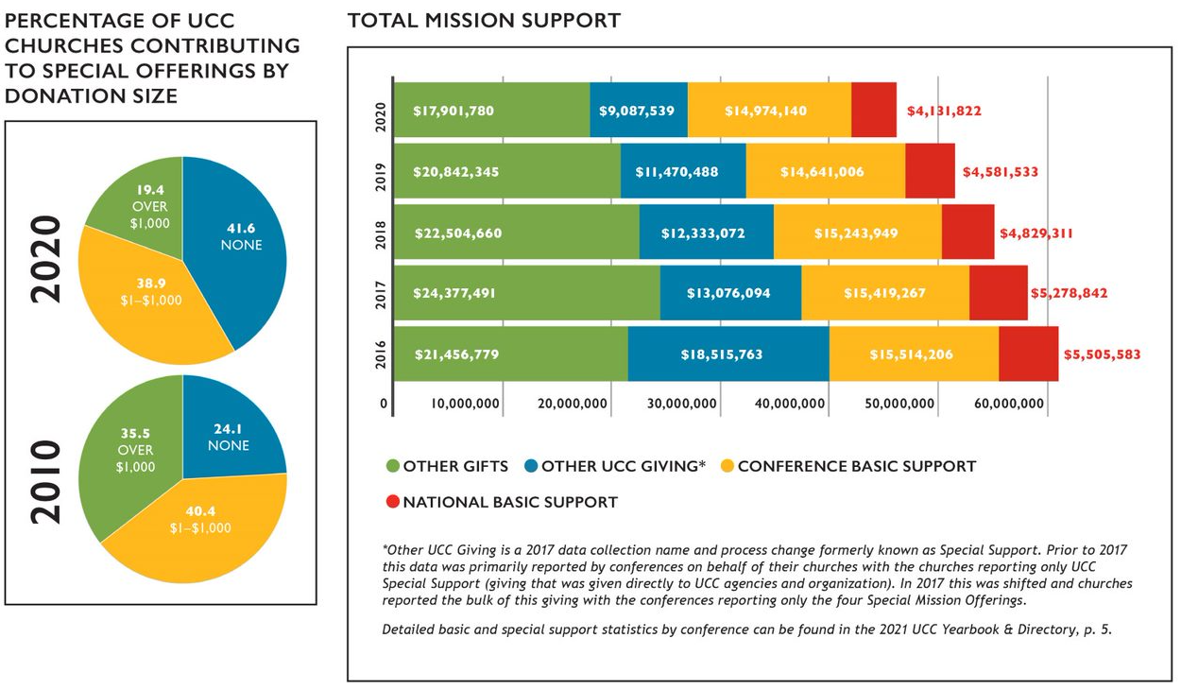
Stewardship and Mission Support
Notes:
Total mission support for 2020 decreased from the previous year by $5,440,111 (-10.6%) and has decreased 24.4% since 2016. Changes, however, have not been uniform across giving categories. While the data indicates that Other UCC Giving has decreased dramatically in the past 4 years (-35.5%), it is important to note that in 2017 the manner in which this data was collected changed.* National Basic Support has declined by 21.4% and Conference Basic Support has declined by 9.4% since 2015. Other Gifts—money given beyond the UCC—had been relatively stable over the past several years; however, in 2019 this category decreased by 8.5% compared to 2015.

Slide 21
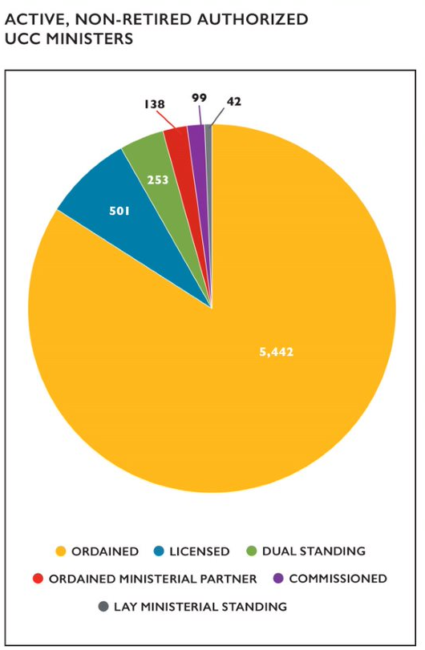
Summary of UCC Ordained Ministers
Notes:
As of December 31, 2020, there were a total of 6,475 active (non-retired) Authorized Ministers in the United Church of Christ (Ordained, Licensed, Lay Ministerial Standing, Dual Standing, Ordained Ministerial Partner, and Commissioned). Ordained Ministers were the largest percentage of active ministers reported (83.4%); and Licensed Ministers comprised the second largest group of Authorized Ministers (7.7%). In addition, one active (non-retired) minister holds standing in the Congregational Christian Church.

Slide 22
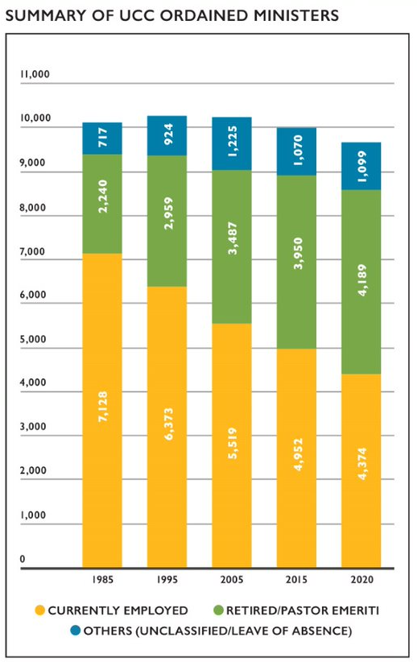
Summary of UCC Ordained Ministers
Notes:
At the end of 2020, there were 9,662 reported Ordained Ministers in Full Standing, including Retired Ministers and Pastor Emeriti. Of those 9,662 Ordained Ministers, nearly one-half (45.3% or 4,374) were employed, with 57.6% (3,048) of those employed actively serving in a local church (either a UCC church or non-UCC church). Four out of ten (43.4% or 4,189) were Retired Ministers or Pastor Emeriti, and 11.4% (1,099) were unclassified (ministers without a reported specialty at the time of Yearbook production) or were on a leave of absence.
Over the last 35 years (1985 to 2020), Ordained Ministers only had a numerical net decrease of 423 (4.2%). However, the number of employed Ordained Ministers decreased by over one third (-38.6%), while Retired Ministers and Pastor Emeriti saw an increase of 86.1% over this same 35-year period.

Slide 23
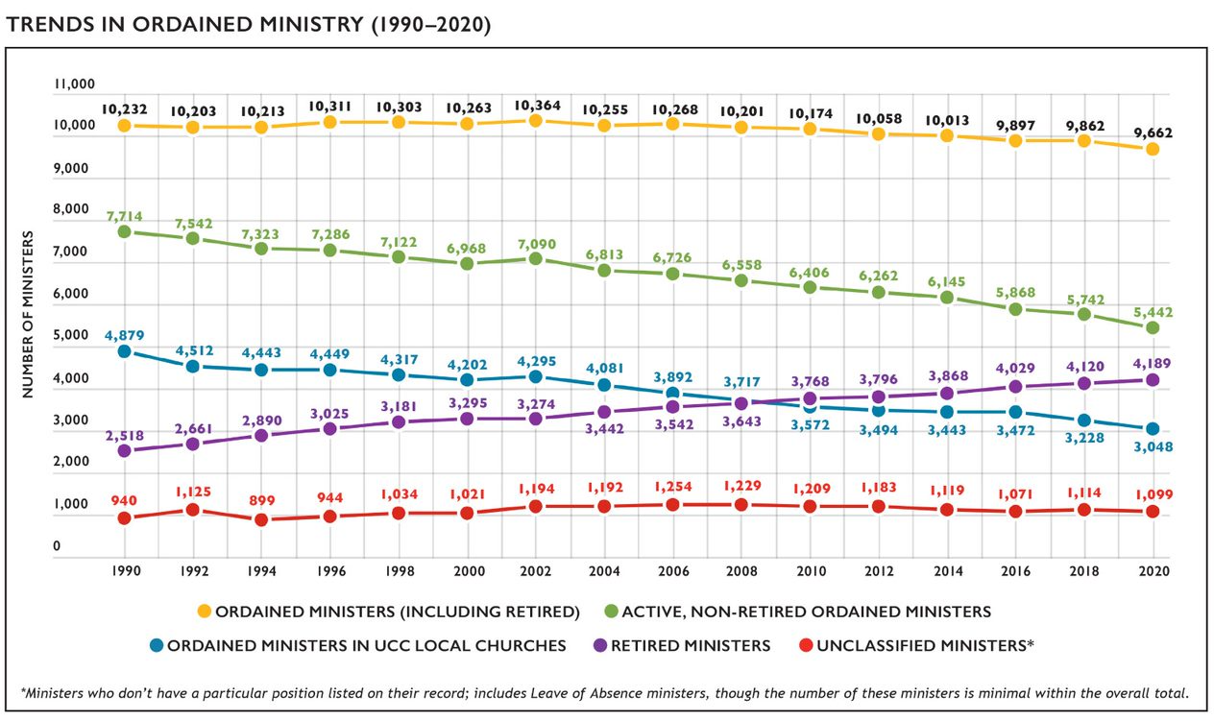
Trends in Ordained Ministry
Notes:
Since 1990, the number of Ordained Ministers has remained relatively stable, though there are slight incremental decreases in more recent years. At the same time, the number of Retired Ministers and Pastor Emeriti has increased steadily. Notably, since 1990 the decline in ordained ministers (-5.5%) has been much smaller than the declines in congregations (-24.3%) or membership (-51.8%) during the same time frame.

Slide 24
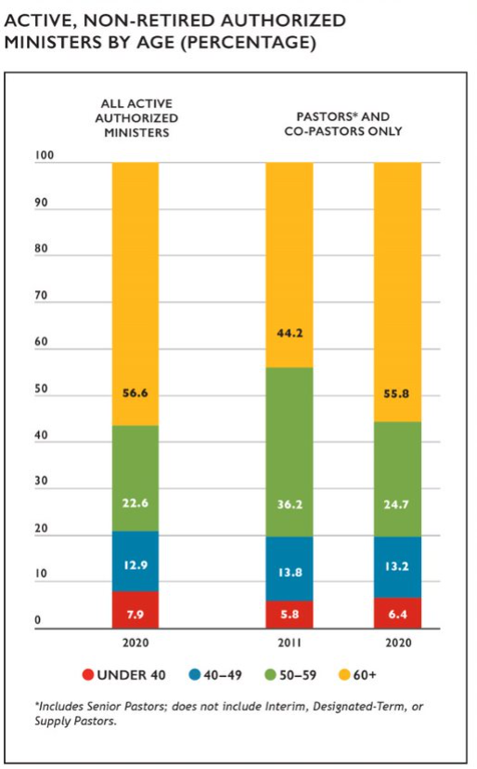
Authorized Ministers by Age
Notes:
Data regarding Authorized Ministers in the denomination reflects a population of predominantly older clergy. When all active (non-retired) Authorized Ministers were considered, over one half were age 60 and above (56.6%) and over three-quarters (79.2%) were 50 and older. Local church pastors and co-pastors are increasingly comprised of the oldest clergy in the UCC, with over half (55.8%) of all congregations being served by authorized ministers age 60 and above. The number of congregations being served by clergy under 50 has remained relatively stable.

Slide 25
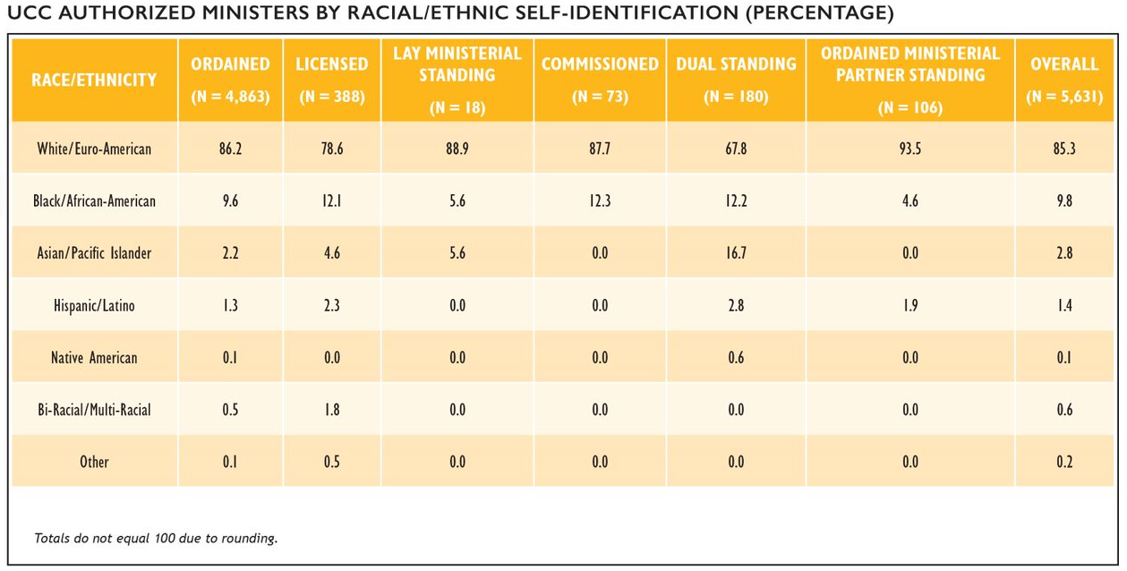
Authorized Ministers by Race/Ethnicity
Notes:
The majority (86.2%) of all active, non-retired UCC Authorized Ministers identified as White/Euro-American, with 13.8% identifying as non-white. Among the various types of authorization, Ministers with Dual Standing were the most racially/ethnically diverse group with three in ten (32.2%) ministers identifying as non-white. Commissioned Ministers, ministers with Lay Ministerial Standing, and ministers with Ordained Ministerial Partner Standing were the least racially/ethnically diverse authorization groups, both in terms of having the highest rates of clergy identifying as White/Euro-American and reflecting the fewest racial/ethnic categories.

Slide 26
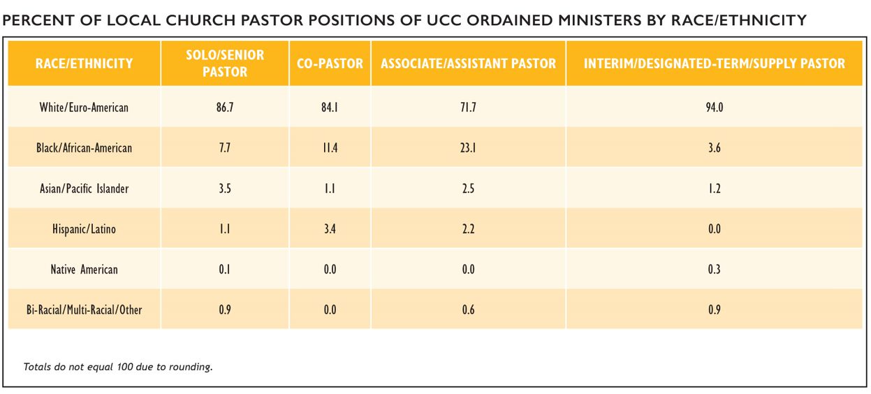
Ordained Ministers in Local Churches by Race/Ethnicity
Notes:
Regarding racial/ethnic representation in local church pastor positions, different patterns emerge based on position. Among senior/solo pastors, clergy who identify as African-American and Hispanic/Latino were proportionally under-represented (7.7% compared to 9.8% overall and 1.1% compared to 1.4% overall, respectively) while clergy who identify as Asian/Pacific Islander were represented at a proportionally higher rate among senior/solo clergy (3.5%) compared to clergy overall (2.8%). Associate/Assistant clergy were notably more racially/ethnically diverse compared to clergy overall, with 28.5% of clergy self-identifying as non-white compared to 14.8% of all active, non-retired Authorized Ministers.

Slide 27
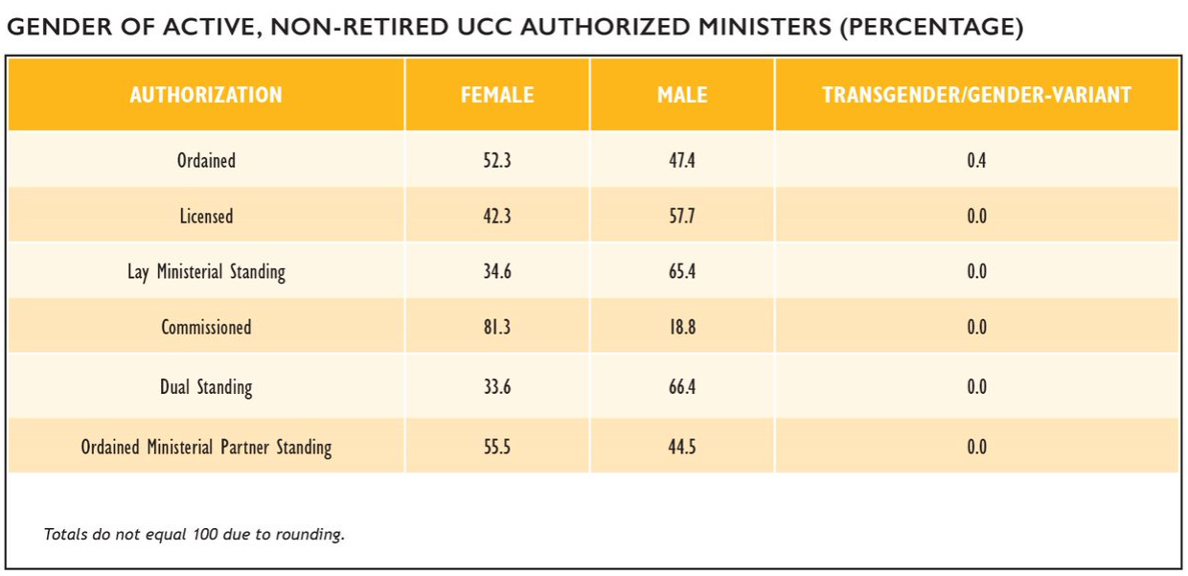
Authorized Ministers by Gender
Notes:
In total, approximately 52.3% of active, non-retired ordained ministers in the United Church of Christ identified as female, 47.4% identified as male, and 0.4% identified as transgender/gender-variant. This is a notable shift from the early 2000s, when according to the 2003 UCC Statistical Handbook only 27% of all Ordained Ministers identified as female. Among other categories of Authorized Ministers, Licensed, Lay Ministerial Standing, and Dual Standing ministers proportionately identified more often as male, while more than 4 out of every 5 Commissioned Ministers identified as female. All clergy who identify as transgender/gender-variant are ordained (19, or 0.4% of non-retired authorized ministers).

Slide 28
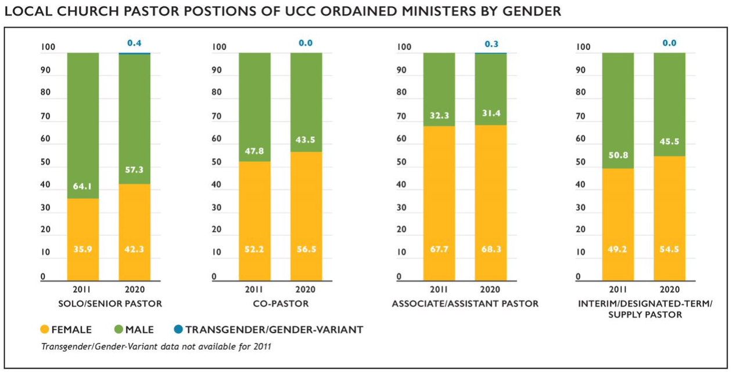
Ordained Ministers in Local Churches by Gender
Notes:
The percentage of active, non-retired female Ordained Ministers serving in local church pastoral positions has continued to increase, from 28.7% in 2004 to 46.5% in 2020. Slightly over four in ten (42.3%) senior/solo pastors identified as female in 2020, compared with 28.7% in 2004 and 35.9% in 2011. Over half (56.5%) of co-pastors and interim/designated-term/supply pastors (54.5%) and over two-thirds (68.3%) of associate/assistant pastors identified as female.

Slide 29
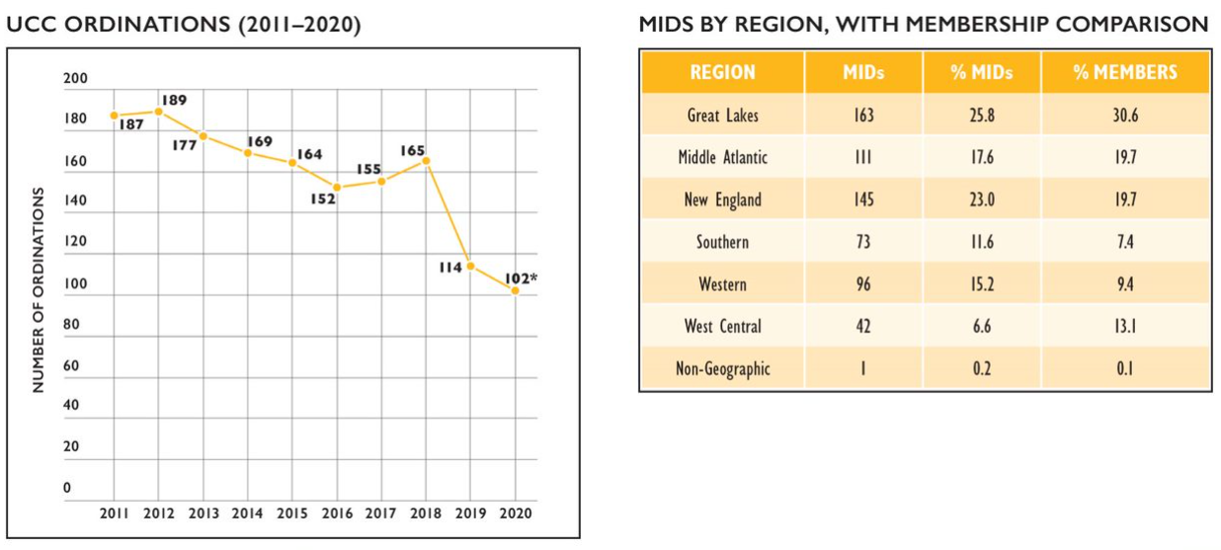
Ordinations and Members in Discernment
Notes:
The number of ordinations per year decreased over the past decade from 171 in 2010 to 102 in 2020.* Overall, the number of ordinations has been in decline; the 2014–2018 annual average of ordinations was 161 compared to the 2009–2013 annual average of 179 ordinations. When reviewing trends over the past several decades, however, ordination numbers fluctuated in similar ways; whether the declines in recent years signal a trend has yet to be seen.
As of April 2021, there were 631 active Members in Discernment on record within the denominational database. Some regions, however, had proportionally more MIDs compared to their overall membership proportion in the UCC—in particular, New England, Southern, and Western regions.
Among MIDs who report their gender identity, females comprised 60.2% of all MIDs, a greater percentage than that of current female Authorized Ministers, which currently comprise 52.3% of all Authorized, non-retired clergy. It is important to note that over one quarter (28.7%) of all MIDs do not have a gender recorded. Members in Discernment were also more racially/ethnically diverse than current Authorized Ministers with 27.5% identifying as non-white (compared with 13.8% of all Authorized Ministers identifying as non-white).
* Number of ordinations for 2020 and recent previous years is expected to increase in 2021 as additional records are updated by Conferences.

Slide 30
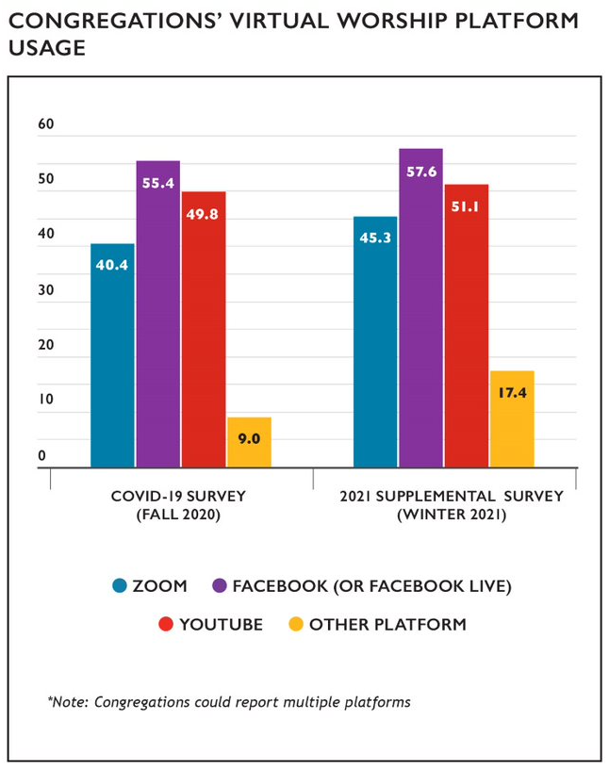
The COVID-19 Pandemic and the Church
Notes:
The COVID-19 pandemic disrupted and has continued to reshape congregational life in the UCC. One of the most notable disruptions that occurred during the pandemic was the widespread need to suspend in-person worship due to local mandates and/ or public health concerns. In the UCC, 96.5% of congregations reported suspending in-person worship at some point due to the pandemic. At the same time, congregations vastly expanded virtual worship offerings to a level never before seen. In the UCC’s first COVID-19 survey, conducted in the fall of 2020, 9% of congregations reported offering virtual worship prior to the pandemic; by the winter of 2021, 91.3% of congregations reported offering virtual worship at some point during the pandemic. These virtual worship opportunities were both live (62.9%) and recorded (53.0%) (note: congregations could report both options). Congregations most commonly used Zoom, Facebook/Facebook Live, and YouTube as platforms for sharing their virtual worship services, with congregations increasingly using multiple platforms for their services over time. Even as some congregations have been able to resume in-person worship, virtual worship is likely to remain a common offering alongside in-person worship, as nearly three quarters (72.5%) of congregations reported that they are planning to continue to offer virtual worship beyond the pandemic.

Slide 31
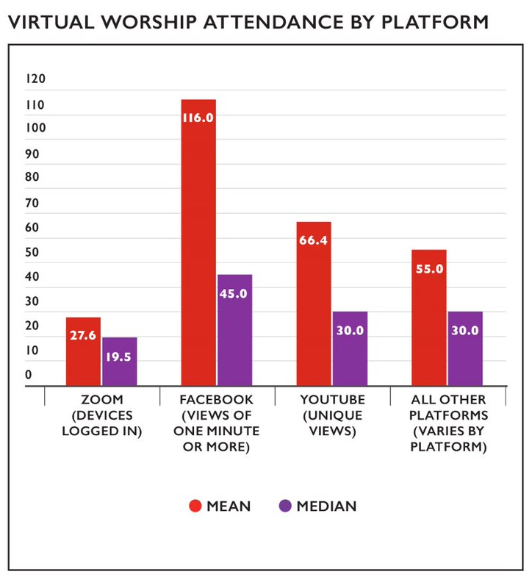
The COVID-19 Pandemic and the Church
Notes:
Virtual worship attendance is measured separately from in-person worship attendance because these numbers essentially measure different things. While in-person worship attendance figures represent the number of people present, online worship attendance generally represents the number of devices that have connected, as multiple people may be viewing worship on a single device or a single device may connect multiple times. In addition, different platforms have different ways of measuring viewership, which is why attendance is measured separately for different platforms.
Given that virtual worship will continue to be a part of church life for the majority of UCC congregations, CARDD will keep collecting this data going forward. While the Data Hub is not currently equipped to collect this data, once CARDD has determined the most reliable way to capture virtual worship attendance for the future, this data will be directly reportable into the Data Hub along with the rest of a church’s annual data. In the meantime, this data is being recorded in the annual Supplemental Survey, where it is attached to the church ID so it can be part of a church’s long-term records.

Slide 32
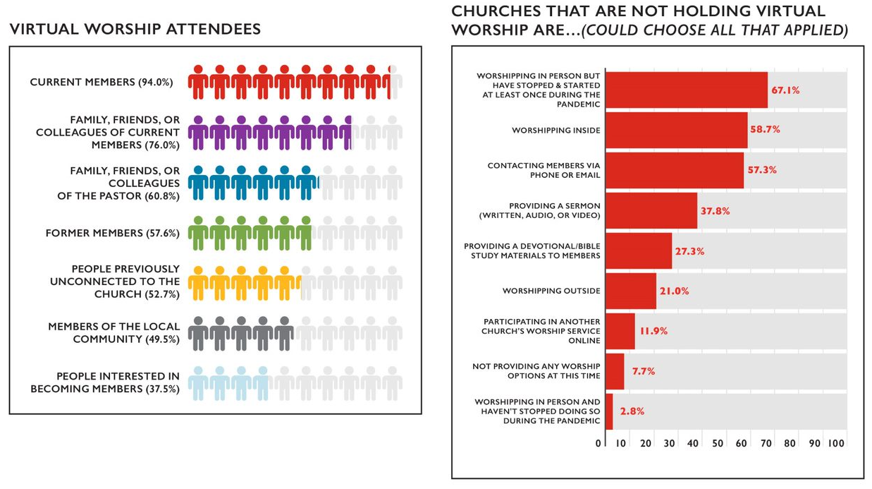
The COVID-19 Pandemic and the Church
Notes:
Virtual worship has enabled congregations to welcome new people to their church as well as reconnect with people whom they haven’t seen in awhile. Among churches holding virtual worship, nearly all congregations (94.0%) reported that current members attended their services. In addition, family, friends, and colleagues of current members (76.0%) as well as family, friends, and colleagues of the pastor (60.8%) also commonly attended congregations’ online worship services. Over half of congregations (52.7%) reported that people previously unconnected to their church were attending their online worship services, suggesting that virtual worship may be a way many congregations can and are engaging in outreach.
While virtual worship has become popular during the pandemic, not every congregation chose to or had the opportunity to offer it. Among congregations who have not offered virtual worship, some have continued to offer in-person worship while others have engaged in a variety of alternatives to virtual worship for being the church amidst a pandemic.

Slide 33
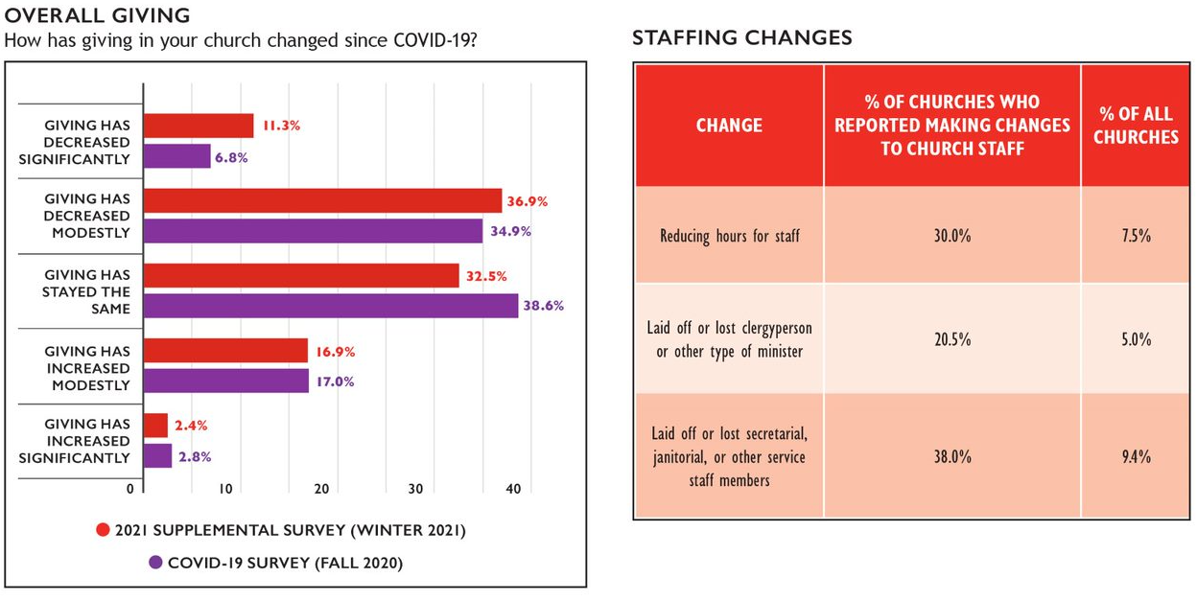
The COVID-19 Pandemic and the Church
Notes:
The pandemic has had a variety of financial implications for congregations. In the 2021 supplemental survey, nearly half (48.2%) of congregations reported that their giving has decreased modestly or significantly, which is an increase over the first COVID-19 survey where 41.7% of congregations reported the same. Nearly 1 in 5 congregations (19.3%) have reported that giving has increased modestly or significantly since the beginning of the pandemic, however, suggesting that the pandemic has had very different financial impacts for different congregations.
Among the results of these financial difficulties for some congregations have been changes in staff and having to dip into endowments. 25.6% of congregations reported having to make changes to church staff as a result of the pandemic, whether a reduction in staff hours or having to cut positions entirely. 13.0% of churches reported having had or planning to dip into their endowments as a result of COVID-19 hardships; 52.5% reported they did not and did not plan to, 19.1% reported not having an endowment, and 15.4% reported they were unsure. Among congregations that reported withdrawing or planning to withdraw from their endowments, the median percentage was 5%.

Slide 34
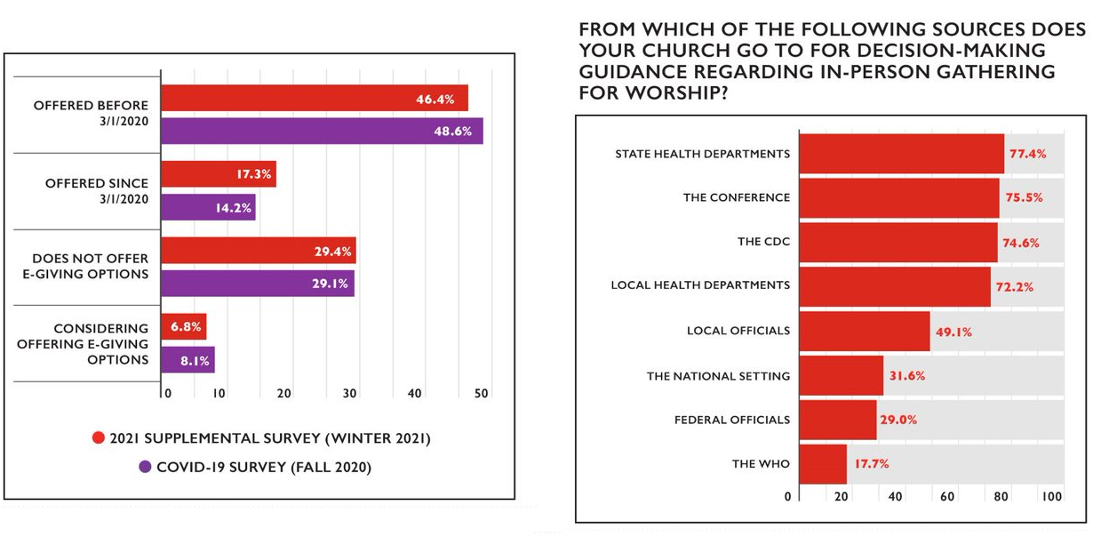
The COVID-19 Pandemic and the Church
In-Person Worship Practices
Electronic Giving
Notes:
As congregations have been unable to gather in-person for worship or have felt unsafe passing plates during an in-person worship service, electronic giving has been a way for people to contribute financially to congregations amidst meeting restrictions and safety concerns. Nearly half of congregations offered electronic giving options before the pandemic, and now nearly two thirds of congregations (63.7%) offer electronic giving. Interestingly, these numbers have not changed much between the two surveys asking COVID-19-related questions, suggesting that churches that adopted online giving as a result of the pandemic did so early on. Congregations who offered electronic giving options were asked to name what platform they used for this offering and most commonly named Vanco (including Realm), Tithe.ly, PayPal, Venmo, and the church or conference website.
For churches that continued to hold or resumed in-person worship during the pandemic, a wide variety of decisions had to be made. Congregations most frequently sought guidance from state health departments, their conference, the CDC, and local health departments. Notably, three quarters of congregations mentioned seeking guidance from their conference offices, underscoring the particularly important role Conference offices have served for congregations during the pandemic. Congregations also reported seeking information from a state level council of churches, congregants/friends/etc. who have training in public health, a non-expert congregational team, other state-level officials, and other external public health or medical experts.

Slide 35
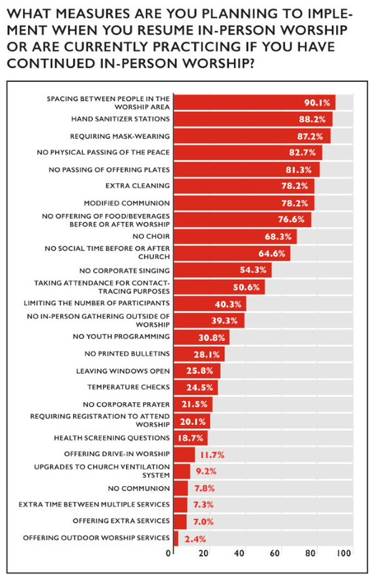
The COVID-19 Pandemic and the Church
Notes:
Throughout the pandemic, congregations have not only faced decisions about whether and when to hold in-person worship, but also under what conditions. Congregations have reported implementing a variety of practices to curb the spread of COVID-19, particularly spacing people in the worship area, including hand sanitizer stations, requiring mask-wearing, not physically passing the peace, and not passing offering plates.

Slide 36
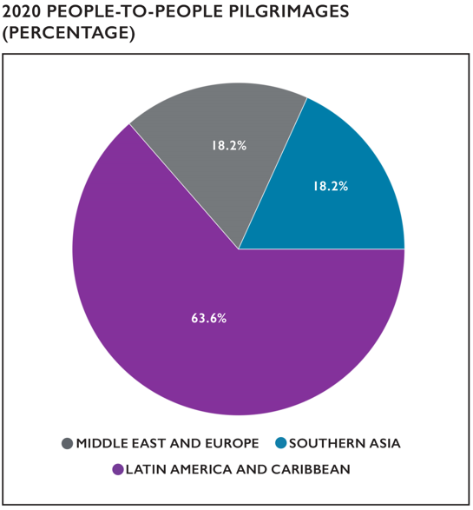
SPECIAL REPORT: PEOPLE-TO-PEOPLE PILGRIMAGE PROGRAM
Notes:
Contributed by: Lorna B. Hernández, Director, Global Ministries
The People-to-People Pilgrimage Program encourages and assists congregations, regions, conferences, and other related organizations of the Christian Church (Disciples of Christ) in the United States and Canada and the United Church of Christ in the United States to live out Global Ministries’ mission of receiving and sharing the Good News of Jesus Christ by joining in person with international partners in their work for justice, reconciliation, and
peace. Mission pilgrimages are transforming experiences through which participants receive and share God’s love while walking with international partners, sharing their joys, and understanding their challenges.
PILGRIMAGES
Eleven (11) pilgrimages were successfully organized and carried out between January 2020 and February 2020. These pilgrimages took place in the areas shown in the chart on this page.
COVID-19
The Program experienced a direct impact from the pandemic of the novel coronavirus, and carefully monitored its development while recognizing the health and safety of international partners and pilgrims as its priority. With a sense of great responsibility and following Jesus’s commandment to “love your neighbor as yourself,” the Program decided to postpone all pilgrimages scheduled from March 2020 through December 2020.
VIRTUAL PILGRIMAGES
The Program remains strong in its commitment to bringing people together to love and support one another as God’s children, and new opportunities for virtual pilgrimages developed as alternatives to traditional, in-person pilgrimages. Two virtual pilgrimages were offered in 2020:
Virtual Pilgrimage to Cuba—released as a series of videos to be enjoyed individually or used in groups.
Virtual Pilgrimage for Peace in Colombia—took place in September 2020 (around the International Day of Peace) with participants from the Pacific Northwest Conference and Northern Lights Region.

Slide 37
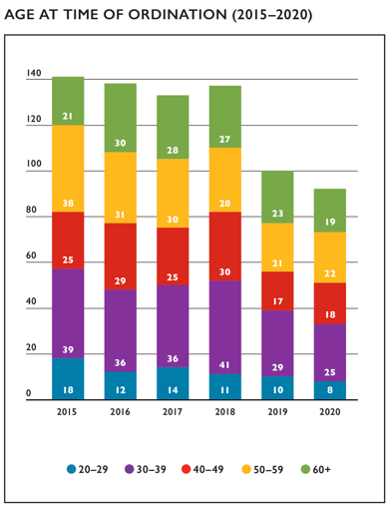
SPECIAL REPORT: WHO IS BEING ORDAINED IN THE UCC?
Notes:
Contributed by the Rev. Elizabeth Dilley, Minister and Team Leader, Ministerial Excellence, Support and Authorization (MESA) Ministry Team
Questions occasionally crop up about an assumed “clergy shortage” in the United Church of Christ. While there is much evidence against this, even a casual read of the UCC’s 2019 Statistical Profile reveals that something close to 51% of the UCC’s active clergy are over the age of 60 and that only 8.2% of our clergy are under the age of 40. Yet the number of authorized ministers has remained relatively steady. That raises the question: who is coming into ordained leadership in the United Church of Christ in order to serve the Church into the future? Data on those ordained between 2015–2020 provided
a wealth of information about who is entering ministry in the denomination. During those years, 832 people were ordained to ministry in and on behalf of the UCC, and ordinations took place in every Conference during this time except the Calvin Synod.
AGE-RELATED DATA
The UCC Data Hub has age-related information on 741 (89%) of those ordained. Readers may be surprised to learn that a plurality (27.8%) of ordinands in the UCC between 2015-2020 were between the ages of 30 and 39. Not only that, but 37.6% of those ordained were under the age of 40. After those younger than 40, the most frequent age group of those being ordained lies between 50 and 59 (22.9%). Seventy-nine percent of all active clergy in the UCC are over the age of 50, but this age cohort makes up just 42.8% of those ordained during this time period. Essentially, the pipeline
for ministry in the UCC includes people of all ages.

Slide 38
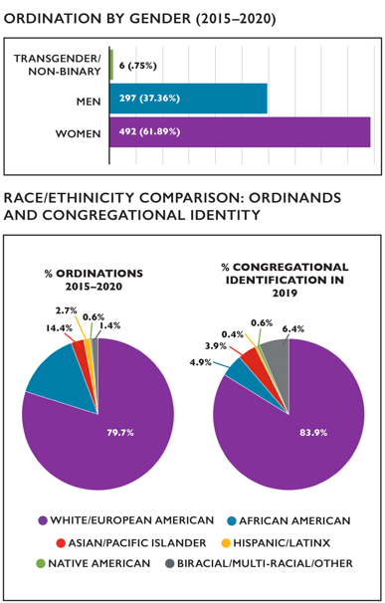
SPECIAL REPORT: WHO IS BEING ORDAINED IN THE UCC?
Notes:
GENDER-RELATED DATA
Among the recent ordinands for whom the UCC has gender data 795 (95.5%) individuals, 492 (61.8%) were women, 297 (37.3%) were men, and 6 (<1%) were transgender or non-binary. This information is unsurprising: the gender gap between men and women clergy closed in 2018, and women now make up 52.5% of all ordained ministers in the UCC. The increase in transgender or nonbinary clergy is also heartening for a denomination whose commitments to the full inclusion of LGBTQ+ members and ministers has deepened over the preceding five decades. That said, given the way the UCC currently collects gender-related data, there is reason to believe this estimate is also low: because trans men are men and trans women are women, they may identify along the gender binary during data collection rather than “transgender/
non-binary.”
RACE & ETHNICITY-RELATED DATA
The United Church of Christ has race/ethnicity data on 587 (70.5%) of the individuals ordained between 2015 and 2020. By far, the largest group of ordinands are White/European Americans—who constitute 468 (79.7%) of the aforementioned individuals. Black/African Americans constitute 85 (14.4%) of ordinands, whereas Asians/Pacific Islanders 16 individuals (2.7%), Hispanics & Latinx 8 individuals (1.3%), and biracial/multiracial or other ethnic groups included 4 individuals (<1%), respectively. Additionally, the United Church of Christ ordained 2 Native American individuals during
this time period—only 0.3% of ordinands. The chart compares the race/ethnicity of recent ordinands with the congregational self-identification of churches from the most recent Statistical Profile. Our ministers are more racially diverse than ever, but this data shows that many clergy of color are likely to serve in a cross-cultural context. While it is worth celebrating that the United Church of Christ is lifting up and ordaining leaders to reflect the church we hope to become, it is the work of our congregations to create spaces where pastoral leaders can work without facing constant microaggression and ongoing racialized trauma.
A FEW FUN FACTS
The oldest ordinand between 2015 and 2020 was 78 at the time of ordination; the youngest was 25.
The National Setting began tracking transgender/non-binary clergy in 2013; the first report listed 10 transgender/non-binary ministers. This report adds significantly to that total.
There were just 98 ordinations recorded in 2020 (as of the writing of this report). This is the second year of precipitous decline in ordinations. That said, the COVID-19 pandemic quite possibly contributed to this small number. MESA and CARDD will continue to assess whether 2019 and 2020 were irregular or the start of a trend.
Newly ordained clergy make up about 2.5% of the overall “active clergy” population in the UCC every year.
SOME CONCLUDING THOUGHTS:
The question of who is being called into ordained leadership in the United Church of Christ is but one facet in the broader concerns of
congregational health, building racially and sexually just communities for members and employees (including pastors), and overall long term
congregational viability. While pastors certainly play a role in leading congregations, everyone involved in the congregation must do
the work needed to live into a just world for all. Given this data, however, we can have confidence that there are sufficient ministers who
are called and equipped to support this work with our churches.

Slide 39
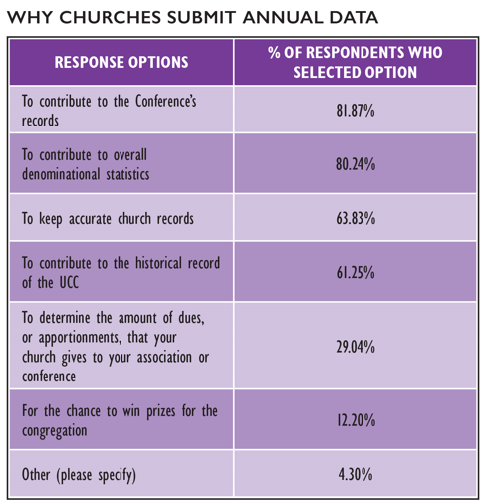
SPECIAL REPORT: YEARBOOK DATA SUBMISSION
Notes:
Contributed by: Erica Dollhopf, Ph.D., Director of the Center for Analytics, Research & Development, and Data (CARDD)
Every year, the CARDD office conducts a collection of our congregations’ annual data, which is published in the Yearbook and Directory and is also available in real-time on AccessUCC. Just under 60% of congregations contribute to this yearly effort. CARDD recognizes that the process to compile and submit church data requires time and effort for every church and we are deeply grateful for this data that enables us to analyze and share trends
within the UCC, many of which we publish here in the Statistical Profile. As part of the 2020 data collection, CARDD asked congregations questions about the data submission process through our annual supplemental survey so that we can better understand and support our congregations who are preparing and sharing this vital information with our office.
First, we were interested to learn why churches submit their data each year. The two most popular answers were “To contribute to the Conference’s records” (81.9%) and “To contribute to overall denominational statistics” (80.2%), suggesting that churches submit data in large part to help their Conference office and the National Setting keep track of long-term trends in our denomination.
The next two most popular answers were “To keep accurate church records” (63.8%) and “To contribute to the historical record of the UCC” (62.3%), which continues the theme of churches wanting to help maintain records, both internally and as part of the wider church.
Next, we asked congregations about the person who usually submits their church’s Yearbook data. The most common answer was the church administrator (43.2%); the next most common option was “Other (please specify),” in which churches frequently named a treasurer, secretary, or clerk as the one responsible for data submission. Just about one fifth of congregations reported that their pastor submitted the annual data for the Yearbook (19.7%), suggesting that Yearbook data is most commonly submitted by
people in non-pastoral leadership roles.

Slide 40
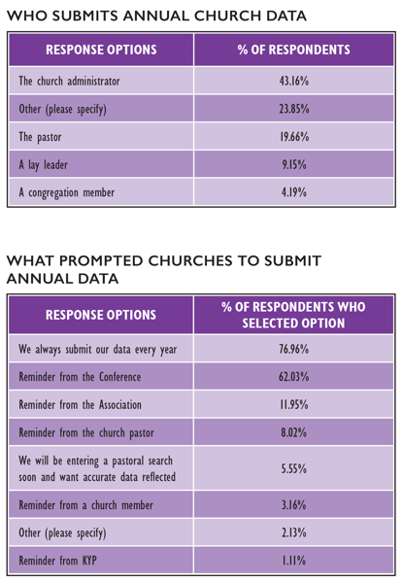
SPECIAL REPORT: YEARBOOK DATA SUBMISSION
Notes:
Finally, we asked what prompted the church to submit their Yearbook data in this particular year. Congregations could select all options that applied to them. The most popular response was “We always submit our data every year,” which suggests that congregations in the habit of submitting their data continue to submit their data. The second most popular answer was “Reminder from the Conference,” indicating that an email, web announcement,
or phone call from the Conference commonly prompted Yearbook data submission for congregations. The remaining response options were much less frequently selected (under 12%), which highlights the critical role our Conference offices have in facilitating the annual Yearbook data collection process, for which CARDD is most grateful!
While these questions are not exhaustive, they give some insight into the Yearbook data collection process. In addition to helping to maintain records, currently and historically, at the local, Conference, Association, and National Settings, submitting Yearbook data also helps congregations to cultivate their covenantal relationships, gives congregations voice through determining the number of delegates a Conference can designate for General Synod, and provides verification for churches seeking loans through the Church Building & Loan Fund or Cornerstone Fund—among many other benefits. CARDD’s “12 Important Reasons to Report Annual Church Data” describes these and many other reasons annual submission of church data is so valuable for congregations as well as the wider church.
CARDD continues to be thankful for the work of our congregations to help us tell the story of the UCC through our research and we hope to simplify the data submission process for congregations every year.
HTTPS://WWW.UCC.ORG/WP-CONTENT/UPLOADS/2021/01/12-IMPORTANT-REASONS-TO-REPORT-ANNUAL-CHURCH-DATA-UPDATED.PDF

Slide 41
SPECIAL REPORT: OUR WHOLE LIVES/SEXUALITY AND OUR FAITH
● The quarterly Our Whole Lives newsletter is distributed to
760 people—up from 600 at the beginning of 2020
● Monthly Our Whole Lives webinars, began in May 2020:
● Topics have included:
● Gender and Related Language
● Racial Justice
● K–1 OWL Revisions
● Gender-Based Violence
● Monthly Our Whole Lives webinars, began in 2021:
● Topics have included:
● Intimacy During a Pandemic
● Parents and Caregivers as Sexuality Educators
● Selecting OWL Facilitators
● Trauma-Informed Sexuality Education
● Consensual Non-Monogamy and Faith
● The number of attendees varied from 50–200 per live
webinar with a total number of views for the 2020
webinars of 929
● Special initiatives begun in 2020:
● Black, Indigenous and People of Color (BIPOC) review of
Our Whole Lives curriculum
● OWL Training online planning
● Revisions-in-process:
● 2nd edition of Grades 10–12 material in developmental
editing
● 2nd edition of K-1 material ready to field test
● 2nd edition of Young Adult material being drafted
Notes:
Contributed by Amy Johnson, UCC Minister for Sexuality Education and Justice
Our Whole Lives & Sexuality and Our Faith are developed and maintained by a partnership between the United Church of Christ and the Unitarian Universalist Association. We work together to create and update curricula, train, and equip approved trainers to train facilitators, and create and update the training process. Due to shutdowns caused by the COVID-19 pandemic, Our Whole Lives trainings were not held from mid-March through December 2020. To provide support to both trainers and facilitators of Our Whole Lives, the following projects were initiated:
THE MONTHLY WEBINARS HAVE BEEN RECORDED AND CAN BE ACCESSED HERE:
HTTPS://WWW.YOUTUBE.COM/PLAYLIST?LIST=PL6VGFHT6ZEY7N42HGL14BECQH_85CBQA6

Slide 42
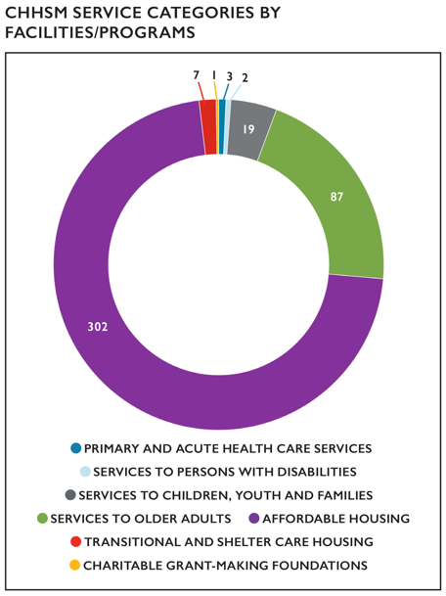
SPECIAL REPORT: DATA HIGHLIGHTS ON THE COUNCIL FOR HEALTH AND HUMAN SERVICE MINISTRIES (CHHSM)
Notes:
Contributed by Paula Baker, Senior Executive Assistant for Events and Administration
Each year, we catalog the abundance of resources that CHHSM’S 69 corporate members have to do the healing and service ministry of Jesus Christ, through 431 facilities and programs affiliated with the United Church of Christ.
In 2020, CHHSM ministries:
Served 2,841,862 individuals including: 21,490 children; 19,710 youth; 16,498 families; 33,5812 older adults; 3,717 veterans; and provided community-based ambulatory health care to over 2.2 million people.
Operated 34,421 residential units including: 21,167 affordable housing units; 10,035 independent living units; and 3,219 assisted living units.
Operated facilities with 6,523 beds providing acute, skilled nursing, and memory care.
Provided residential and non-residential services to over 350 people with developmental disabilities.
Provided 370,275 hours of volunteer service.
Provided $1 billion for uncompensated and charity care.
Received $60.3 million in charitable contributions.
Expended $13.7 billion for operations with revenues of $14.4 billion, and
Maintained capital assets with a replacement value of $15.7 billion.
Employed 88,544 people.

Slide 43
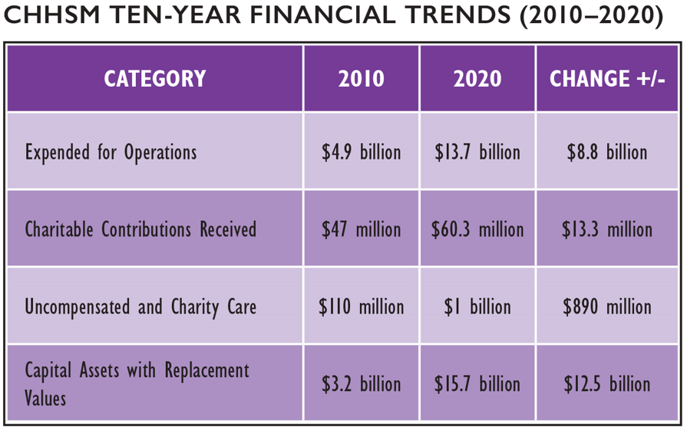
SPECIAL REPORT: DATA HIGHLIGHTS ON THE COUNCIL FOR HEALTH AND HUMAN SERVICE MINISTRIES (CHHSM)
Notes:
FINANCIAL TRENDS
Over the last decade, CHHSM organizations saw an increase in all financial categories. Keeping in trend with previous decadal data, uncompensated/charity care totals increased significantly by $890 million from 2010 to 2020. Also noteworthy is the $13.3 billion dollar increase in charitable contributions received in the same timeframe.
TO LEARN MORE ABOUT CHHSM, ITS MEMBERS AND SERVICES VISIT THE WEBSITE WWW.CHHSM.ORG AND FACEBOOK HTTPS://WWW.FACEBOOK.COM/CHHSM/
TO SEE THE MOST RECENT ANNUAL REPORT: HTTPS://WWW.CHHSM.ORG/ABOUT/ANNUAL-REPORT/

Slide 44
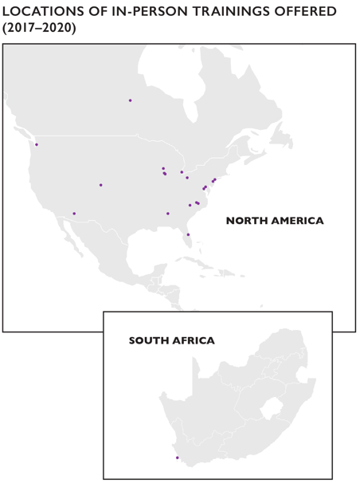
SPECIAL REPORT: RACIAL JUSTICE MINISTRIES AND ANTI-RACISM OPPORTUNTIES OF ENGAGEMENT
Notes:
Contributed by Velda Love, UCC Minister for Racial Justice, Justice and Local Church Ministries
Racial Justice Ministries supplies multiple opportunities for denominational staff, local churches, conferences, and associations, and affiliated UCC partners to enter dialogue, advocacy, and activism toward dismantling racism. Anti-racism work involves an inward interrogation of biases, prejudices, internalized White supremacy and internalized racism beliefs, and overt racist behaviors. The approach to anti-racism engagement invites participants
to learn within community settings the impact of 500+ years of structural racism resulting in government policies, institutional acts of injustice, and individual acts of harm and violence toward communities of predominately African, Asian and Pacific Islander, Latinx, and/or Native descent.
Racial Justice Opportunities of Engagement are available, such as:
Sacred Conversations to End Racism annual facilitator training
2-day intensive workshops
5-week intensive bi-annual anti-racism workshops
Churchwide book reads and discussion
Trainings and other opportunities for anti-racism engagement were offered across the United States, Cape Town, South Africa, and Manitoba, Canada.

Slide 45
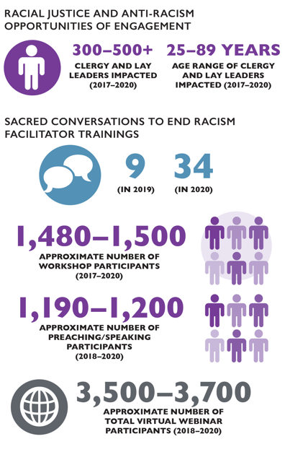
SPECIAL REPORT: RACIAL JUSTICE MINISTRIES AND ANTI-RACISM OPPORTUNTIES OF ENGAGEMENT
Notes:
Settings for Virtual Sacred Conversation to End Racism Trainings and Workshops in 2020:
St. Louis Association UCC, St. Louis, MO
Southwest Association UCC Fall Gathering, MI
Pension Board and Governing Board UCC
First Community Church, Columbus, OH
Heartland Conference UCC, Faith Formation, Worthington, OH
Summer and Fall 2020 Sacred Conversations to End Racism (SC2ER) Institutes
United Methodist Women’s Conference
2020 Zoom Webinars:
Juneteenth 2020—between 1800-2000 participants
Ahmaud Arbery—between 1000-1500 participants
4-Part Advent Faith Based Community Organizing—150 participants per week

Slide 46
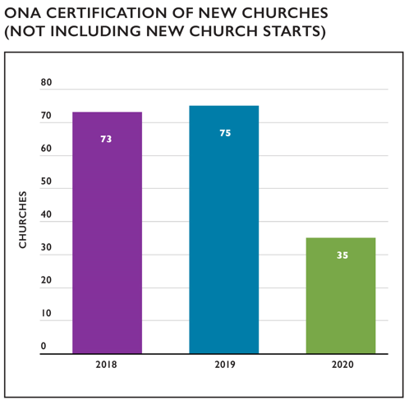
SPECIAL REPORT: OPEN AND AFFIRMING COALITION PARTNER PRIORITIES
Notes:
Contributed by Andy Lang, Executive Director
The number of Open and Affirming (ONA) churches in the UCC continues to grow at a steady rate. As of March 1, 2020 (our last report), the Coalition reported a total of 1,668 congregations have been assigned ONA numbers since 1985. As a result of database reconciliation, and our new practice of assigning ONA numbers to new church starts, the official number of ONA certifications stands at 1,714 as of this report. Factoring in congregations that
have closed or merged in the past 36 years, there currently are 1,630 active ONA churches in the UCC—including 12 new church starts.
In the past year, we have certified a monthly average of one to two newly ONA churches and other settings. This is a significant decline from previous years (when the average was one to two new ONA congregations every week) and is principally the result of churches that paused their ONA process during the pandemic. As most of these congregations resume the ONA process, we expect a return to the previous rate of growth over the next 12 to
18 months.
Approximately 34.0% of UCC congregations are currently Open and Affirming. On the one hand, this means we are the largest and fastest-growing LGBTQ-affirming church movement in the world. On the other, it underscores our priority to expand our reach until most UCC congregations have adopted ONA covenants.
Congregations in rural communities have become an important part of our growing edge. Churches that five or ten years ago would not have imagined affirming their LGBTQ+ neighbors are now engaging in the conversation with the Coalition’s support. Among these are UCC congregations in Sheridan, WY and Red Lodge, MT—both of which the Coalition certified as ONA over the past year.
Our expanding webinar series has become a decisive tool for our movement’s growth both to support congregations through the ONA process and to help existing ONA churches renew and deepen their commitment(s). When the pandemic made it impossible for Coalition staff to travel, we already had an established program of webinars to meet the needs of local churches. In the past year, the number of topics we offer has increased to seven
with a wide range of topics covered: from best practices for the ONA process which may reduce the risk of conflict to intensive education on gender identity and expression. These webinars are offered at least twice per year.
Topics covered in 2020-2021 were:
ONA 101
ONA 201
ONA and the Bible
Beyond Binary
Transgender/Nonbinary 201
Gender and the Bible
Bisexuality/Pansexuality
One-to-One Conversations about ONA
Other topics, including best practices for ONA advocacy, will be introduced in 2021–2022. This subject is critical as a wave of new state laws threaten transgender youth and legal protections against discrimination are undermined by “religious exemptions.”
We continue to fund this movement through direct member support, grants, and product sales. The national ONA program receives no regular budgetary support from OCWM, although we work in close partnership with national ministry teams and the
National Setting provides indirect support in many ways. The Coalition’s governing body is our Leadership Team. Members include seven UCC pastors, one seminary professor, one community partner, and the Rev. Michael Schuenemeyer, who serves ex officio on behalf of the National Setting. Leadership Team and staff are currently 64% non-Hispanic White, 36% Black, Latinx, or of mixed race or ethnicity (e.g., White/American Indian). Furthermore, 92% of our leadership/staff identify as LGBTQIA+, including one or more members of the following identities: gay, lesbian, bisexual, transgender, two-spirit, and asexual. Additionally, 21% of the leadership/staff live with a diagnosed disability.
As we prepare for the future, 2022 will be the Coalition’s 50th Anniversary. Celebrating the legacies of courageous leaders who founded and led our movement over the past five decades will be a focus of the National ONA Gathering next year. As we enter the next 50 years of our history, we expect strong growth for our movement—not only in numbers, but also in passion for living out the Gospel in ways that bring new life to the United Church of
Christ.
TO FOLLOW OPEN AND AFFIRMING NEWS, PLEASE SUBSCRIBE TO OUR RIPPLES NEWSLETTER AT HTTPS://OPENANDAFFIRMING.ORG/NEWS/SUBSCRIBE/
AND FOLLOW US ON FACEBOOK AT HTTPS://FACEBOOK.COM/UCC.COALITION.

Slide 47
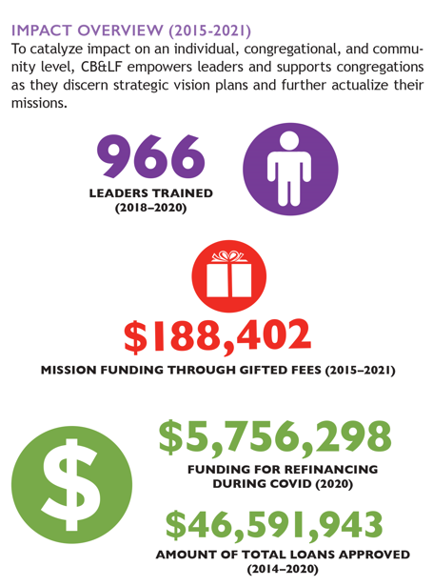
SPECIAL REPORT: CHURCH BUILDING & LOAN FUND: LONGSTANDING COMMITMENT TO TRANSFORMATION
Notes:
Contributed by Church Building & Loan Fund
ABOUT THE UNITED CHURCH OF CHRIST CHURCH BUILDING & LOAN FUND
Established in 1853 to advance a progressive Christian vision and mission, the United Church of Christ Church Building & Loan Fund (CB&LF) is the oldest institution of its kind. The vision of CB&LF is to reinvent the concept of “church” by equipping church leaders to advance the Gospel mission through innovative uses of buildings and space created through unique partnerships, inventive church operating models, revenue-generating, faith driven enterprises and the application of impact-driven metrics. CB&LF hopes to realize this vision by assisting new and renewing UCC congregations and other Christian congregations whether they are buying their first church building or renovating existing church-owned, UCC mission-advancing real estate. CB&LF helps churches plan, raise, finance, and build transformative projects through loan programs, capital campaigns, training programs, and
consulting services. Specific programs include Partners in Vision (PIV), the Adese Fellowship, Visioning/Strategic Planning, loan programs for repurposing/redevelopment, affordable housing on church property, and other church real estate projects. In turn, the congregations served by CB&LF impact their local communities by seeking to increase the economic, social, environmental, and spiritual vitality of their neighborhoods.

Slide 48
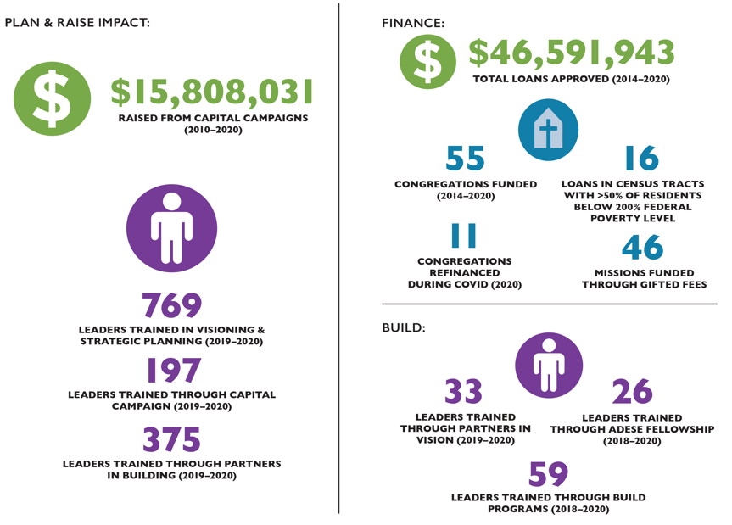
SPECIAL REPORT: CHURCH BUILDING & LOAN FUND: LONGSTANDING COMMITMENT TO TRANSFORMATION

Slide 49
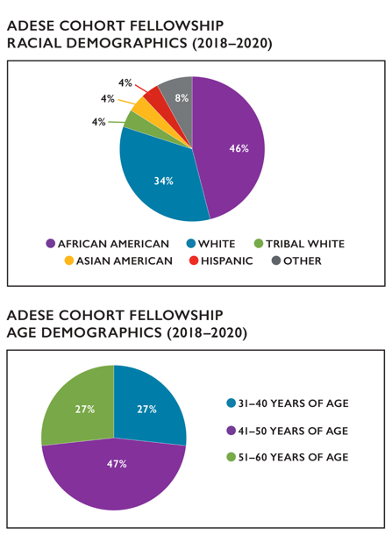
SPECIAL REPORT: BUILDING TRANSFORMATIONAL LEADERS & INNOVATIVE CHURCH REAL ESTATE PROJECTS
Notes:
Contributed by Church Building & Loan Fund
ADESE FELLOWSHIP
The Adese Fellowship is a year-long program that engages participants seeking to advance a concept or early-stage venture. This groundbreaking fellowship maximizes the business acumen and entrepreneurial capacity of participants to launch scalable and sustainable ventures that counter systemic poverty. Thoroughly collaborative, Adese Fellows confer with leaders in church, the academy, and business to explore how the church can create social, spiritual, and economic value. Between 2018 and 2020, our 26 Adese Fellows produced 19 new ventures.
Goal: Maximize business acumen and entrepreneurial capacity
Operation: Advance concepts of early-stage ventures via a yearlong business development program
ADESE COHORT FELLOW DEMOGRAPHICS
Adese welcomes and leverages differences. The charts show that, between 2018 and 2020, the Adese Fellowship trained a diverse, predominately African American, female, and clerical cohort of participants between ages 41 and 50. Fellowship participants represent clergy and laypeople, rural
and urban locations, and report varying identities related to age, race, ethnicity, and ability. Ultimately, the Adese Fellowship desires that participants share a common passion to engage at intersections—specifically, the intersection of faith and enterprise—
to create impact.

Slide 50
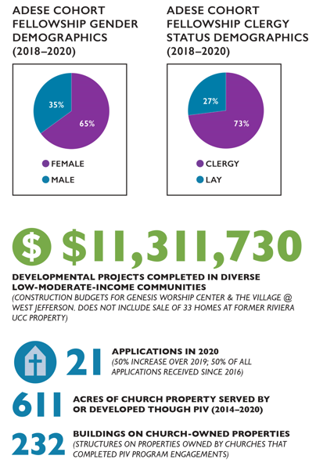
SPECIAL REPORT: BUILDING TRANSFORMATIONAL LEADERS & INNOVATIVE CHURCH REAL ESTATE PROJECTS
Notes:
PARTNERS IN VISION
Our Partners In Vision (PIV) program offers planning and consulting services for major projects involving church property. We help churches create resourceful, sustainable, creative, and mission focused plans. Additional assistance is provided through project management, pre-development, and repurposing unused or underused church owned property. Our goal is to strategically plan complex projects and chart a course for real estate in transition.
GOAL: Provide technical assistance to major church real estate projects
OPERATION: Propel church real estate projects through partnership and resources connection
The total acreage of reported church property served by or developed through Partners in Vision (PIV) encompasses 5 completed projects:
1. United Methodist Women—475 acres of property/216 buildings in 23 states & 2 US territories, 2-year consulting engagement to create strategic approach to property management.
2. Franklinton Center Retreat on historic African American farmland—130 acres re-zoned for multiple uses/12 buildings.
3. Riviera UCC—5 acres re-zoned (clear land) and sold for family housing.
4. Genesis Worship Center—1/3-acre/2 buildings redeveloped as supportive housing for returning citizens.
5. The Village @ West Jefferson—½ acre mixed-used commercial/retail/office, 2 buildings.

Slide 51
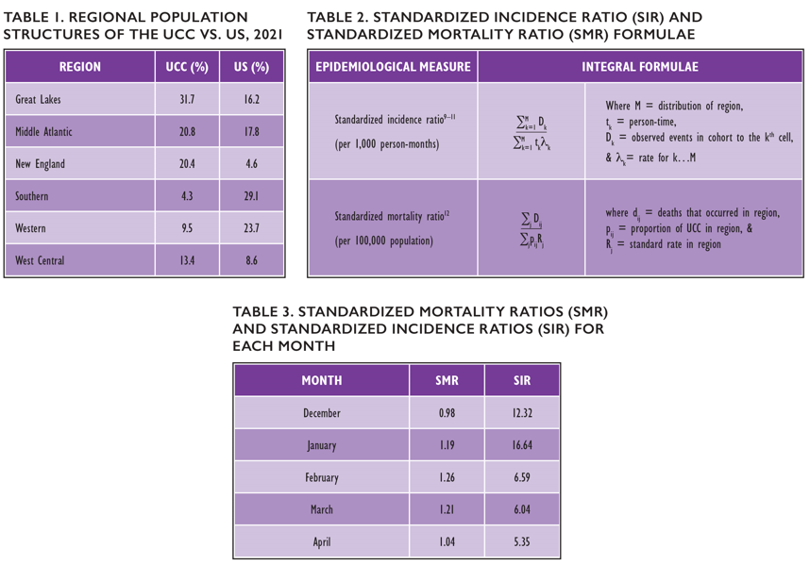
SPECIAL REPORT: THE HYPOTHETICAL EPIDEMIOLOGICAL IMPLICATIONS OF “BEING THE CHURCH”
Notes:
Contributed by Joshua E. Tucker, MPH, Data Analyst, Center for Analytics, Research & Development, and Data (CARDD)
As some Americans have gingerly reacclimated to pews, restaurants, and workplaces this past summer, hundreds of thousands of faces will be absent. An estimated 1,323 of the UCC’s own can be counted among the lost as of April 22.1,2 For context, that translates to roughly 1 death per 600 UCC members or 4.6% of the UCC’s net membership decline this year.3 While it is impossible to discount the toll of the COVID-19 pandemic, UCC clergy, leaders, and congregants must proactively keep in mind the following as they serve communities of today and tomorrow: infectious disease emergencies (e.g., the COVID-19 pandemic) are likely to grow in frequency as climate change progresses.4 In other words, the UCC, from the congregational to National Setting, will likely grapple with another public health emergency in the coming years or decades. Therefore, as we work to build and strengthen community amongst people of faith across the United States and the globe, we must consider the epidemiological implications of
“being the Church.” Using CDC data collected concurrent to the recent 2021 Supplemental Survey, a hypothetical, “what if” epidemiological portrait of the COVID-19 pandemic—specifically, of its mortality and case burden—in the US can be constructed for the UCC’s reflection.1,2,5
The spread, containment, and mitigation of pathogens such as SARS-CoV-2 are all dependent upon a population’s distribution.6,7 For example, hypothetical COVID-19 mortality—estimated with a tool termed the standardized mortality ratio (Table 2)—would have been 12% greater between 12/11/2020 and 4/17/2021 if the US population were distributed like the UCC’s membership. In other words, an additional 26,265 Americans—or an excess 17 Americans per 500 UCC members—would have died in such a hypothetical United States. Furthermore, though mortality would have been slightly diminished (-2%) in December, the hypothetical COVID-19 mortality rate would have been significantly greater
(+26%) in February than what was actually observed (Table 3). In contrast to hypothetical COVID-19 mortality, the incidence of COVID-19 (estimated with the standardized incidence ratio (Table 2)) would have been diminished in said hypothetical United States between 12/11/2020 and 4/22/2021. Whereas COVID-19 incidence would have been slightly elevated above what was observed during the span of March 1, 2020 to April 22, 2020, the number of Americans who caught COVID-19 would have been significantly reduced between December 11 and February 28.
In sum, this report demonstrates that the seemingly uncomplicated ongoing ambition of many churches to expand their reach into communities and bring new faces into churches—is not so simple with regard to public health. To “be the Church” is to be in community with one another. Therefore, “being the Church” is a matter of public health. Going forward, what are the steps we can take now to prepare for the next emergency? What does the Church have to say about public health? Although it is tempting to leave the answers to these questions to the future, “prevention is preferable to cure.”8
REFERENCES:
1National Center for Health Statistics. Weekly Provisional Counts of Deaths by State and Select Causes, 2020-2021. Published online 2021. https://data.cdc.gov/NCHS/Weekly- Provisional-Counts-of-Deaths-by-State-and-S/muzy-jte6
2U.S. Census Bureau, Generated by Joshua E. Tucker. ACS 1-Year Estimate - Public Use Microdata Sample (2019). Published online 2021. https://bit.ly/3fpR44W
3The United Church of Christ, Center for Analytics, Research & Development, and Data. 2021 UCC Yearbook & Directory. Published online 2021:6.
4Watts N, Amann M, Arnell N, et al. The 2020 report of The Lancet Countdown on health and climate change: responding to converging crises. Lancet (London, England). 2021;397(10269):129-170. doi:10.1016/S0140-6736(20)32290-X
5CDC Case Surveillance Task Force, Lee B. COVID-19 Case Surveillance Public Use Data with Geography. Published online 2021. https://data.cdc.gov/Case-Surveillance/COVID-19-Case-Surveillance-Public-Use-Data-with-Ge/n8mc-b4w4
6Bhopal RS. Concepts of Epidemiology: Integrating the Ideas, Theories, Principles, and Methods of Epidemiology (3 Ed.). Oxford University Press; 2002.
7Gordis L. Epidemiology. Elsevier/Saunders; 2009.
8Lasagna L. Would Hippocrates Rewrite His Oath? Published online 1964. https://www.nytimes.com/1964/06/28/archives/would-hippocrates-rewrite-his-oath-after-2000-years-thegreek.html
9Aschengrau A, Seage GR. Essentials of Epidemiology in Public Health. Vol Fourth edi. Jones & Bartlett Learning; 2020. http://proxy.lib.umich.edu/login?url=http://search.ebscohost. com/login.aspx?direct=true&db=nlebk&AN=1862287&site=ehost-live&scope=site
10Day N, Breslow N. Rates and Rate Standardization. In: Heseltine E, ed. Statistical Methods in Cancer Research Volume II: The Design and Analysis of Cohort Studies. International Agency for Research on Cancer; 1987.
11Sahai H, Khurshid A. Statistics in Epidemiology: Methods, Techniques, and Applications. CRC Press; 1996.
12Coggon D, Barker D. Comparing disease rates. In: Epidemiology for the Uninitiated. 5th ed. BMJ Books; 2003.

Slide 52
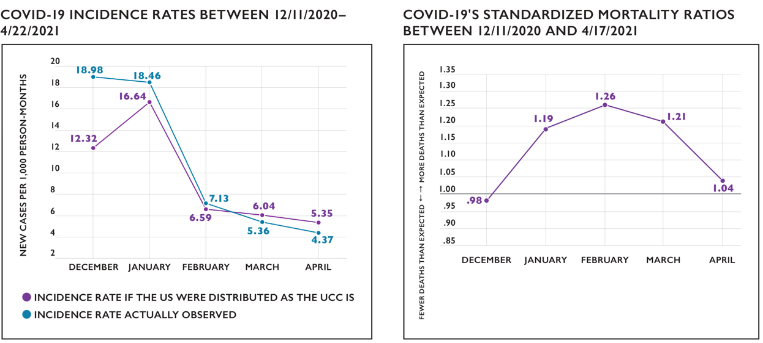
SPECIAL REPORT: THE HYPOTHETICAL EPIDEMIOLOGICAL IMPLICATIONS OF “BEING THE CHURCH”

Slide 53
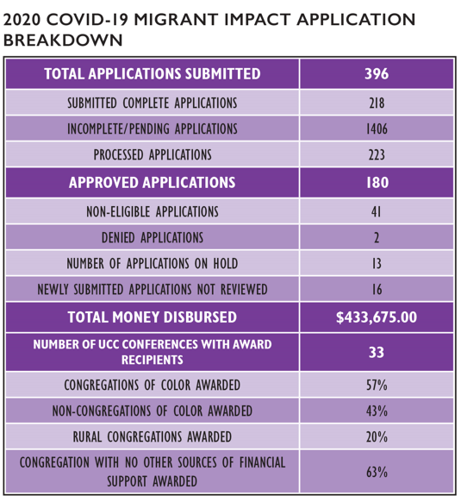
SPECIAL REPORT: COVID-19 MICROGRANT IMPACT REPORT
Notes:
Contributed by the Rev. Dr. Aaron Wade, Minister for Congregational Granting, Faith Education, Innovation and Formation (Faith INFO)
The prolonged impact of COVID-19 caused heightened economic challenge for many of our churches. The United Church of Christ’s National Setting and partners made available $2.6 million in grants and loans in 2020 for COVID-19 relief efforts. Of this collective resource, Justice and Local Church Ministries (JCLM) released $433,675 in microgrants for 2020 to meet the direct needs of congregations in response to COVID-19. These funds were made available by repurposing and redirecting established grant funding for one year toward these efforts.
We sought to allow recipients to use funds as they prioritized their own needs. Our goal was to release resources with the least amount of red tape toward directed initiatives while maintaining accountability for funds and integrity of donors’ intent. We granted congregations funds toward operational costs (e.g., staffing, rent/mortgage, etc.) and for community gardens. Grants ranged from $1,000 to $3,000. To ensure equity, three priority areas were identified: rural congregations, congregations of color and ethnic minorities, and congregations that had not obtained funding from any other source during the pandemic.
To this end, we were able to award 180 microgrants totaling $433,675. Of all awards made, 57% of the awards went to congregations of color, 20% to rural congregations, and 63% to congregations that had not received any other financial support from any other source.
Finally, we were able to offer support that had a meaningful impact on our congregations affected by the COVID-19 pandemic.
In closing, read the words of the Rev. Troy Sanders, the pastor of Rehoboth Fellowship of Atlanta, UCC, a 2020 COVID-19 grant recipient:
“During this pandemic, this grant afforded us the opportunity to provide an online weekly therapy support group with licensed professionals as a way to help our members cope with isolation, fear, and other issues that are triggered by COVID-19 and other social/ economic determinants of health. This grant literally helped to save one of our member’s lives.”

Slide 54
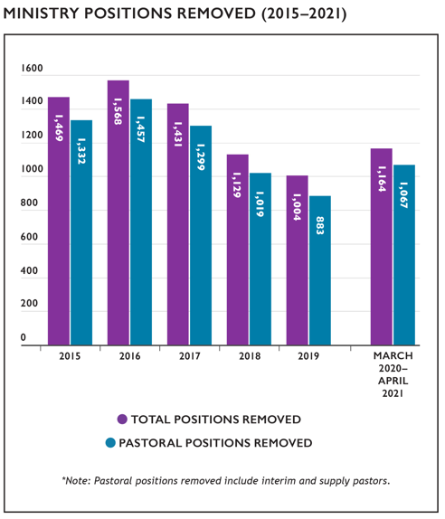
SPECIAL REPORT: THE PANDEMIC’S EFFECTS ON MINISTRY RESIGNATIONS
Notes:
Contributed by the Rev. Jeff Nelson, Minister for Ministerial Calls and Transitions, Ministerial Excellence, Support, and Authorization Team (MESA)
The COVID-19 pandemic’s potential effects on Search and Call have been a point of interest for national staff, Conference staff, and search committees. The profiles system and opportunities for Ministers and Ministry Settings have remained open throughout the pandemic, but some have raised concern that fewer candidates may elect to engage in the process during this time, or that the strain of ministering in this season may take so great a toll on those currently in ministry that a larger number of Ministers may leave their positions due to stress or burnout.
To analyze these possibilities, records of concluded pastoral positions were pulled from the UCC Data Hub from March 2020 through April 2021. For the purpose of comparison, the same variables were pulled from 2015 to 2019.
Several caveats apply for this analysis. First, the month in which a ministry position was recorded as ending in the Data Hub reflects when this information was logged by Conference staff and not necessarily when the position concluded. Second, the results could not be parsed out to account for retirements, position eliminations, deaths, and other factors.
This table shows the total ministry positions removed, as well as how many of those positions were specifically pastoral in nature (this second number includes interims and supply pastors). The graph breaks down how many positions were recorded each month from March 2020 through April 2021.

Slide 55
SPECIAL REPORT: THE PANDEMIC’S EFFECTS ON MINISTRY RESIGNATIONS
Notes:
On average, 1,198 pastoral positions were removed each year between 2015 and 2019. As of this report’s writing, the number of positions
that have been removed during the pandemic has been lower. So far, there has been no consistent trend since March 2020 to indicate that
a greater number of ministers have left their ministry settings during this season.
As vaccines become more widely distributed, ministry settings begin to return to in-person events, and ministers have more of an opportunity
to engage in discernment and self-assessment, the data collected this time next year has the potential to provide an interesting
comparison with current results.

Slide 56
SPECIAL REPORT: 2020 OCWM & DIRECTED GIFTS BY DONORS
Notes:
Contributed by the Rev. Kent Siladi, Director of Philanthropy, OPTIC
In 2020, the “Year of the Pandemic” was a year unlike any other in our lifetime. We are so grateful for the support from our donors who align with our mission and ministry in the National Setting. Our donors include individuals who make undesignated or designated gifts; our Conferences, who through their Basic Support Giving, pass along a portion of gifts from local churches; local churches who make direct gifts to the National Setting; and other
partners who support our work.
Donors are a vital part of our ministries at the National Setting. Each donor helps us carry out the vision, “United in Christ’s love, a just world for all.” As we move toward building a donor-centered approach to giving as outlined in the General Synod Resolution “A New Framework for Covenantal Giving and Implementing Fundraising Best Practices,” we are committed to building relationships with our donors and helping them align their passions with our various ministries.
Our Church’s Wider Mission (OCWM) are the monies that are received for Basic Support and the Four Special Mission offerings collected each year.
BASIC SUPPORT is the monies shared with the National Setting through the Conferences. Each Conference determines how much of the monies received from local churches will be retained by the Conference for its ministries and how much of the monies will be sent to the National Setting for its ministries. In the National Setting, Basic Support is applied across our covenanted ministries (Office of the General Minister and President, Wider Church
Ministries, Local Church Ministries, and Justice and Witness Ministries). In 2020, we received $4,432,348 for Basic Support.
SPECIAL MISSION OFFERINGS
ONE GREAT HOUR OF SHARING (OGHS) is the oldest Special Mission offering appeal. Taken during the Lenten season, OGHS supports the disaster, refugee, and development ministries within Wider Church Ministries. Across the globe, your support of OGHS is used to make a difference. During 2020 the appeal was lower than previous years as Lent coincided with the start of the pandemic stay-at-home order. In 2020, we received $1,153,038 for OGHS.
STRENGTHEN THE CHURCH (STC) offering reflects the shared commitment of people across the United Church of Christ to cooperatively build up the UCC. Conferences and the National Setting share the gifts given by members and friends through their local congregations equally. The funds raised support leadership development, new churches, youth ministry, and innovation in existing congregations. The recommended date for receiving this offering is Pentecost Sunday. In 2020, we received $208,499 for Strengthen the Church.
NEIGHBORS IN NEED (NIN) is a special mission offering of the United Church of Christ that supports ministries of justice and compassion throughout the United States. One-third of NIN funds support the Council for American Indian Ministry (CAIM). Two thirds of this offering is used by the UCC’s Justice and Witness Ministries (JWM) to support a variety of justice initiatives, advocacy efforts, and direct service projects through grants. It is often received on World Communion Sunday in October. In 2020, we received $837,506 for Neighbors in Need.
THE CHRISTMAS FUND (CF) has been caring for active and retired clergy and lay employees of the United Church of Christ for over 100 years. The Christmas Fund provides emergency grants, supplementation of small annuities and health premiums, and Christmas “Thank You” gift checks each December to our lower income retirees. The Christmas Fund for Veterans of the Cross is managed by the Pension Boards. In 2020, the Pension Boards
received $1,807,720.
Directed Giving by donors included support for:
Justice and Witness Ministries: $57,111
Local Church Ministries: $16,498
Office of the General Minister: $133,880
Wider Church Ministries (General Support and the USA and International Emergency Donations): $637,403
We have also participated in Giving Tuesday for the last five years and the 2020 Giving Tuesday appeal brought in $109,135 for
Refugee and Asylum Seeker support.
Finally, the UCC ANNUAL FUND are monies that are raised from donors for the work in the National Setting specifically. The Annual Fund makes two appeals per year; in 2020, donations totaled $455,601.
What is not represented in these annual giving numbers are the planned gifts (bequests) that have been made to the National Setting. We are grateful to those who have made a gift in their wills to support our ministries.
The total giving in 2020 was $9,888,739. When we come together to share our resources and express our generosity, we make a
tremendous impact. A huge thank you to all of our donors who supported the ministries of the National Setting in 2020.

Slide 57
SPECIAL REPORT: THE UCC 3 GREAT LOVES INITIATIVE
Notes:
Contributed by the Rev. Dave Sigmund, 3 Great Loves Ambassador, and Rev. Kim Whisler-Vasko, 3 Great Loves Coordinator
The 3 Great Loves initiative launched at General Synod in Baltimore in 2017 as a way to engage our denomination in a shared response to our newly crafted Purpose, Mission, and Vision statements. 3 Great Loves has been us, collectively as a united church, putting “hands and feet” to those statements. Living out our love for God, living and giving Christ’s love, and seeking to make a just world for all through the lens of 3 Great Loves: Love of Neighbor, Love of Children, and Love of Creation. 3 Great Loves shared the stories of how all of us are living out that love—God’s love—in missional, measurable, and meaningful ways.
Throughout the past four years, the 3 Great Loves team narrated and curated stories of how God’s love is embodied and incarnated in the work and faithful ministries across the breadth of the United Church of Christ in all its varied settings. It’s the Church at its best—from west to east, south to north, and spanning the globe. It was awe-inspiring to be entrusted with these stories and to hear about what your commitments of love have made possible in the world and in your communities. From sowing seeds to sewing masks; sharing food and fellowship; raising awareness, educating and empowering; from rural churches to suburban and urban churches; from a small knitting group to church-wide work projects; both before and during the pandemic, we have read stories of hope, inspiration, and immense joy.
Although the pandemic altered our lives in undeniable ways in 2020 and 2021, we bore witness to the creativity, resilience, and resound of the United Church of Christ as ministries adapted to continue to love God and serve others in the name of God’s love. 3 Great Loves has been a movement of divine love that has touched countless lives, and we extend our thanks for your profound and lasting impact.
As this phase of our shared missional initiative saw its sunset at the Special Edition 2021 General Synod 33, we heralded the dawn of a new chapter. All are invited to carry forward the 3 Great Loves as prisms within God’s proverbial kaleidoscope that reflects God’s light and love out into the world. Imagine the possibilities in the movement of God’s light and love through the turning of the wheel at the end of a kaleidoscope! So many shapes, sizes,
colors, and textures in motion create infinite patterns and possibilities. This has been a movement of God’s love. And that love has, can, and will continue to change the world. Continue to join in this movement of love and to embody the light and love God made known.
In 2020, 3 Great Loves:
Engaged the denomination in a tree planting campaign in honor of the 50th Anniversary of Earth Day in partnership with Environmental Justice Ministries as well as Global Ministries partners.
Provided continued engagement resources including: the 3 Great Loves Campaign Document which contained a vast array of resources for clergy and churches, the 3 Great Loves 2020 Stewardship Theme Materials, “Beloved, Love,” and the 3 Great Loves 2020 Advent Toolkit.
Received over 60,000 views and likes for 3 Great Loves video and image stories shared on social media platforms.
And since its inception in 2017 at General Synod 31 in Baltimore, MD, more than half of all UCC churches, representing all 38 Conferences, have participated in 3 Great Loves through faithful and lifegiving ministry. In 2020 that continued and included global locations from Botswana, Great Britain, Honduras, India, Israel-Palestine, and Kenya.
Thank you, United Church of Christ. It’s been a holy and humble honor. Keep on being love!

Slide 58
SPECIAL REPORT: UNITED CHURCH BOARD FOR MINISTERIAL ASSISTANCE, EMERGENCY GRANTS DISBURSEMENT JAN. 1–DEC. 31, 2020
Notes:
Contributed by: The Pension Boards–United Church of Christ, Inc.
The United Church Board for Ministerial Assistance (UCBMA), the philanthropic arm of the Pension Boards-United Church of Christ, operates
with a covenantal spirit as it:
provides direct financial support and compassionate responses to authorized ministers, lay church employees, and their surviving spouses/partners, in times of urgent need and personal crises.
administers and raises funds for leadership initiatives that promote faithful and fruitful ministry across the United Church of Christ.
In 2020, a total of 96 Emergency Grants totaling $214,649 were approved to assist clergy and lay employees in situations of financial hardship.
Of these, 41 grants ($81,426, or 43% of total emergency disbursements) were awarded to cover COVID-19-related hardship. Funds for the Emergency Grants program are made possible by contributions to the Christmas Fund for the Veterans of the Cross and the Emergency Fund—one of four Special Mission Offerings of the United Church of Christ.
Due to the COVID-19 pandemic, the amount disbursed in Emergency Grants in 2020 increased by 73.5% from 2019; to $214,649 in 2020 from
$123,727 in 2019.

Slide 59
SPECIAL REPORT: 2020 WASHINGTON D.C. OFFICE ACTION ALERTS
Notes:
Contributed by Jessica Quinn, Online Communications Specialist, D.C. Office
Each week, targeted action alerts are sent out to advocates across the country through the UCC’s Justice and Peace Action Network (JPANet). In 2020, 42 alerts were sent out on a wide range of issues. Advocates who took action through our system sent direct emails and tweeted to their elected
representatives using language written by UCC staff.
On domestic issues, 28 alerts were sent to the JPANet. Of those, the highest number of actions taken by advocates were on the topics of COVID-19 relief funding, justice in policing, and voting rights. An alert condemning the use of federal troops in Portland was the most acted upon by advocates;
2,182 advocates sent 6,919 emails and tweets to legislators. Additionally, alerts concerning the defense of democracy and a call for meaningful COVID-19 relief garnered 1,058 and 953 advocates, respectively. As the world grappled with the impact of the pandemic, cries arose across the country for racial justice and policing reform, and the UCC’s Washington, D.C. office rallied advocates during the pivotal 2020 elections with the Our Faith Our Vote Campaign, it was fitting these alerts generated the strongest response.

Slide 60
SPECIAL REPORT: GLOBAL MINISTRIES PARTNER PRIORITIES: 2020 ACTION ALERT ISSUES
Notes:
Contributed by Jessica Quinn, Online Communications Specialist, D.C. Office
In 2020, there were 14 alerts relating to global issues informed by our Global Ministries (UCC and Disciples) partners. Advocates who took action through our system sent email and tweet directly to their elected representatives using language written by UCC staff.
The issues which had the highest number of advocates were (1) urging the restoration of funding to the World Health Organization (WHO) amidst the COVID-19 pandemic, and (2) a call to end annexation and occupation of Palestine. Amidst the pandemic, it was clear advocates were concerned for
their neighbors at home and abroad. In addition to funding the WHO, advocates also took strong action in calling for the lifting of sanctions during the pandemic.

Slide 61
SPECIAL REPORT: INSURANCE BOARD’S CLAIM TRENDS & KEY TAKEAWAYS
Notes:
Contributed by: Insurance Board
As the pandemic ramped up in 2020, the Insurance Board experienced a disturbing spike in claim trends. Global changes in climate led to the most active U.S. Atlantic hurricane season on record with 30 named storms: just on the heels of the costliest four-year stretch of U.S. hurricanes in recorded history. Additionally, five of the largest California wildfires consumed more than 10.3 million acres in 2020. The year also yielded a continuing pattern of water damage claims among program participants. This year’s statistical report highlights some claim trends and the initiatives underway to help ministries mitigate their risk of financial insurance losses.
In 2020 there were a total of 18 fires, with 5 related to western wildfires. Seven of the fire claims were minimum $500,000.
Water damage claims amounted to $4.9 million and represented the most frequent type of claim reported in 2020; the average claim was for roughly $30,000. Insurance Board has paid more than $25,000,000 in water damage claims since 2015. Water damage claims are largely preventable, and include plumbing and appliance leaks, frozen pipes, sewer and drain back-ups, roof leaks, sprinkler leaks and discharges, etc. In an effort to mitigate the incidence of such claims, the Insurance Board introduced an early warning water sensor program that monitors and detects water leaks and conditions potentially leading to cause water intrusion such as unsafe drops in temperature. Many water damage claims resulted from and were exacerbated by deferred maintenance at insured church properties. Water damage claims add about $900 per church per year in insurance premiums. Reducing the incidence of water intrusion-related issues positively impacts insurance costs.
As a financial ministry, Insurance Board is committed to helping churches lower their risk. When one church has a massive claim, it affects all churches across the program. Whereas many claims are beyond the control of the insured, there are many claims that are preventable. Our goal is to help churches lower their risk for claims so that we can lower the cost of insurance for all of the participating ministries we serve.
In addition to fire, water, wind, hail, and abuse claims, Insurance Board has monitored claims related to COVID-19, slip, trip and falls, and employment practice liability claims.
To help with the challenges presented to churches as employers, Insurance Board’s policyholders have access to an exclusive resource through Insurance Board’s partnership with AIG and collaboration with Littler Mendelson. The EPL Pak® Premier is an industry-leading loss prevention resource available through https://www.eplriskmanager.com/. This is important considering Insurance Board saw a 31% increase in Employment Practices Liability claims. As churches continue to navigate a variety of human resource issues throughout the pandemic, Insurance Board is committed to providing resources that meet churches’ unique needs during these challenging times and beyond.
Imagine walking into a church building and finding a pipe burst or a bathroom flooded. Now the church is faced with the overwhelming task of cleanup during a pandemic, in addition to addressing the water damage. Twenty-one percent of all property losses in 2020, according to Insurance Board data were due to water damage. To help churches avoid and mitigate water losses, Insurance Board has partnered with HSB Connected Technologies to offer a valuable early warning system that uses the latest sensor technology. Now, churches enrolled in the water sensor detection program can detect water and monitor indoor temperatures that can help avoid a disruptive impact on ministries.
The majority of slip, trip, and fall claims in 2020 took place during the winter months of November through February. Many of the claims were preventable; for example, a fall on a sidewalk due to uneven pavement or ice/snow that was not removed. Such accidents can be prevented with proper maintenance and routine clearing of snow and ice. Regular walk-throughs can be conducted to make sure church property is kept in good condition. In order to provide a safe place for guests, it is important to consider the most common causes of slips and falls claims. Evaluation of church property and the removal of potential hazards can reduce the likelihood that someone will be injured on church property.
Insurance Board is committed to providing relevant and timely resources to ministries we serve. As a part of that commitment, Insurance Board partners with Praesidium, the Nation’s leading provider for abuse prevention, to offer our SafeConduct™ Workbench, a comprehensive toolkit to assist churches in developing a strong abuse prevention program. Churches can protect their ministry against the potential of abuse through proper policies, background checks and screening, and state of the art training. While 2020 was a trying year with many challenges, Insurance Board did not lose sight of the importance of protecting people at the ministries we serve; therefore, a new abuse prevention resource, C.A.S.E., was added to our SafeConduct™ Workbench. C.A.S.E (Creating A Safe Environment) through Praesidium is a research based, facilitator led, video-based virtual training that provides practical solutions to navigating the challenges ministries face daily.
KEY TAKEAWAYS
The top three property claims drivers of 2020 were fire, water, and windstorm related.
Insurance Board encourages ministries to keep their building, grounds, and people safe by regularly inspecting their properties, performing routine maintenance, and having proper policies and plans in place for emergencies and disasters.
Ministries can access loss control resources on our website at: www.InsuranceBoard.org/safety-central/

Slide 62
SPECIAL REPORT: DIGITAL PROGRAMMING SYNOPSIS AND LEARNINGS
Notes:
Contributed by: Jennifer White, Coordinator of Digital Events, Faith Education, Innovation, and Formation, and the Rev. Dr. Chris Davies, Minister and Team Leader, Faith Education, Innovation, and Formation
2020 provided a level of challenge and opportunity that we collectively have not witnessed in shared memory. Like many, we started the year unaware of what was to come: booking events, planning worship services, and curating the resources local churches and communities request and need for service toward our shared mission.
When the pandemic rocked the core of how we do things, we had to pivot and adapt with grace and speed. From this context evolved a robust program of Digital Events throughout 2020. This report will illuminate some of the teaching themes, witness, audience, and learnings of our digital programming from 2020.
Faith Education, Innovation, and Formation (Faith INFO) recognized that many churches in the UCC and beyond would not have access to the digital platforms or the skills (yet!) to host services online, and that it is our work to teach and create opportunities to worship together. We oriented our work through two main series of events:
Tuesdays for Nurture: the occasional Tuesday webinars in this series which we faithfully focus on education for the people of God. Topics ranged from faith-filled politics; to how-tos in congregational life; to the impacts of current realities on the life of the church. Each webinar includes clear suggestions on what YOU can do to change the church and the world towards the world God imagines for us.
Thursdays for the Soul: A webinar series to care for the whole church. Topics are wide ranging and are focused on the spirituality and care of people. Prayer, worship, music, Psalm readings, or compassionate teaching are included.
We produced 75 one-hour digital programs, a full-length Christmas Pageant on film with an accompanying music CD, and countless resources to share with communities both large and small. We recorded every conversation and have curated them on the UCC’s YouTube channel for use in congregational learning and worship.
We have spoken with guest power houses such as Senator Elizabeth Warren, the illustrious Mama Ruby Sales, Sister Simone Campbell, and Stacey Abrams. We heard preaching from the Rev. Otis Moss III, teaching from the Rev. Dr. Starsky Wilson, were inspired and held by the stewardship and support of the Rev. Traci Blackmon, as well as the leadership and presence of the Rev. Dr. John Dorhauer and the Rev. Karen Georgia Thompson
through many sessions.
One of the core values of our work was that, in addition to lifting thought leadership and well-known theologians, we also highlighted people doing church work, right where the people of the UCC are: lay leaders and chaplains, the sermons that keep preaching, and the skills of congregational life. Some of our most watched programs are the amplification of the work that local churches are doing in the day-to-day of congregational life: supporting our pastors so they can support you, affirming lay leadership, youth ministry and youth voices, amplifying rural churches, and more.
Overall, in 2020, we explored themes such as:
Our Faith; Our Vote
Grief and Trauma
Innovation in Congregations
Music and Worship
Racial Justice and Equity
Youth and Young Adults
Intersectionality
Our most popular 2020 programs, including day-of as well as ongoing use, were:
SANKOFA: Reaching Back & Stepping Up
Revolutionary Love: A Conversation between Rev. Traci Blackmon and Valarie Kaur
Supporting Your Pastor So They Can Support You
Your Backstage Pass: How We Do Digital Events and Measure Impact
Maundy Thursday Service
We have worked diligently to make sure that everything in our series is covered under the correct copyright licensing. Furthermore,
not only did we curate resources and conversations, but we also sought to help local congregations learn from our experiments
and replicate what is possible. We pulled together several documents to help support other entities using Zoom as a platform of learning and worship.
How to Host Zoom Meetings with Lots of People—This document has tips from quick learning, lots of listening, and trial and error.
Digital Programming Best Practices—This document serves as a guide to assist those working to create engaging webinars for audiences that cannot gather in person.
Best Practices: A Panelist’s Guide—This document is shared with every panelist we have in an effort to inform and ease anxieties about the technology.
From the beginning of our digital work, we prioritized accessibility as much as possible, given the limiting nature of the platform. We used the recommendations of the American Association of People with Disabilities as a guideline and adapted each time the technology did to do better. While it is an ongoing journey, and we are still learning, some key pieces of our work in accessibility have been:
Closed captioning, with a paid service, and then through Zoom’s automated integration
Image descriptions wherever possible (verbally too)
Holding the program as standalone from the “chat” within the feature
Reading the Q & A aloud before answering
Overall, 92% of the people who have attended and filled out a post-event survey have named that the use of technology has enhanced their experience, and very few people experienced it as glitchy in the process. Our audience is global, though focused in the United States, where the United Church of Christ calls home. The majority of our known attendees are local church lay leaders (37%), and about 20% of known attendees identified as authorized clergy.
One of the most surprising pieces of our collective digital events has been the community that has developed. People engage and recognize each other in the Zoom chat and reach out to connect with experts and speakers through email even after each program. We recognize people and joyfully welcome them back to each program. About 40% of our attendees utilize the chat and/or Question and Answer sections of Zoom to help build community.
Finally, we conclude the report by offering immense gratitude to each listener and guest on the program. It is because of your support,
through your presence, encouragement, and wisdom offered that we can do this work together. The generous donations to the Annual
Fund of the United Church of Christ continue to help us prioritize our digital programming, in service towards the local congregations of
the United Church of Christ, and our shared vision of a Just World for All. To you, for everything, thank you.

